Slide 1
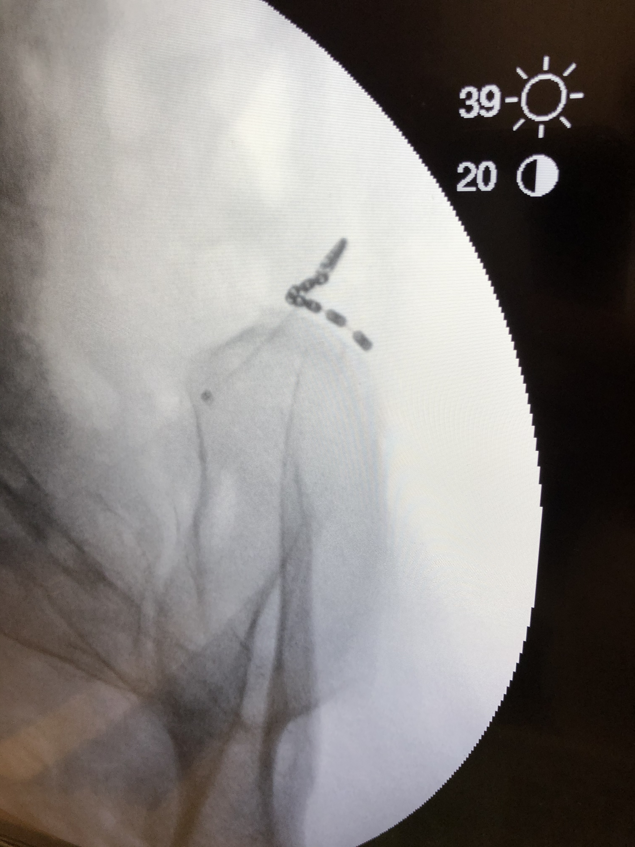
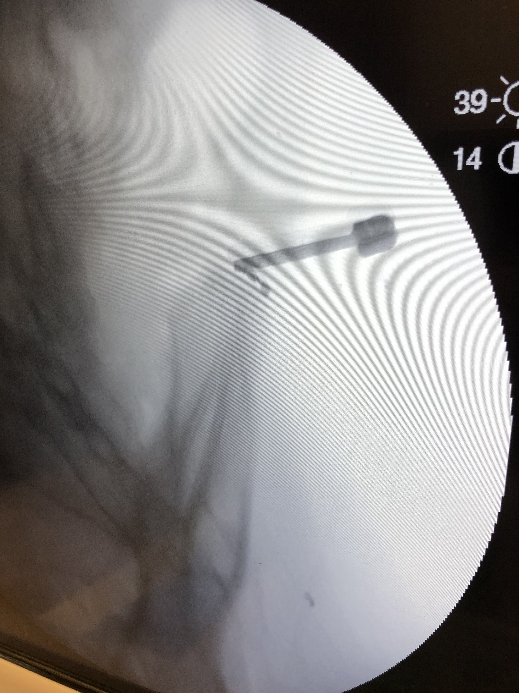
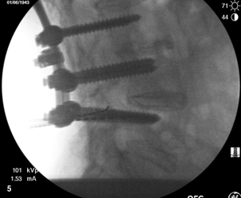
Wireless Stimulation of Superior Cluneal Nerve for Chronic Low Back Pain, a Case Series (n=13)
Chad Pletnick MD¹, charles Brownlow MD², Matthias Wiederholz MD³, Arpit A. Patel DO^{4,} Randall J. Warren MD⁵, Carissa Stone MD⁶, Sloane Yu MD⁷, Suzanne Manzi MD³, Pawan Grover MD³, Kenneth Giraldo MD⁸,Niek Vanquathem BA⁹
¹Arizona Pan Care Center, ²Georgia Pain and Spine care, ³Performance Pain and Sports, ⁴Excel Pain and Spine, ⁵Apollo Pain Management, ⁶Comprehensive Spine Institute, ⁷Allied Pain and Spine Institutes, ⁸Kenneth Giraldo Practice , ⁹Stimwave LLC, USA
Background
Trial: Fluoroscopy, ultrasound and palpation were used to plan the introducer entry point and route for a 8-electrode trial stimulator targeting the superior cluneal nerve (Figure 1). A 13-gauge introducer was used to enter the skin approximately 6 cm medial to the posterior superior iliac spine (PSIS). The electrode array was inserted through the introducer and advanced towards the superior cluneal nerve along the iliac crest. The steering stylet was removed and receiver inserted into the inner lumen of the electrode array. The trial stimulator was then secured to the skin with Mastisol and Steri Strips and completely covered under a sterile Tegaderm.
Permanent Implant: A small incision was made and the placement technique for the 4-contact permanent stimulator was repeated. The steering stylet was removed and a receiver inserted into the inner lumen of the electrode array. A receiver pocket was made approximately 10 cm from the first marker band on the electrode array and the neurostimulator tunneled to the pocket. A knot was tied to permanently mate the receiver and electrode array. The distal portion of the stimulator was coiled, sutured to itself to eliminate any sharp ends, and then sutured to the fascia. The pocket was closed with subcutaneous and then subcuticular sutures. The devices for all patients were programmed with a frequency of 1499 Hz, pulse width of 30 μs and current as preferred by patients.
Fig. 1: Image showing placement at superior cluneal nerve
Chronic low back pain (CLBP) is a widespread issue with profound effects on an individual’s level of activity and quality of life. CLBP may originate from a variety of spinal structures but its etiology is non-specific in the majority of patients. The superior cluneal nerves (SCN) are an under-recognized cause of CLBP. SCN are cutaneous nerves of the buttocks. These nerves are responsible for providing sensory innervation to the skin. Historically, there have been limited treatment options for nerve pain experienced in this area of the body. Currently, peripheral nerve stimulation (PNS) is highly regarded as a vigorous modality for the treatment of cluneal peripheral nerve pain. Technological advancements allow for less invasive placement procedures and improvement in cosmesis, making implantation less morbid and more accessible.
Methods
Conclusions
Wirelessly powered, battery-free PNS was a successful option for patients suffering of debilitating low back pain as a result of mononeuropathy of the superior cluneal nerves and cluneal neuritis following laminectomy. Wireless neurostimulation allows PNS in difficult to access sites with limited options for a traditional IPG placement.
Wireless System Components
The Freedom PNS System (Fig. 2) utilizes wireless technology. Each electrode array contains four or eight contacts (1.3 mm in diameter with 4 mm spacing) with embedded electronics and a separate, mated receiver component. A small, externally, wearable, rechargeable transmitter attached to a transmitting antenna worn in clothing provides the energy to power the implanted device wirelessly through the skin. The device uses pulsed electrical current to create an electrical field that acts on nerves to inhibit the transmission of pain signals to the brain.
All subjects were successfully treated with wirelessly powered PNS and reported high satisfaction, with increased levels of activity, improved sleep, and medication reductions. Mean pain scores reduced from 8.3 at baseline to 1.2 at the end of the trial, 1.3 at 3 months (n=8) and 1.9 at 6 months (n=8) post-implant. Quality of life and functionality was improved drastically, medication was reduced, and mean satisfaction was rated at 7/7. No complications were reported.
Results
Case Report
We report 13 subjects (6 females, 7 males), with a mean age of 73 years old, who presented with CLBP described as “burning” (six subjects had pain radiating into the buttocks and hips) impacting their functionality and ambulation. Subjects were diagnosed with either mono-neuropathy of the SCN, cluneal neuritis, scoliosis, sacroiliitis, superior cluneal neuralgia and/or post-laminectomy syndrome. Previous conservative treatments included physical therapy, injections, ablations, opiates, intrathecal pump and SCS trials that were all unsuccessful.
Fig. 2: System components
Discussion
A wireless stimulator provides technical advantages compared to the conventional methods of tunneling leads to IPGs and implanted batteries. Wireless peripheral nerve stimulation is an effective option for chronic pain of peripheral nerve origin including the superior cluneal nerves.
Contact
cpletnick@gmail.com

