Slide 1
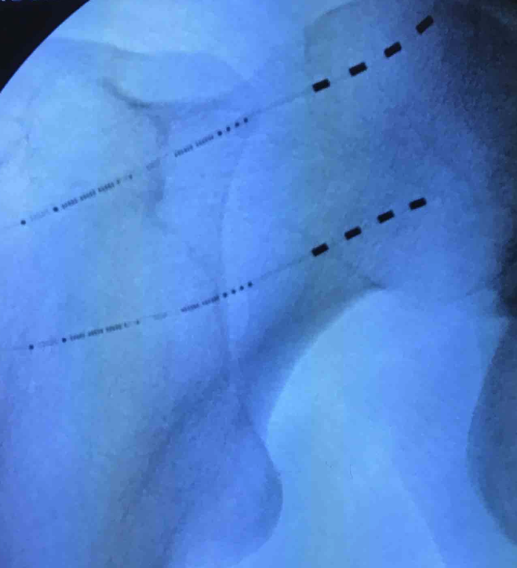
Wirelessly, Powered, Battery-Free Peripheral Nerve Stimulation of the Femoral Nerve for Chronic Hip Pain
George Kum-Nji MD¹, Niek Vanquathem, BA²
¹Interdisciplinary Pain Management Clinic (IPMC), ²Stimwave Technologies
Background
A diagnostic fluoroscopic guided nerve block of the femoral articular branches was performed, which provided greater than 75% pain relief for several days.
Fig. 1: Image showing the quadripolar electrode array at the lateral femoral cutaneous nerve (LFCN)
Conclusions
The femoral nerve is one of the largest nerves in the legs and is located near the groin, controlling the muscles that help straighten legs and move the hips. It also provides sensation to the lower extremity and the front of the thigh. When the femoral nerve is damaged, it can cause chronic pain in hips and groin and can affect the ability to ambulate.
Chronic hip pain can be resistant to conservative medical management treatment, including physical therapy, medications and injections. Peripheral nerve (PNS) has been used effectively to treat pain of peripheral nerve origin. It can be difficult to determine whether hip pain originates from nerves within the joint itself, or neuropathy in surrounding nerve tissue. A series of nerve blocks can be administered to identify the origin of the pain. They can assist in determining the most appropriate placement for a peripheral nerve stimulator for treating pain in the hip joint region.
Wirelessly powered, peripheral nerve stimulation was a successful option for this patient suffering from debilitating hip and groin pain secondary to a superior labral tear. This battery-free system offers advantages of significant pain relief devoid of complications associated with the bulk of an implantable pulse generator and flexibility as related to device placement and programming protocols.
Methods
Trial: Ultrasound, palpation and fluoroscopy were used to plan the introducer entry point and route for two, 8-contact trial stimulators, targeting the femoral articular branches. The trial stimulators were inserted through the introducer to the femoral head neck junction overlying the articular branches. Fluoroscopy was used to confirm placement. The steering stylets were removed, and the receivers inserted into the inner lumen of the electrode array. The trial stimulators were then secured with Mastisol and Steri Strips and completely covered under a sterile Tegaderm. The patient completed a several-day trial and reported 90% pain relief.
Permanent Implant: The path of the femoral nerve in the groin was visualized, and a introducer entry point and pathway were planned using ultrasound, palpation and fluoroscopy. After local anesthetic infiltration, an incision was made and a PNS introducer was passed through the subcutaneous tissue and advanced in an inferior-lateral to superior-medial approach under ultrasound guidance, via an approach parallel and superficial to the femoral head-neck junction. A 4-electrode array was advanced through the introducer and placed next to the femoral articular branches. The same technique was used to place the second electrode array parallel and slightly inferior to the first (Figure 1). The steering stylets were removed, and receivers coupled to the electrode arrays. A receiver pocket was created distal to the insertion locations and both stimulators were tunneled to the pocket and sutured to deep fascia with the tails of the stimulators coiled within the receiver pocket.
Wireless System Components
The StimQ System (Fig. 2) utilizes wireless technology. Each electrode array contains four or eight contacts (1.3 mm in diameter with 4 mm spacing) with embedded electronics and a separate, mated receiver component. A small, externally, wearable, rechargeable transmitter attached to a transmitting antenna worn in clothing provides the energy to power the implanted device wirelessly through the skin. The device uses pulsed electrical current to create an electrical field that acts on nerves to inhibit the transmission of pain signals to the brain.
Results
Fig. 2: System components
Case Report
The patient wears the wearable antenna assembly on his right lateral thigh. A stimulation scheme with a pulse rate of 1499 Hz and pulse width of 30 µs at 2.0 mA was tested and found effective. The patient reported consistent pain reduction (75% pain relief) over 12 months after permanent implant. No complications were reported, and he was able to return to full duty at his job as a warehouse worker.
A 41-year-old male presented with constant, dull right hip and groin pain presumably due to a superior labral tear. However, a labral tear repair procedure was unsuccessful in providing pain relief. His pain level did not improve despite several courses of physical therapy and medication management.
Next, he received several right intra-articular corticosteroid injections which provided only a few days of significant relief. He then received multiple right intra-articular hip platelet-rich plasma (PRP) injections, which provided greater than 50% pain relief; however these injections would only last about 3-4 months.
Discussion
Chronic musculoskeletal pain is often thought to be to be purely nociceptive in nature, but there can often be a neuropathic component to the pain. Nerve blocks can be a good diagnostic tools in determining whether there is a significant neuropathic component to an individual’s pain.
Contact
kumnji90@gmail.com

