Slide 1
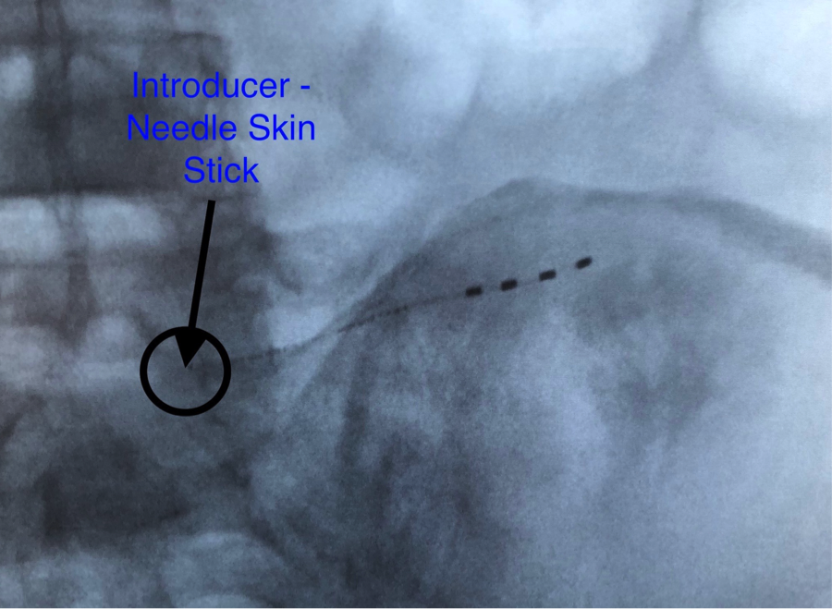
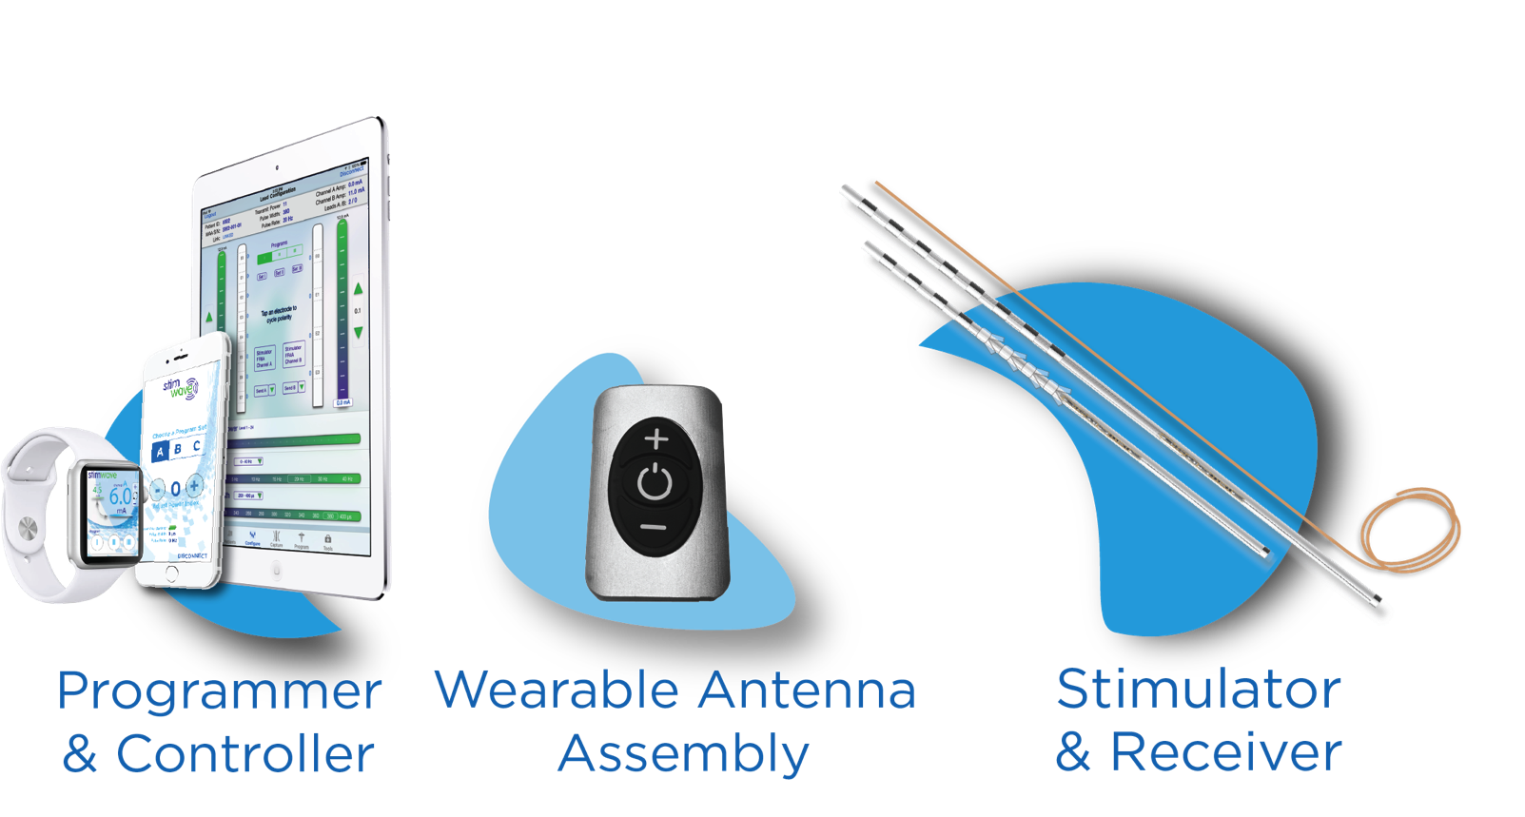
Peripheral Nerve Stimulation for Low Back Pain Targeting the Superior Cluneal Nerve with Wireless Stimulator
Brian Rich MD¹, Niek Vanquathem²
¹Accellerated Interventional Orthopedics, ²Stimwave LLC, USA
Background
Percutaneous placement of a wireless neurostimulator device directly adjacent to affected cluneal nerve(s) is a minimally invasive and reversible method of pain control in patients with superior cluneal peripheral nerve pain refractory to conventional medical managements.
Cluneal nerves are cutaneous nerves of the buttocks. Cutaneous nerves are responsible for providing sensory innervation to the skin. Historically, there have been limited treatment options for nerve pain experienced in this area of the body. Currently, peripheral nerve stimulation (PNS) is considered to be of high regard and vigorous modality for the treatment of cluneal peripheral nerve pain. Technological advancements allow for less invasive placement procedures and improvement in cosmesis, making implantation less morbid and more accessible.
Methods
Conclusions
Each patient underwent a 5 day trial, removal of the trial stimulator, followed then by a permanent implant. Each patient underwent either unilateral or bilateral placement of wireless PNS stimulators on the superior edge of the iliac crest. A small stab wound was made at the medial edge of the iliac crest. A Touhy needle or plastic introducer was advanced across the iliac crest and a tined 4-electrode neurostimulator (Stimwave STQ4-RCV-A0) was advanced across the iliac crest (Fig. 1). Stimulator was sutured to fascia using 2-0 silk then tunneled to surgical receiver pocket medially and across midline horizontally. When bilateral stimulators were needed, the procedure was repeated on the opposite side. Before coiling and knots, a receiver stylet was inserted into the inner lumen of the stimulators. Pocket was closed in layers. Patient wears antenna on a belt at the small of the back with the battery in the belt pocket.
Fig. 1: Image showing placement at superior cluneal nerve
Wireless System Components
Results
The Freedom SCS System (Fig. 2) utilizes wireless technology. Each electrode array contains four or eight contacts (1.3 mm in diameter with 4 mm spacing) with embedded electronics and a separate, mated receiver component. A small, externally, wearable, rechargeable transmitter attached to a transmitting antenna worn in clothing provides the energy to power the implanted device wirelessly through the skin. The device uses pulsed electrical current to create an electrical field that acts on nerves to inhibit the transmission of pain signals to the brain.
There were no adverse events reported. Across the 5 patients, pain was reduced with a mean of 63%. Post implant all patients are now able to perform ADLs that they could not do prior to the implant. Medication usage was not tracked at this time.
Case series
This clinical case series investigates 5 patients with axial low back pain with limited ambulatation, restricting activities of daily living (ADLs). Physical therapy and pain medications were common across all patients. Patients were classified by ODI from bed bound to crippled. Some patients previously had radiofrequency ablations (RFA). All patients were diagnosed with Intractable pain, chronic pain syndrome, and superior cluneal neuralgia.
A wireless stimulator provides technical advantages compared to the conventional methods of tunneling leads to IPGs. This case series confirms an effective option for cluneal peripheral nerve pain treatment that can provide relief to an under-treated patient population.
Discussion
Fig. 2: Device Components
Contact
bkrichmd@gmail.com

