Slide 1
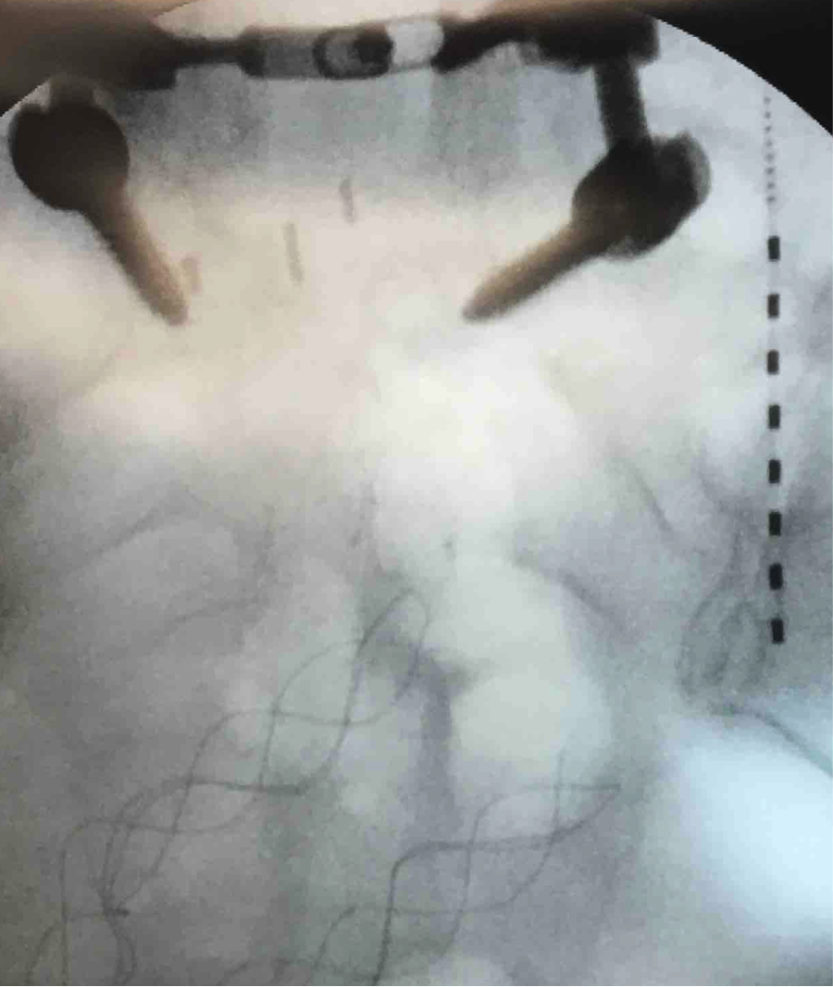
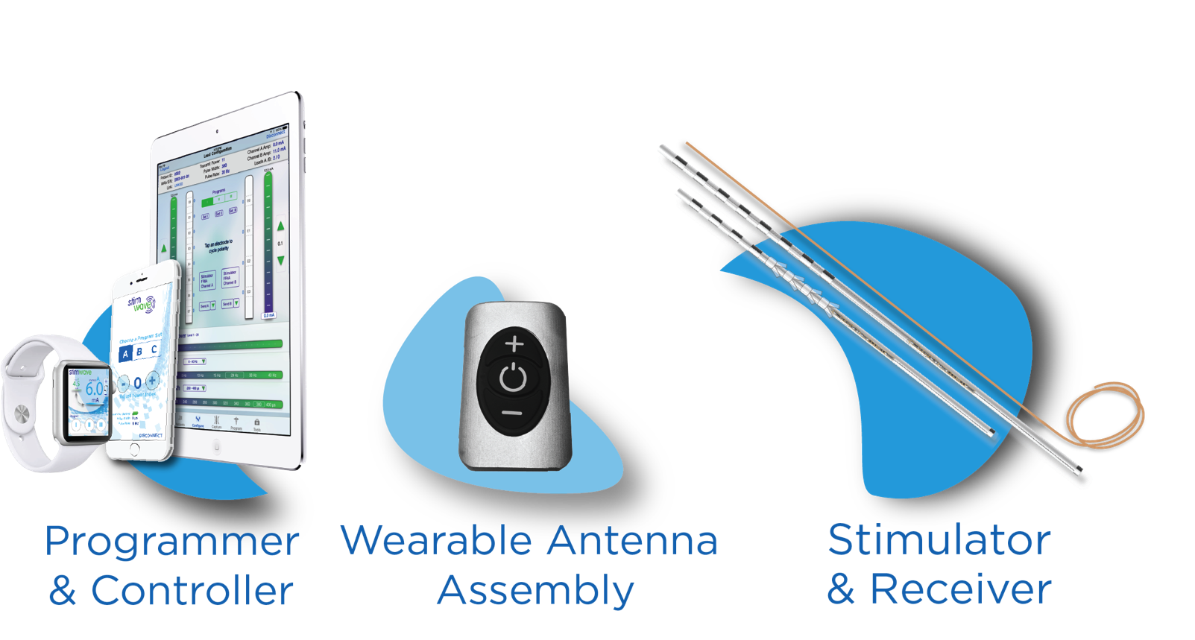
The Role of Middle Cluneal Nerve Stimulation with a Wireless Device for the Treatment
of Sacroiliac Pain after Fusion
Michael Lupi¹, Niek Vanquathem²
¹Spine, Brain and joint institute, ²Stimwave LLC, USA
Background
lasting 1-4 months. She was taking hydrocodone 10/325 3x/day with minimal relief, and pain was interfering with ADLs.
Fig. 1: Final placement at the Middle Cluneal Nerve
Conclusions
Low back pain after lumbar fusion is an unfortunately common consequence of the change in body mechanics with lumbar stabilization surgery that can lead to sacroiliac (SI) pathology. SI pathology can mimic lumbar radiculopathy or facet pathology. Once the diagnosis of SI pathology is made, there are relatively few long-term treatments available. Recognition of the role of middle cluneal nerve innervation of the SI joint has led to the use of peripheral nerve stimulation (PNS) of the middle cluneal nerve to treat intractable SI pain.
Middle cluneal neuralgia is an under-recognized cause of low back pain, and this condition may respond to PNS stimulation of the middle cluneal nerves.
Methods
The patient was placed in prone position. A stab wound was made and introducer inserted approximately 4 inches medial to the posterior superior iliac spine (PSIS) and 4 inches above the inferior pole of the right SI joint. The introducer stylet was removed and an contact Stimwave Freedom 8A neurostimulator was inserted into the introducer cannula and advanced to the middle cluneal nerve, medial to the joint line and lateral to the sacral foramen. The wearable antenna assembly was used to confirm the area of stimulation. After the placement was confirmed, the stimulators were sutured to the fascia using 2-0 silk and a secondary incision was made distal to the first to create a subcutaneous pocket and the distal end of the electrode array was tunneled to the subcutaneous pocket. A receiver coil was made, placed into the subcutaneous pocket, and sutured to the fascia to anchor the device. Deep layers were closed using interrupted 2-0 Vicryl. Superficial layers were closed using 4-0 vicryl in subcuticular fashion
Wireless System Components
The Freedom SCS System (Fig. 2) utilizes wireless technology. Each electrode array contains four or eight contacts (1.3 mm in diameter with 4 mm spacing) with embedded electronics and a separate, mated receiver component. A small, externally wearable, rechargeable transmitter attached to a transmitting antenna worn in clothing provides the energy to power the implanted device wirelessly through the skin. The device uses pulsed electrical current to create an electrical field that acts on nerves to inhibit the transmission of pain signals to the brain.
Results
Since the trial and continuing after her three months post implantation visit, patient continues to note pain scores of only 1/10. She is able to sleep through the night for the first time in 10 years, and she has decreased her pain medications to only intermittently. She notes that she only needs to wear the Stimwave device for several hours every 2-3 days because of the “carryover” pain relief.
Case Report
Patient presented with right low back and hip pain after lumbar laminectomy with instrumented fusion. She was s/p multiple prior surgeries, including bilateral TKA and left ankle reconstruction. Past medical history includes HTN, emphysema, COPD, thyroid disorder, GERD. Prior treatments included PT and epidural steroid injections in the past. After the diagnosis of SI pathology was made, patient underwent a series of at least 12 SI joint injections by a variety of providers with 80-95% relief but only
Discussion
Fig. 2: Device Components
In general, peripheral nerve stimulation is difficult with conventional devices which require not only an IPG but also extensions to the site where the IPG is implanted. The anatomical conditions for this case are such that the implant of a conventional system with an IPG would have been virtually impossible.
Contact
mikelupi79@gmail.com

