Slide 1
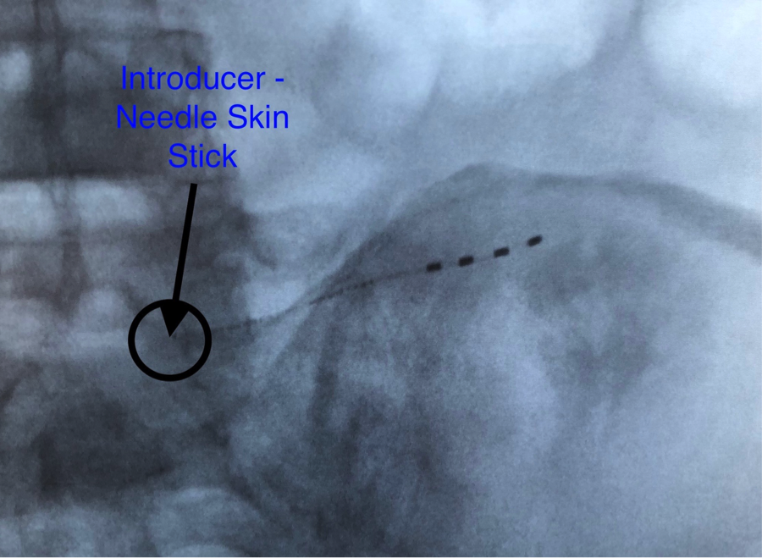
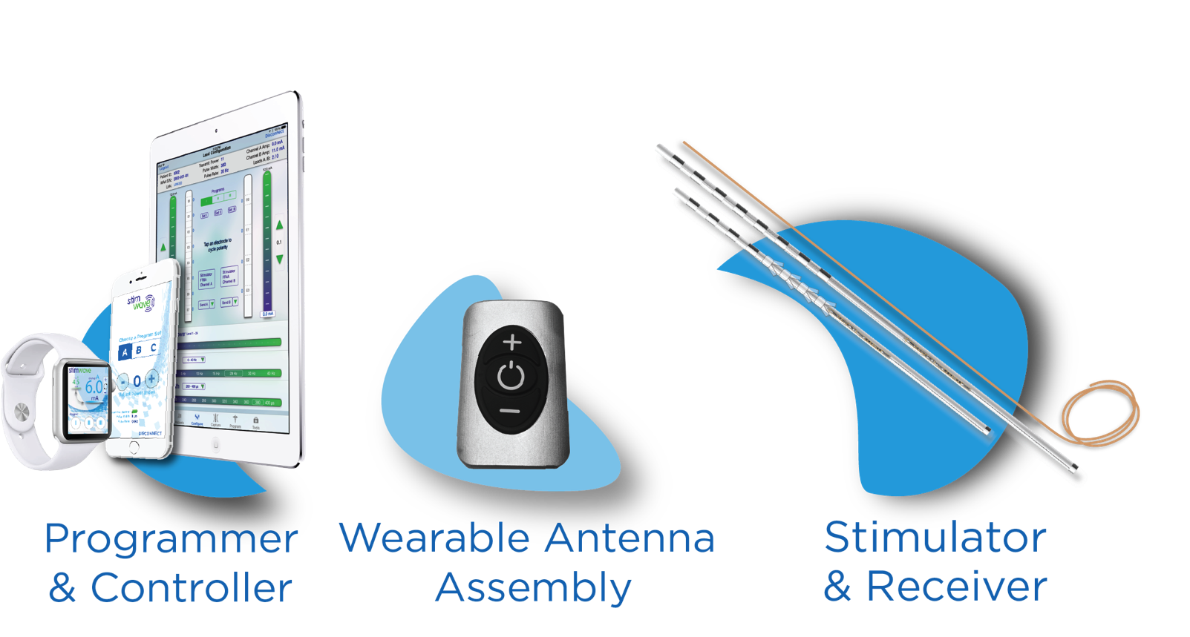
Wireless Superior Cluneal Peripheral Nerve Stimulation Pain Outcomes
Hassan Chahadeh MD¹, Niek Vanquathem²
¹AOK Spine & Pain, ²Stimwave LLC, USA
Background
The patient was placed in a prone position. 1% lidocaine was applied locally. A small stab wound was made, with a # 10 blade, at the medial iliac crest. The incision was carried down to the fascia using Bovie and blunt dissection with 1 cm depth. A 15-gauge Touhy needle was inserted in the area overlying the superior cluneal nerve on the left side medial. The needle was advanced across the iliac crest at 1 cm inferior to the iliac crest with a middle approach. Subsequently, the inferior cluneal nerve was approached with a Tuohy needle advanced distally. The stylets were removed and two-tined four-electrode neurostimulators were inserted and advanced (Fig.1). 1% lidocaine was used to localize the skin and a surgical pocket was created around 8 cm cephalad in the lumber area of L3-4 area. The stimulators were sutured to the fascia using 2-0 silk then tunneled to the secondary surgical pocket cephalad and tied at proximal ends. The electrode arrays were secured into the fascia of the pocket. Deep layers were closed using interrupted 2-0 Vicryl. Superficial layers were closed using 4-0 vicryl in subcuticular fashion. Sterile dressing was applied along with steri-strips. Patient wears the antenna on a belt, provided by Stimwave, on the lower back.
Percutaneous placement of a wireless PNS device is an efficacious and minimally invasive option for pain control in those with superior and middle cluneal peripheral nerve pain. The wireless stimulator also provides technical advantages compared to the conventional methods of tunneling leads to IPGs.
Cluneal nerves are cutaneous nerves of the buttocks. These are responsible for providing sensory innervation to the skin. Historically, there have been limited treatment options for nerve pain experienced in this area of the body. Currently, peripheral nerve stimulation (PNS) is considered to be of high regard and vigorous modality for the treatment of cluneal peripheral nerve pain. Technological advancements allow for less invasive placement procedures and improvement in cosmesis, making implantation less morbid and more accessible.
Methods
Fig. 1: Image showing placement at superior cluneal nerve
Conclusions
Wireless System Components
The Freedom SCS System (Fig. 2) utilizes wireless technology. Each electrode array contains four or eight contacts (1.3 mm in diameter with 4 mm spacing) with embedded electronics and a separate, mated receiver component. A small, externally, wearable, rechargeable transmitter attached to a transmitting antenna worn in clothing provides the energy to power the implanted device wirelessly through the skin. The device uses pulsed electrical current to create an electrical field that acts on nerves to inhibit the transmission of pain signals to the brain.
Results
There were no adverse events reported. Post-implant patient is now able to perform ADLs such as: mowing her lawn, gardening and shopping. Pain scores decreased after implantation to 1/10. Medication usage also decreased from tramadol every four-six hours at the one-month follow-up to “once nightly before bed” at the six-month follow-up. Sleep disturbance at one-month follow-up decreased from waking five to six times a night to sleeping through the night.
Case Report
This clinical case study investigates a 70-year old house-bound female presenting with inflammation of the sacroiliac (SI) joint with limited ambulation, restricting her activities of daily living (ADLs). Pain scores rating 10/10. Sleep disturbance noted. Patient previously had radiofrequency ablations (RFA) at the bilateral L5-S1 facet and of the sacroiliac joints. Physical therapy was tried, in addition to tramadol. Subject was diagnosed with: Intractable, chronic pain syndrome, radiculopathy, sacroiliitis and superior cluneal neuralgia.
Discussion
Fig. 2: Device Components
A wireless stimulator provides technical advantages compared to the conventional methods of tunneling leads to IPGs and implanted batteries. Wireless peripheral nerve stimulation is an effective option for chronic pain of peripheral nerve origin including the superior cluneal nerve.

