Slide 1
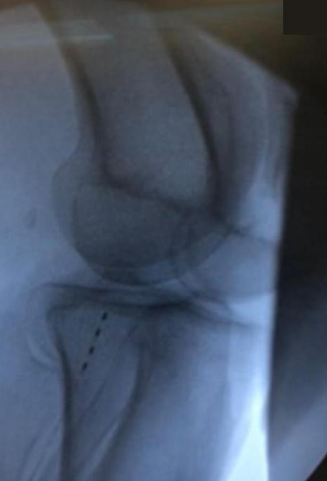
Wirelessly Powered, Battery-Free PNS at the Peroneal Nerve for the Treatment of Tumor Nerve Pain
Nathan J. Neufeld^{1,} Wallace G. Dudley^{1,} Niek Vanquathem²
¹Southeastern Regional Medical Center, ²Stimwave Technologies
Trial: Fluoroscopy and palpation were used to plan the introducer entry point and route for a 4-contact trial stimulator targeting the right peroneal nerve. A 13-gauge (G) introducer was used to enter the skin and was positioned subcutaneously progressing from the mid outer calf to the posterior aspect of the fibular head. The electrode array was inserted through the introducer and placed parallel to the common peroneal nerve. The steering stylet was removed and receiver inserted into the inner lumen of the electrode array. The trial stimulator was then secured to the skin with Mastisol and Steri Strips and completely covered under a sterile Tegaderm.
Permanent Implant: A small incision was made and the placement technique for the permanent stimulator was repeated. The steering stylet was removed and a receiver inserted into the inner lumen of the electrode array. approximately 10 cm from the first marker band on the electrode array and the neurostimulator tunneled to the pocket. A knot was tied to permanently mate the receiver and electrode array. The distal portion of the stimulator was coiled, sutured to itself to eliminate any sharp ends, and then sutured to the fascia. The pocket was closed with subcutaneous and then subcuticular sutures. The device was programmed with a frequency of 1499 Hz and a pulse width of 30 μs.
Fig. 1: Image showing the quadripolar electrode array parallel to the common peroneal nerve
Background
Methods
Conclusions
Peripheral nerve tumors (such as Schwannomas) are growths in or near peripheral nerves. These tumors can occur anywhere in the body, and though most of them are not malignant, they can lead to pain, nerve damage and loss of function in the affected area.
The common peroneal nerve is a branch of the sciatic nerve beginning just cephalad to the popliteal fossa, then splitting into additional branches at the fibular head and continuing through the outer calf (1). It can be vulnerable to damage from trauma as portions along its pathway are fairly superficial. It is also one of the most commonly involved nerves in complex regional pain syndrome (CRPS) of the foot and ankle region (2).
Wirelessly powered peripheral nerve stimulation was a successful option for this patient suffering of debilitating leg pain due to a tumor.
Wireless System Components
The StimQ PNS System (Fig. 2) utilizes wireless technology. Each electrode array contains four or eight contacts (1.3 mm in diameter with 4 mm spacing) with embedded electronics and a separate, mated receiver component. A small, externally, wearable, rechargeable transmitter attached to a transmitting antenna worn in clothing provides the energy to power the implanted device wirelessly through the skin. The device uses pulsed electrical current to create an electrical field that acts on nerves to inhibit the transmission of pain signals to the brain.
Results
The patient responded to the trial with 60% relief, then he underwent implantation of a permanent peripheral nerve stimulator. At 1 month follow up, he was doing remarkably well, reporting 2/10 pain with improved functionality which remained consistent with pain “well managed “ at 3 month post-permanent implant, all while being weaned off opioids.
Case Report
Fig. 2: System components
A 60-year-old male was diagnosed with a Schwannoma of the right lateral calf. An MRI revealed a “11x11x12mm well circumscribed T2 hyperintense enhancing lesion in the fibular longus muscle in the extensor compartment”. An excision of this intramuscular mass was performed but the patient reporting persistent stabbing, dull pain in the right lateral calf. A right common peroneal nerve block with stimulation guidance provided short-term relief, and the patient was subsequently offered a PNS trial with a battery-free peripheral nerve stimulator (Stimwave Technologies, Pompano Beach, FL).
Discussion
A wireless stimulator provides technical advantages compared to the conventional methods of tunneling leads to IPGs. This experience hints at advantages such as significant pain relief devoid of complications associated with the bulk of an implantable pulse generator, and flexibility as related to device placement and programming protocols.
References
Palastanga N & Soames R Anatomy and Human Movement, Structure and Function. 6th ed. China: Elsevier (Churchil Livingstone) Limited; 2012
Chae, Won Soek et al. “Reduction in mechanical allodynia in complex regional pain syndrome patients with ultrasound-guided pulsed radiofrequency treatment of the superficial peroneal nerve.” The Korean journal of pain vol. 29,4 (2016): 266-269. doi:10.3344/kjp.2016.29.4.266
Contact
njneufelddo@gmail.com

