Slide 1
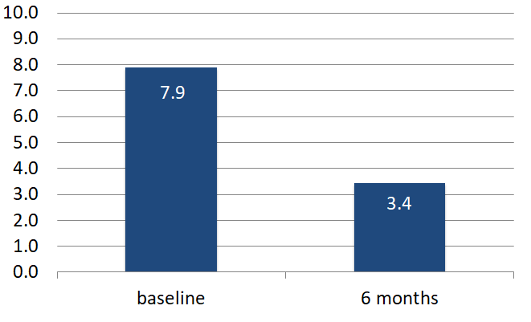
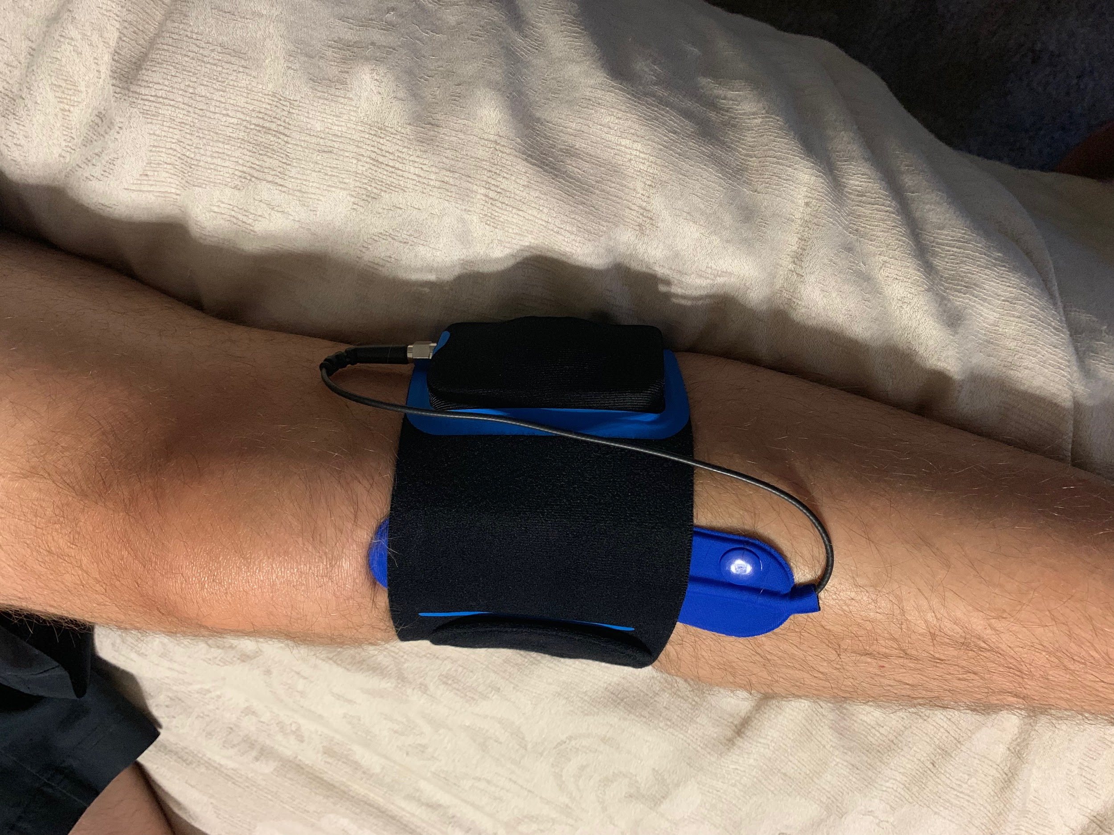
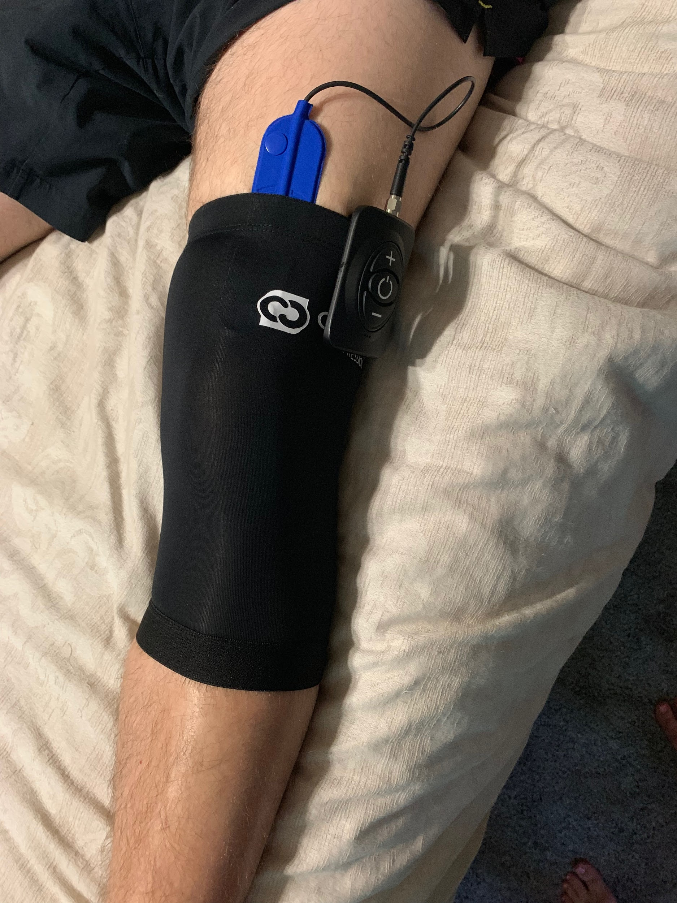
Wireless Peripheral Nerve Stimulation for the Treatment of Chronic Pain: A Case Series
Ellen Lin MD, Nicolette Cardiel, Francesca Toscano
Introduction
Description of Procedure
Results
Results
Peripheral nerve stimulation has long been considered a treatment option for chronic pain conditions. As the population ages, patients will require non-surgical treatment of joint pain.
With the new development of wireless peripheral nerve stimulation devices, clinicians are able to offer a less invasive, more user-friendly method of delivering pain relieving impulses to the corresponding peripheral nerves (1).
In this retrospective study, we review the outcomes of peripheral nerve stimulation to treat nonsurgical joint pain conditions.
Trial procedures: Landmarks for needle insertion and final placement were identified and confirmed under fluoroscopy. Local infiltration of anesthesia was provided at the distal measured site where a small stab incision was made to allow for easy insertion of the introducer, which was passed in the subcutaneous tissue toward the targeted nerve. The introducers were advanced using a tenting technique to stay within the subcutaneous tissues and monitored to prevent diving into the deeper muscular tissue. The introducer was positioned at a shallow angle with no more than 10-degrees and this was monitored under fluoroscopic guidance. The stimulator was inserted through the introducer and advanced to the nerve target. The receiver was then embedded into the inner lumen of the stimulator. Once the device is in the correct position, the introducer is removed, and the tubing fixated to the skin with Tegaderm.
Permanent Implant: Permanent placement techniques were similar to the trial. A pocket for receiver was made about 7 cm distal from the insertion location of the stimulator. The receiver element was carefully advanced into the lumen of the stimulator. The system is tested intraoperatively with an external transmitter in a sterile bag, after retraction of the introducer needle. After stimulation was confirmed, the tunneler was passed below the skin directed into the receiver pocket toward the initial incision for the stimulator. The tubing from the stimulator was tunneled in the proximal direction from the entry port to the secondary receiver pocket through the length of this tunneler. The tubing was then coiled in a circular manner, secured with silk sutures, and then placed in the receiver pocket. The receiver coil was secured in place under the skin fixation with 3-0 nylon suture and the pocket closed. The site was then dressed with Tegaderm and a compression wrap.
Of the nine patients who received wireless peripheral nerve stimulator trials, 8/9 patients had over 50% pain relief (Fig.3). Of the 8 patients who had successful trials, 5/8 patients had a reduction of opiates intake. The average opiates reduction in morphine milligram equivalence (MME) before and after implantation is 66.4%. All 8 patients reported increased in physical activities, including walking longer distances, returning to playing tennis, or better use of upper extremities for activities of daily living (ADL).
In this small series of patients with intractable nonsurgical joint pain, implantation of wireless peripheral nerve stimulator devices proved their efficacy in pain reduction, opiates intake reduction and functional increases. For future intractable joint pain patients, peripheral nerve stimulation should be considered if other conservative treatments failed.
The Freedom SCS System utilizes wireless technology. Each electrode array contains four or eight contacts (1.3 mm in diameter with 4 mm spacing) with embedded electronics and a separate, mated receiver component. A small, externally, wearable, rechargeable transmitter attached to a transmitting antenna worn in clothing provides the energy to power the implanted device wirelessly through the skin. The device uses pulsed electrical current to create an electrical field that acts on nerves to inhibit the transmission of pain signals to the brain.
Methods
Figure 3: NPRS Scores
For this retrospective study, the charts of 50 patients with previous PNS implants were reviewed. Of these charts, 31 patients were included. Of these 31 patients, 9 had peripheral nerve stimulators implanted for various joint pain conditions, including knees (Fig. 1), shoulders (Figure 2), and hips.
Figure 4: External antenna and power source
Figure 1: Genicular stimulator for knee pain
Discussion
Figure 2: Suprascapular stimulator for shoulder pain
PNS is a promising complementary treatment to SCS in nonresponsive cases of neuropathic pain. Widespread use has been limited due to the possible complications related to the bulky conventional systems (2). Wireless PNS is capable of providing effective treatment for chronic pain from peripheral nerve origin while mitigating the complications associated with wired PNS such as erosion, infection. IPG systems have proven to be malsuited for peripheral nerve stimulation in areas such as the limbs and extremities due to lack of subcutaneous tissue deep enough to house an IPG.
References
1.Billet, B., Wynendaele, R. and Vanquathem, N.E. (2018), A Novel Minimally Invasive Wireless Technology for Neuromodulation via Percutaneous Intercostal Nerve Stimulation for Post‐Herpetic Neuralgia: A Case Report with Short‐Term Follow‐up. Pain Pract, 18: 374-379
2.Eldabe S, Buchser E, Duarte R. Complications of spinal cord stimulation and peripheral nerve stimulation techniques: A review of the literature. Pain Med 2016; 17: 325-336.

