Slide 1
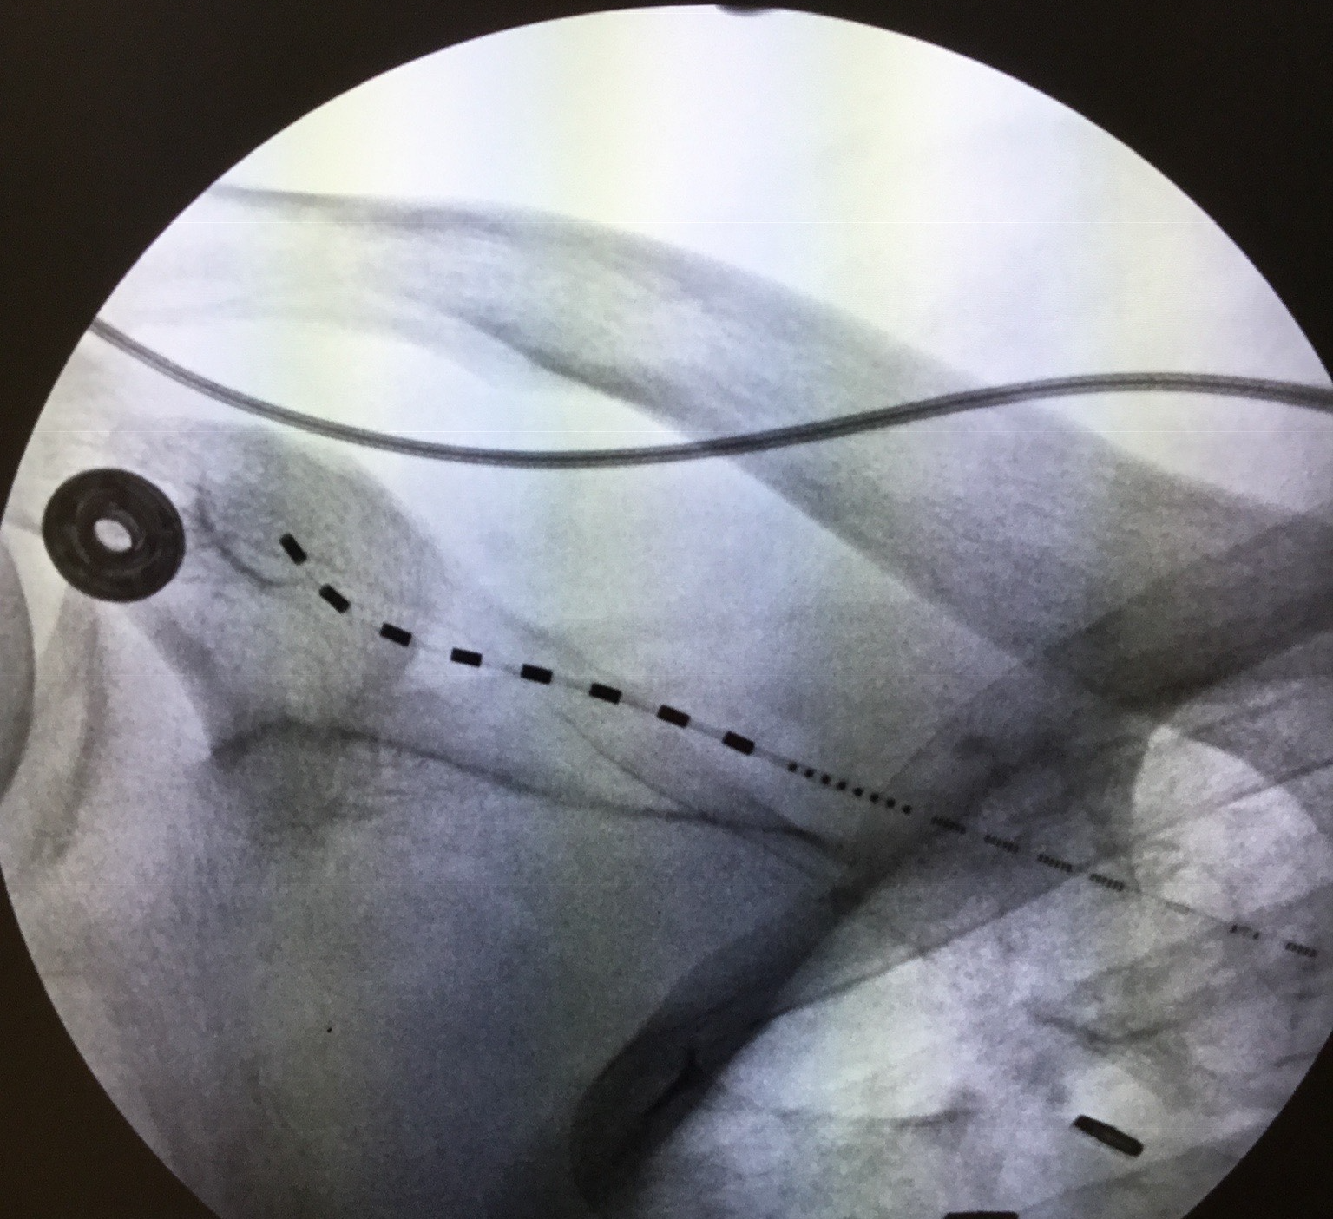
Wireless Peripheral Nerve Stimulation for the Treatment of Chronic Shoulder Pain
Robert Ycaza, MD¹, Niek Vanquathem, BA²
¹Bradenton Pain and Wellness Center, ²Stimwave Technologies, USA
Background
Methods
Fig. 1: AP of trial device placement
Conclusions
Shoulder pain has an estimated population prevalence of 4% to 26%. About 1% of adults aged over 45 years in the UK consult their GP with shoulder pain every year. The most common source of shoulder pain is the rotator cuff, accounting for over two-thirds of cases (1). Other sources of shoulder pain are avascular necrosis, brachial plexus injury, broken arm or collarbone, bursitis, cervical radiculopathy, dislocated shoulder, frozen shoulder, impingement, osteoarthritis, polymyalgia rheumatica, rheumatoid arthritis, rotator cuff injury, separated shoulder, septic arthritis, sprains, tendinitis or tendon rupture and torn cartilage, among others.
Wireless neurostimulation has been used effectively for the treatment of pain syndromes of multiple etiologies (2,3,4). A 4- or 8-contact peripheral nerve stimulator (PNS), can be implanted percutaneously in the targeted area, using an introducer, and a small, external, transmitter, worn over the patient’s clothing, provides the stimulation parameters and energy to power the neurostimulator via radio frequency (RF). The implantation of an implantable pulse generator (IPG) and the tunneling of the extensions required for traditional neurostimulation are not necessary.
Trial Procedure: A suprascapular 8-contact peripheral nerve stimulator was trialed (Figure 1), and the pain went from a VAS rate of 3-7/10 to 100% relief post-implant. The patient was satisfied with the results and opted for a permanent implant.
Permanent Implant: A 4-contact electrode array with tines was laid on the prepped skin and the distal electrode at the tip of the device was placed at the proximal anatomical (osseous) location where the suprascapular nerve was identified by fluoroscopy. Using a skin marker, a 1cm sagital line was marked over the needle entry location proximally. The skin and deeper tissues were anesthetized using a mixture of 1% lidocaine with epinephrine and 0.5% bupivacaine. Using a #11 blade, an incision was made with a scalpel to allow insertion of the introducer, which was passed through the subcutaneous tissues toward the desired nerve target. The introducer was placed at a shallow angle and advanced using a “tenting” approach to stay within the subcutaneous layer and to prevent diving into the muscular fascia. The electrode array was inserted through the introducer and advanced towards the target nerve under fluoroscopic guidance. At this point, the skin was infiltrated with local anesthetic and a 1 inch incision was made to create a receiver pocket, about 10 cm medial to the electrode array entry site incision. The needle was passed subcutaneously from the receiver pocket to the electrode array entry site. The proximal end of the electrode array was threaded through the distal tip of the needle to the subcutaneous receiver pocket. After withdrawal of the needle, the receiver was inserted into the inner lumen of the electrode array and intraoperative testing was completed with an external transmitter. Good paresthesia coverage of the painful areas was obtained. A knot was tied in the electrode array containing the receiver and the remaining end of the neurostimulator was coiled, sutured to itself to eliminate any sharp ends, secured to the fascia with fixation suture and the pocket closed using 4-0 Monocryl.
Wireless peripheral nerve simulation was a successful option for this patient suffering of debilitating left shoulder pain due to a left rotator cuff tear of the supraspinatus muscle.
Wireless System Components
The StimQ System (Fig. 2) utilizes wireless technology. Each stimulator contains four or eight contacts (1.3 mm in diameter with 4 mm spacing) with embedded electronics and a separate, mated receiver component. A small, externally wearable, rechargeable transmitter attached to a transmitting antenna worn in clothing provides the energy to power the implanted device wirelessly through the skin. The device uses pulsed electrical current to create an electrical field that acts on nerves to inhibit the transmission of pain signals to the brain.
Results
Six months post-implant, the patient answered the EQ-5D-5L quality of Life questionnaire and reported excellent mobility of the shoulder, no problems with self-care or usual activities, no pain or discomfort and no anxiety or depression. He scaled his health as related to the shoulder as 95 % (100% best, 0% worst). He also reported a patient global impression of change as a 7/7. The Oswestry Disability Index (ODI) 6 weeks post-surgery was 4% (0% = no disability, 100% = bed ridden).
18 months post-implant, the patient still had close to 100% pain relief and was able to decrease his medication intake from morphine sulfate extended release 15 mg from 3 times a day to 2 times a day and morphine immediate release 30 mg from 4 times a day to 3 times a day.
Fig. 2: System components
Case Report
A 65-year old male presented with sharp, localized pain on abduction of the left shoulder since 2015. A CT guided arthrogram (5/2017) revealed a full thickness tear of the supraspinatus muscle, degenerative tearing of the inferior and superior labrum, degenerative hypertrophy of the acromioclavicular (AC) joint and mild to moderate glenohumeral (GH) joint degenerative arthritis. Several treatment options were attempted but these never provided long lasting pain relief. A left suprascapular diagnostic nerve block proved 100% pain relief for about 6 hours. A left suprascapular peripheral nerve stimulator trial was offered to the patient.
References
Discussion
The anatomical conditions of the area are such that the implant of a conventional system’s lead with an IPG would have been very difficult. In general, peripheral nerve stimulation is difficult with conventional devices which require not only an IPG but also extensions to the site where the IPG is implanted. With the wireless system, these drawbacks are avoided and the implant of a single lead with the corresponding antenna, both smaller than conventional systems, enable neurostimulation in areas where conventional systems cannot be used (5,6).
Murphy, R. J. and A. J. Carr (2010). "Shoulder pain." BMJ clinical evidence 2010: 1107.
Weiner, R. L., A. Yeung, C. Montes Garcia, L. Tyler Perryman and B. Speck "Treatment of FBSS Low Back Pain with a Novel Percutaneous DRG Wireless Stimulator: Pilot and Feasibility Study." Pain Med (2016) 17(10): 1911-1916.
Perryman (2018). "Wireless neuromodulation in the management of chronic refractory FBSS back pain: Preliminary prospective experience with different stimulation targets and waveforms." Anesthesia & Perioperative Management Journal 2:003.
Satija P, A.-E. A., Vanquathem N .. "Peripheral Nerve Stimulation for Treating Superior Gluteal and Sciatic Neuropathies." Chron Pain Manag (2020) 4: 121. DOI: 10.29011/2576-957X.100021
George J. Arcos, D., and Niek Vanquathem, BA (2018). "WIRELESS HIGH FREQUENCY SPINAL CORD STIMULATION FOR THE TREATMENT OF POST-HERPETIC OCULAR NEURALGIA: A CASE REPORT." Interventional Pain Management Reports 2(5): 167-171
Herschkowitz, D. and J. Kubias (2018). "Wireless peripheral nerve stimulation for complex regional pain syndrome type I of the upper extremity: a case illustration introducing a novel technology." Scand J Pain 18(3): 555-560.
Contact
vigafra@yahoo.com

