Slide 1
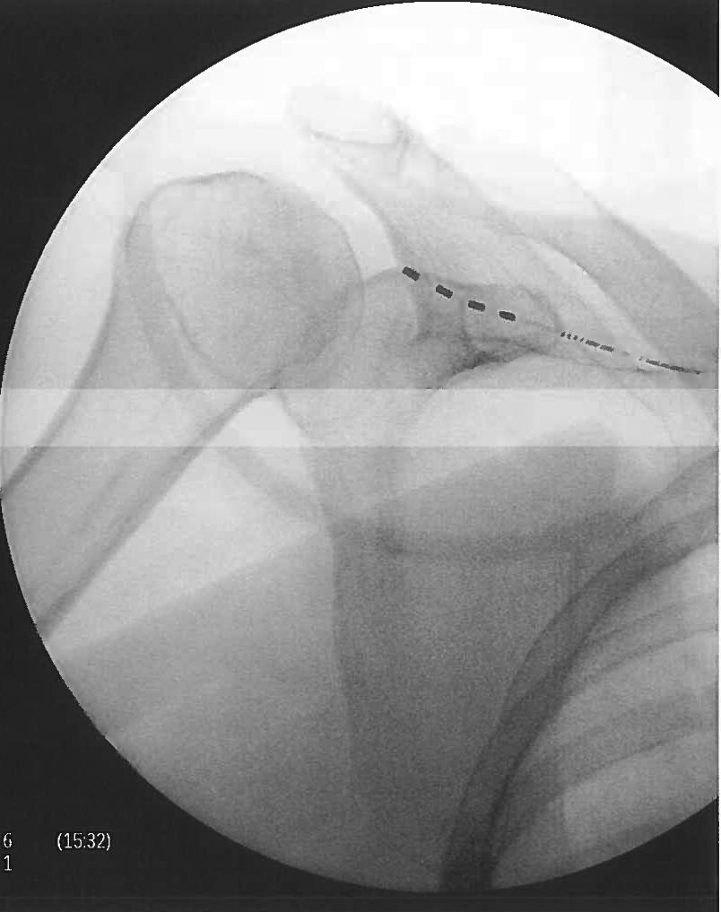
Wirelessly Powered, Battery-Free, Peripheral Nerve Stimulation for the Treatment of Chronic Bilateral Shoulder Pain
Kent Remley, MD¹, Niek Vanquathem, BA²
¹Georgia Pain and Spine Care, ²Stimwave Technologies, USA
Background
suprascapular notch on the right side. The needle stylet was removed, and a 4 contact, trial stimulator was placed through the introducer with the tip ending at the suprascapular nerve branches inferior to the suprascapular notch. The steering stylet was removed, and the receiver inserted into the inner lumen of the electrode array. The procedure was repeated for the left shoulder. The trial stimulators were then secured with Mastisol and Steri Strips and completely covered under a sterile Tegaderm.
Surgical description for the permanent implant: The suprascapular notch was visualized by fluoroscopy, and an introducer entry and route were planned and marked on the skin. A small skin stab wound was made and the introducer was placed subcutaneously along the planned route from medial to lateral, directed toward the shoulder joint. The electrode array was inserted and advanced near the right suprascapular notch (Figure 1). After confirming location, the introducer was removed, then the steering stylet was removed from the device, and the receiver was inserted into the inner lumen of the electrode array. A receiver pocket was created, approximately 10 cm from the first marker band on the electrode array and the neurostimulator tunneled to the pocket. A knot was tied to permanently mate the receiver and electrode array. The distal portion of the stimulator was coiled, sutured to itself to eliminate any sharp ends, and then sutured to the fascia. The pocket was closed with subcutaneous and then subcuticular sutures. The procedure was repeated for the left shoulder. The RF transmitters were programmed with a frequency of 1499 Hz, pulse width of 30 μs, and 0.8 mA.
Fig. 1: AP of 4-contact electrode array at the right suprascapular notch
Conclusions
Suprascapular neuropathy is caused by an injury to the nerve related to its anatomy and course. The common etiologies include repetitive overhead activity, rotator cuff pathology and compression of the nerve at either the suprascapular or the spinoglenoid notch secondary to space-occupying lesions.
Wireless neurostimulation has been used effectively for the treatment of pain syndromes of multiple etiologies (1,2,3). A 4- or 8-contact peripheral nerve stimulator (PNS), can be implanted percutaneously in the targeted area, using an introducer, and a small, external, transmitter, worn over the patient’s clothing, provides the stimulation parameters and energy to power the neurostimulator via radio frequency (RF). The implantation of an implantable pulse generator (IPG) and the tunneling of the extensions required for traditional neurostimulation are not necessary.
Wirelessly powered peripheral nerve stimulation bilaterally at the suprascapular nerves was a successful option for this patient suffering of chronic bilateral pain in her shoulders. This battery-free system is able to offers advantages such as significant pain relief, devoid of complications associated with the bulk of an implantable pulse generator.
Wireless System Components
The StimQ PNS System (Fig. 2) utilizes wireless technology. Each stimulator contains four or eight contacts (1.3 mm in diameter with 4 mm spacing) with embedded electronics and a separate, mated receiver component. A small, externally wearable, rechargeable transmitter attached to a transmitting antenna worn in clothing provides the energy to power the implanted device wirelessly through the skin. The device uses pulsed electrical current to create an electrical field that acts on nerves to inhibit the transmission of pain signals to the brain.
Results
The patient wears the transmitters on the collar of her shirt or waistline of her pants with the antenna under her bra strap. The patient received a permanent system after a successful trial (90% pain reduction), and pain scores remained consistent 12 months after the permanent procedure (90-100% pain reduction) The patient rates her satisfaction as 7/7, with increased quality of life and functionality. She is now able to reach overhead and hold her granddaughter for the first time. She only wears the device when needed.
Case Report
Fig. 2: System components
The patient is a 70-year old female with a history of breast cancer, rheumatoid arthritis, cervical fusion, myocardial infarction, and lung disease (smoker) who presented with chronic bilateral shoulder pain radiating down to the arms. She was diagnosed with bilateral suprascapular neuropathy with chronic rotator cuff tears in both shoulders.
Discussion
Placing a lithium ion battery in certain areas of the body (for example, in the foot) can be challenging, or even impossible, due to the lack of subcutaneous tissue, which makes the placement risky and likely to cause significant discomfort to the patient. The use of the StimQ PNS System is designed to mitigate these issues, as there is no need for battery implantation.
References
Methods
Weiner, R. L., A. Yeung, C. Montes Garcia, L. Tyler Perryman and B. Speck "Treatment of FBSS Low Back Pain with a Novel Percutaneous DRG Wireless Stimulator: Pilot and Feasibility Study." Pain Med (2016) 17(10): 1911-1916.
Perryman (2018). "Wireless neuromodulation in the management of chronic refractory FBSS back pain: Preliminary prospective experience with different stimulation targets and waveforms." Anesthesia & Perioperative Management Journal 2:003.
Satija P, A.-E. A., Vanquathem N .. "Peripheral Nerve Stimulation for Treating Superior Gluteal and Sciatic Neuropathies." Chron Pain Manag (2020) 4: 121. DOI: 10.29011/2576-957X.100021
Surgical description for the trial implant: A 13 gauge introducer needle was percutaneously inserted 4 inches medial to the axilla, near the inferior border of the scapula and was advanced under fluoroscopic guidance until the tip of the introducer was just inferior to the
Contact
remleymd@gmail.com

