Slide 1
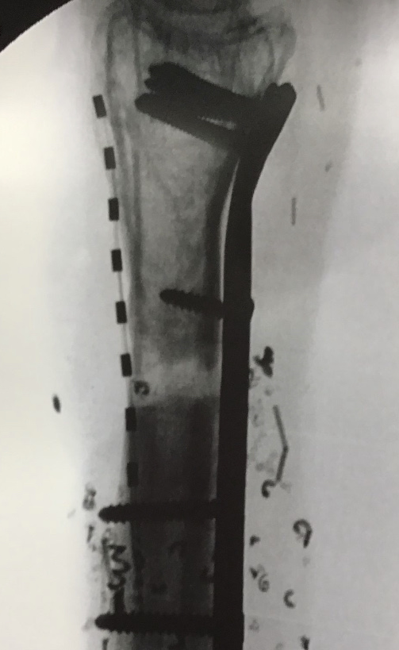
Patient with CRPS Type 2 of Distal Radial Nerve Chose Peripheral Nerve Stimulation (PNS) Over Spinal Cord Stimulation (SCS)
Stephen Pyles MD¹, Niek Vanquathem BA²
¹Pain treatment Centers, ²Stimwave Technologies
Background
Methods
Fig. 1: Image of the 8-contact stimulator over the radial nerve
Conclusions
Degloving or avulsion is a type of severe injury that happens when the top layers of the skin and tissue are ripped from the underlying muscle, connective tissue, or bone. It can affect any body part. Degloving injuries are often life-threatening as they involve large amounts of blood loss and tissue death. When the skin and tissue is ripped away, exposing muscle, bone, or connective tissue, it’s known as open degloving. Treatment options include: reattaching the skin, skin grafts, reattachment and amputation. All of these options usually require multiple surgeries. Due to the initial trauma and repeated surgeries, chronic pain after the fact remains highly likely.
Trial: The patient underwent a trial with cervical spinal cord stimulation (covering C4, C5, C6) and peripheral nerve stimulation over the distal radial nerve using two Stimwave 8-contact Freedom stimulators. He tested both systems independently during the trial period with subthreshold stimulation settings at a frequency of 1 kHz, pulse width of 30 μs with amplitudes 1-3 mA.
Permanent Implant: A ¼ inch incision facilitated the introduction of two 10-inch coude needles proximally to distally into the subcutaneous tissues over the radial nerve in the left forearm. An 8-contact electrode array was advanced through each needle and placed directly over his maximal complaint of pain corresponding to his left radial nerve (Fig.1). A receiver pocket was created approximately 10 cm proximal to the first marker band, and the electrode array were tunneled beneath the skin to the receiver pocket. A knot was tied to permanently mate each receiver and electrode array. The distal portion of the stimulators were coiled, sutured to itself to eliminate any sharp ends, and then sutured to the fascia. The pocket was closed with subcutaneous and then subcuticular sutures. The patient wears the transmitter with antenna on his forearm. Stimulation settings were set at a frequency of 1 kHz, pulse width of 30 μs with amplitudes 4.8 mA.
A patient with chronic regional pain syndrome type 2 after multiple surgeries caused by a degloving injury may realize more pain relief with a peripheral nerve stimulator over a spinal cord stimulator.
Wireless System Components
The StimQ PNS System (Fig. 2) utilizes wireless technology. Each electrode array contains four or eight contacts (1.3 mm in diameter with 4 mm spacing) with embedded electronics and a separate, mated receiver component. A small, externally, wearable, rechargeable transmitter attached to a transmitting antenna worn in clothing provides the energy to power the implanted device wirelessly through the skin. The device uses pulsed electrical current to create an electrical field that acts on nerves to inhibit the transmission of pain signals to the brain.
Results
He received 60% reduction in pain when using the cervical SCS lead but reported 100% pain relief when using only the lead placed over the distal radial nerve. Following the trial, the patient decided to proceed with only the peripheral nerve stimulator system over the distal radial nerve in the forearm. At his 6 months follow up visit, he continued to report 100% pain relief along with improvement in his range of motion and a 50% reduction in opioid use.
Case Report
A 65-year-old male presented with severe chronic pain in the distal radial nerve of the forearm, wrist and hand. Trauma of the distal radial nerve was a result of a work related degloving injury. The patient had subsequent reattachment of the forearm and 11 additional surgeries on the forearm prior to being referred to pain management. The patient was offered a trial with both cervical spinal cord stimulation and peripheral nerve stimulation of the radial nerve to assess whether on treatment would provide superior relief to the other.
Fig. 2: System components
Discussion
Wireless neurostimulation systems posses an inherent flexibility as related to placement location and programming possibilities. Both spinal cord and peripheral nerve stimulation are possible and effective options. Wireless systems are devoid of complications associated with implantable batteries and wiring.
Contact
stpyles@prodigy.net

