Slide 1
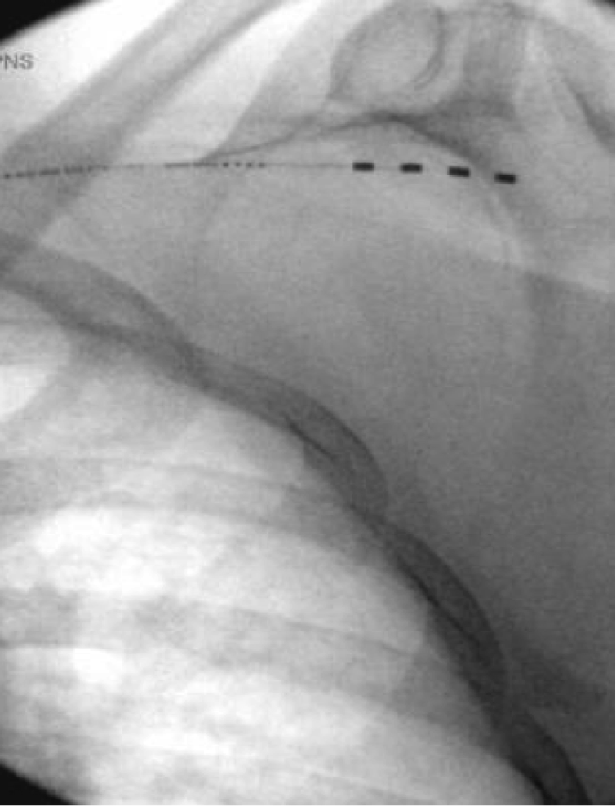
Wirelessly Powered, Battery-Free Peripheral Nerve Stimulation at the Suprascapular Nerve for the Treatment of Chronic Shoulder Pain
Iden Cowan, MD¹, Niek Vanquathem, BA²
¹Capitol Pain Institute , ²Stimwave LLC, USA
Background
Methods
Fig. 1: Image showing the four-contact neurostimulator at the suprascapular nerve branches inferior to the suprascapular notch
Conclusions
Shoulder pain can find its origin in many sources, including rotator cuff, brachial plexus, and the cervical spine among others (1). Suprascapular neuropathy is a cause of shoulder pain; injury to the nerve is intrinsically related to the anatomy and course of the suprascapular nerve. Suprascapular neuropathy can be diagnosed through physical examination and electrodiagnostics, after exclusion of other possible causes. Symptoms can include shoulder weakness, with atrophy in severe cases, and aching or burning pain at the entire shoulder girdle (2). Management of suprascapular nerve pain is challenging. Treatment options include pharmacological treatments such as acetaminophen, non-steroidal anti-inflammatory drugs (NSAIDs), anti-seizure medications and antidepressants. Non-pharmacological treatments include physical and occupational therapy. When these therapies fail, interventional procedures including surgical decompression, steroid injections and neuroablation may be considered (3). Pain control may be unsatisfactory despite all of the above modalities.
When the pain remains resistant to medications and interventions, peripheral nerve stimulation (PNS) might provide an alternative. PNS involves electrical stimulation of a specific nerve that supplies a distinct area of the body. Electrode arrays can be placed under open dissection or percutaneously. However, conventional battery-based systems that use implanted power generators (IPG) are not usually suitable for PNS due to the bulk and wiring of these systems, which are placed inside the patient’s body; because the IPG requires enough tissue to create a large pocket, they often need to be tunneled long distances. Complications related to the IPG include: dislocation, erosion, and infection. Additional issues may arise from the implantable battery with displacement and pocket pain as common events (4, 5). The novel, wireless StimQ PNS system (Stimwave Technologies Incorporated) is designed to mitigate some of these types of complications and challenges.
Surgical description for the trial implant: A 13 gauge introducer needle was percutaneously inserted 4 inches medial to the scapula and was advanced laterally under fluoroscopic guidance until the tip of the introducer was just inferior to the suprascapular notch on the right side. The needle stylet was removed, and a 4 contact, trial stimulator was placed through the introducer with the tip ending at the suprascapular nerve branches inferior to the suprascapular notch. The steering stylet was removed, and the receiver inserted into the inner lumen of the electrode array. The trial stimulator was then secured with Mastisol and Steri Strips and completely covered under a sterile Tegaderm.
During the trial, her average pain came down to a 0/10 from 7.5/10. Given the excellent results of the trial, the patient agreed to move forward with the permanent implant.
Surgical description for the permanent implant: The trial stimulator was explanted and replaced by a permanent system similar to the trial procedure. The suprascapular notch was visualized by fluoroscopy, and an introducer entry and route were planned and marked on the skin. A small skin stab wound was made and the introducer was placed subcutaneously along the planned route from medial to lateral, directed toward the shoulder joint. The electrode array was inserted and advanced near the right suprascapular notch (Fig. 1). After confirming location, the introducer was removed, then the steering stylet was removed from the device, and the receiver was inserted into the inner lumen of the electrode array. A receiver pocket was created, approximately 10 cm from the first marker band on the electrode array and the neurostimulator tunneled to the pocket. A knot was tied to permanently mate the receiver and electrode array. The distal portion of the stimulator was coiled, sutured to itself to eliminate any sharp ends, and then sutured to the fascia. The pocket was closed with subcutaneous and then subcuticular sutures. The patient wears the transmitter and antenna between the scapula and the spine. The external RF transmitter was programmed with a frequency of 1499 Hz, pulse width of 30 μs, and 6.0 mA.
Wireless peripheral nerve stimulation at the suprascapular nerve was a successful option for this patient suffering of chronic pain in the right shoulder. This battery-free system is able to offers advantages such as significant pain relief, devoid of complications associated with the bulk of an implantable pulse generator.
Wireless System Components
The StimQ PNS System (Fig. 2) utilizes wireless technology. Each stimulator contains four or eight contacts (1.3 mm in diameter with 4 mm spacing) with embedded electronics and a separate, mated receiver component. A small, externally wearable, rechargeable transmitter attached to a transmitting antenna worn in clothing provides the energy to power the implanted device wirelessly through the skin. The device uses pulsed electrical current to create an electrical field that acts on nerves to inhibit the transmission of pain signals to the brain.
Results
The patient reports significantly decreased pain (100%) at 1-month post-implant and is better able to perform activities of daily living. She is less dependent on her opioids and is excited to wean them, whereas this was a topic she was not amenable to prior to the implantation.
Discussion
Fig. 2: System components
The suprascapular nerve can be injured or irritated in several ways. Mechanical stress, compression, or injury from surgical procedures or trauma can cause serious damage and lasting pain (6, 7). Suprascapular neuropathy may lead to weakness in muscles supplied by the nerve including the supraspinatus and infraspinatus muscles. In addition, patients may complain of weakness in the shoulder during movement, which may, or may not, be appreciated on clinical exam (8, 9).
Diagnosis overall can be challenging as there are several other conditions that can paint a similar clinical picture including rotator cuff injury, cervical radicular pain, brachial plexopathy, bursitis and myofascial pain. A thorough history and exam are essential in finding the true source of the symptoms. Diagnostic injections of the suprascapular nerve are an important diagnostic tool.
Placing an IPG in certain areas of the body can be challenging due to the lack of subcutaneous tissue, which makes the IPG placement risky and likely to cause significant discomfort to the patient
References
Antoniadis G, Richter HP, Rath S, et al. . Suprascapular nerve entrapment: experience with 28 cases. J Neurosurg. 1996; 85:1020 –1025.
Vastamaki M, Goransson H. Suprascapular nerve entrapment. Clin Orthop. 1993;( 297): 135 –143.
Massenet V, Crielaard JM. [SUPRASCAPULAR NEUROPATHY]. Rev Med Liege. 2016 May;71(5):242-7.
Cummins CA, Messer TM, Nuber GW. Suprascapular nerve entrapment. J Bone Joint Surg Am. 2000 Mar;82(3):415-424.
Trentman TL, Slavin KV, Freeman JA, Zimmerman RS. Occipital nervestimulator placement via a retromastoid to infraclavicular approach:a technical report. Stereotact Funct Neurosurg. 2010; 88: 121-125.
Eldabe S, Buchser E, Duarte R. Complications of spinal cord stimulation and peripheral nerve stimulation techniques: A review of the literature. Pain Med 2016; 17: 325-336.
Ferretti A, Cerullo G, Russo G. Suprascapular neuropathy in volleyball players. J Bone Joint Surg Am. 1987 Feb;69(2):260-263.
Callahan JD, Scully TB, Shapiro SA, Worth RM. Suprascapular nerve entrapment. A series of 27 cases. J Neurosurg. 1991 Jun;74(6):893-896.
Post M. Diagnosis and treatment of suprascapular nerve entrapment. Clin Orthop. 1999 ;(368): 92 – 100.
Case Report
A 62-year-old female with a past surgical history of right shoulder arthroplasty presented with joint pain in both shoulders. Multiple shoulder injections, including subacromial bursa injections and suprascapular nerve blocks were unsuccessful in delivering long term relief.
Contact
idenmcowan@gmail.com

