Slide 1
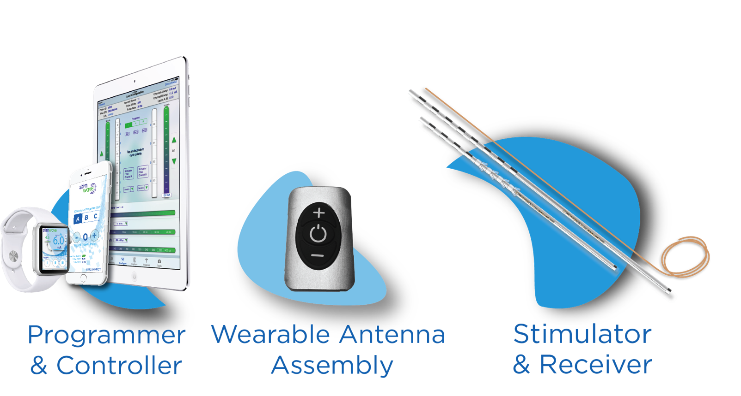
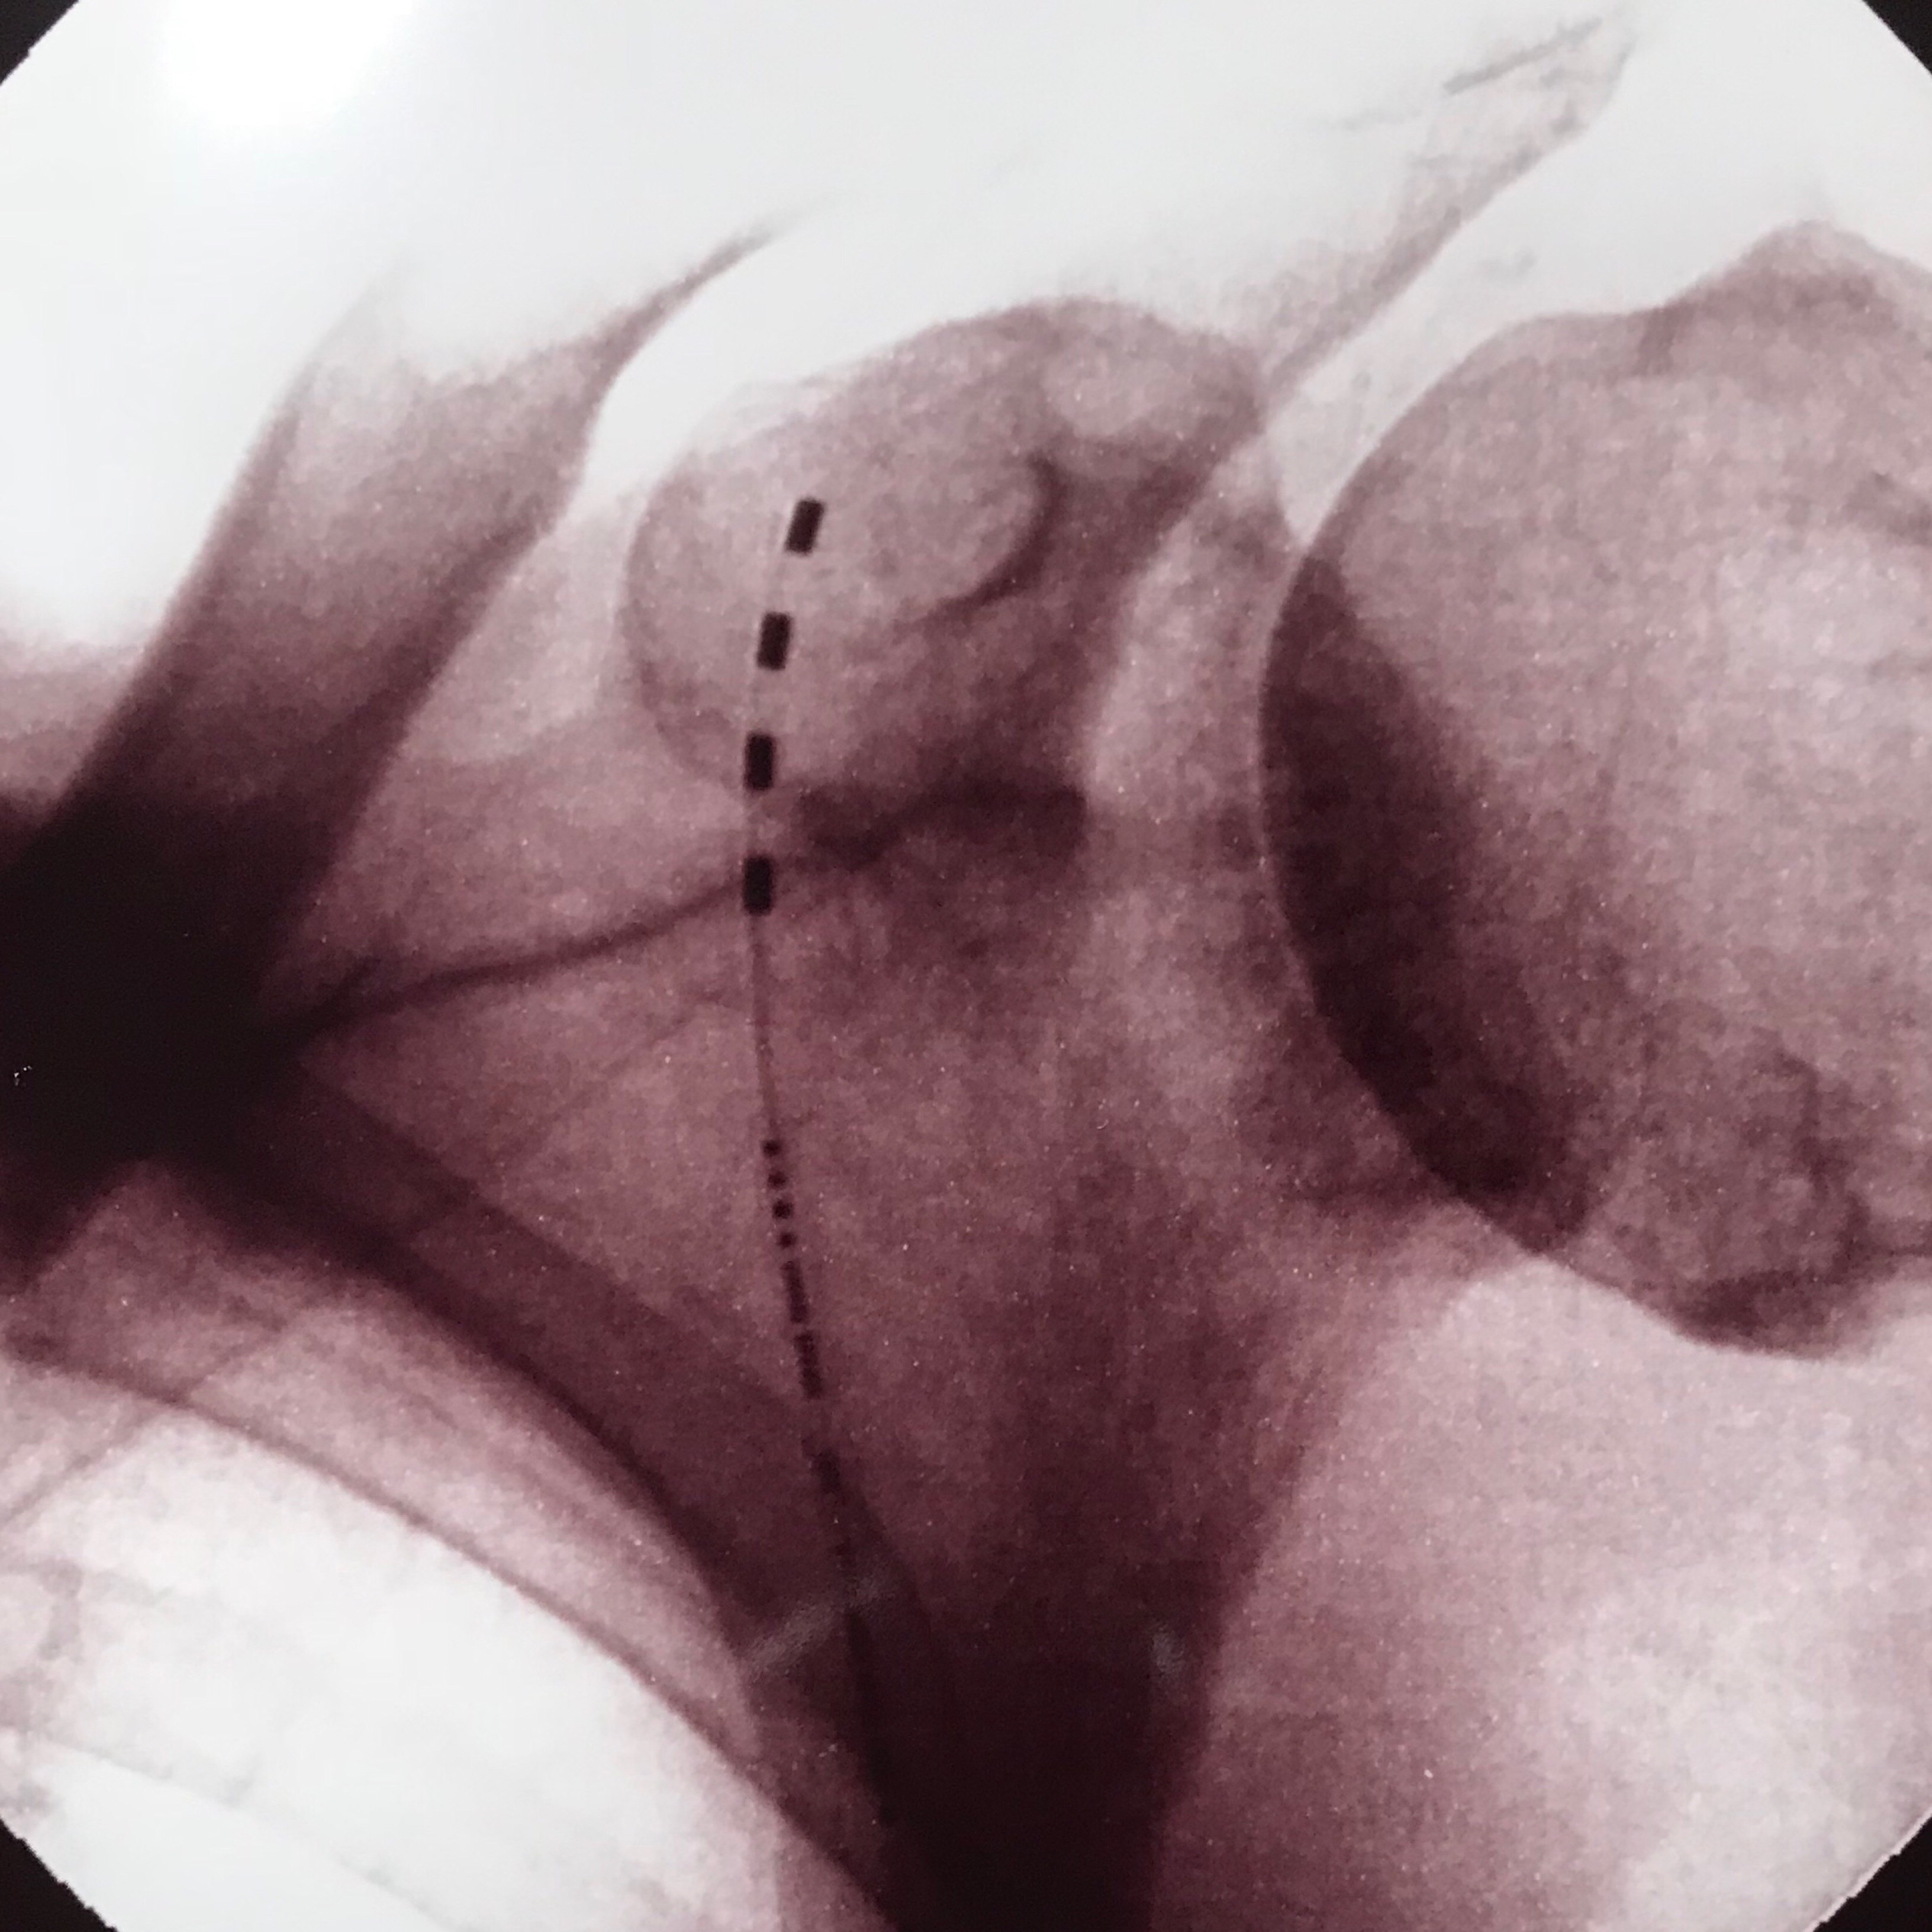
Wireless Peripheral Nerve Stimulation for the Treatment of Chronic Shoulder Pain
Brian Rich MD¹, Niek Vanquathem²
¹Acellerated Interventional Orthopedics, ²Stimwave LLC, USA
Introduction
Two weeks after the suprascapular block, the patient continued to report reduced pain of 2/10 under movement and was able to better manage ADL’s. Long-term options included radiofrequency ablation (RFA) or peripheral nerve stimulation of the suprascapular nerve with a minimally invasive procedure. The patient opted for the latter.
A receiver pocket two centimeters long was made approximately 12 cm distal from the entry point and a Touhy needle was utilized to tunnel the receiver the full length of the track to the secondary subcutaneous pocket. The distal portion of the receiver was coiled, sutured to itself to eliminate any sharp ends, and then sutured to the fascia. Multilayer wound closure was done after copious irrigation. Steri-Strips were applied and Tegaderm was placed over the incisions. The placement was verified with renewed testing at the similar settings found effective during the trial period. The patient tolerated the procedure well and there were no complications.
Conclusions
The suprascapular nerve (SSN) originates from the upper trunk of the brachial plexus with some anatomic variability among different individuals branching from the ventral rami of primarily C5 and C6 (76%), C4, C5 and C6 (18%) and C5 nerve roots (6%) (1). The suprascapular nerve can be injured by compression of surrounding structures, anatomical abnormalities and fractures of adjacent bones (2, 3). Management of suprascapular neuropathy typically includes non-pharmacological, pharmacological and interventional pain procedures such as steroid injections and nerve blocks. Similar to any other chronic pain condition, shoulder pain can be refractory to these types of treatment.
IPG-based SCS systems have been used widely throughout the industry off-label to treat peripheral nerve pain. Conventional wired SCS devices do not lend themselves to PNS placement due to the extensive connections required between the electrode arrays and the implanted battery generator (IPG) (4). This can lead to to complications such as electrode displacement, device fracture and battery-related issues, including dislodgement. Further, none of these devices are rated for MRI scans of the implanted area when utilized at PNS nerve targets. IPGs require tunneling of the electrode arrays to the IPG connector port, which can create the potential for dislodgement and infection from the added surgery and surface area of the implanted battery devices. Other causes of discomfort include battery malposition and pocket pain (5, 6).We report a case with a novel device, devoid of electrode array extensions and an IPG battery unit, specifically designed to mitigate complications related to the bulk of conventional wired devices utilizing an electrode array and a separate receiver element, 5% of the volume of battery devices.
Wireless peripheral nerve simulation was a successful option for an elderly patient suffering of debilitating right shoulder pain due to glenohumeral osteoarthritis.
Wireless PNS stimulators allow for access to difficult sites and it is technically less risky for a clinician to place the units and ensure fixation since joints do not have to be crossed, tunneling to a larger volume IPG pocket under general anesthesia.
Methods
Trial Procedure: The trial implant procedure was done in the prone position under light sedation, with local anesthesia. The suprascapular nerve was identified laterally at 1/3rd of the scapula, and an 8 cm Touhy needle was positioned along the suprascapular nerve under fluoroscopic guidance. The track for the trial electrode array created by the Touhy needle was copiously infused with a solution of 5 ml of marcaine 0.5% and 5 ml lidocaine 2%. Once the device was placed (Fig. 1), the introducer was removed, and the tubing was fixated to the skin with Tegaderm. The patient tolerated the procedure well and there were no complications. The trialed programming settings were 1.5 kHz, 32 μs and 3.5 mA. The patient reported a pain reduction of 100% from the trial and opted for a permanent implant.
Wireless System Components
Results
The Freedom SCS System (Fig. 2) utilizes wireless technology. Each electrode array contains four or eight contacts (1.3 mm in diameter with 4 mm spacing) with embedded electronics and a separate, mated receiver component. A small, externally, wearable, rechargeable transmitter attached to a transmitting antenna worn in clothing provides the energy to power the implanted device wirelessly through the skin. The device uses pulsed electrical current to create an electrical field that acts on nerves to inhibit the transmission of pain signals to the brain.
The patient was fully recovered and had little to no post-operative pain 2 weeks post-implant. He graded his shoulder pain under movement at 0/10 compared to baseline. The patient stated that 10 hours of stimulation per day was sufficient to maintain that level of relief.
Pain relief was sustained and results at 6 months indicated a considerable improvement on Quality of Life (QoL) measured by the Disability of the Arm, Shoulder and Arm Score (8.33 postoperative vs. 75 preoperative), Shoulder Pain and Disability Index Pain Scale (12% postoperative), and Disability Scale (10% postoperative). The patient also stated that he was more ambulatory since he was able to use his crutch again.
Fig. 2: System components
Fig. 1: Suprascapular stimulator placement
Discussion
Suprascapular neuropathic pain can originate from a wide variety of sources and presents with severe, refractory pain as a consequence. Experience with peripheral nerve stimulation at the suprascapular nerve is very limited. PNS has historically been tested for various etiologies with promising efficacy (7).
This was a unique indication for the use of wireless peripheral nerve stimulation. The anatomical conditions of the area are such, that the implant of a conventional system with an IPG would have been very difficult. Off-label use of SCS components is common and often leads to technical shortcomings (5,6). Failed PNS reasons include complications such as migration, fracture, malpositioning and scar tissue along the entire track created by tunneling lead extensions. Complications due to the wiring and bulk of these devices include infections and IPG pocket pain (8). With a wireless system, this type of bulk is avoided, and the implantation elements consist of an electrode array and a separate receiver the size of a wire, allowing for device placement in previously untreatable nerve targets and inaccessible areas.
Because of the overall simplicity of the system and cosmetic advantages, the above-described technology offers an inviting treatment option for similar pathologies that patients will tolerate and utilize widely where they previously would not consider placement of an active implantable battery unit.
Case Report
The patient is a 94-year old widower who suffered from poliomyelitis as a child that affected his left leg and his ability to walk. He lives alone and depends on the use of crutches to ambulate and manage daily activities (ADL). He complained of progressive pain in the right shoulder and deteriorating mobility. He could not lift his right arm above his head without significant pain. He was diagnosed with right glenohumeral osteoarthritis but was not considered an appropriate candidate for surgery because of his age and medical history. Treatment with glenohumeral shoulder injections of corticosteroids and medical treatment during four years was found to be ineffective. The patient’s pain during movement was reported as 7/10 on the visual analogue scale (VAS) and the patient complained that the pain was seriously compromising his ability to self-care.
A suprascapular block was done with a 5 ml lidocaine 2% injection in the suprascapular notch under ultrasound guidance. An exam of the right shoulder after the injection confirmed marked improvements in painless range of motion.
References
Shin C, Lee SE, Yu KH, Chae HK, Lee KS. “Spinal root origins and innervations of the suprascapular nerve.” Surg Radiol Anat. 2010 Mar;32(3):235-8.
Zehetgruber H, Noske H, Lang T, Wurnig C. “Suprascapular nerve entrapment. A meta-analysis”. Int Orthop. 2002;26(6):339-43.
Lee BC, Yegappan M, Thiagarajan P. “Suprascapular nerve neuropathy secondary to spinoglenoid notch ganglion cyst: case reports and review of literature.” Ann Acad Med Singapore. 2007 Dec;36(12):1032-5.
Slavin KV (ed): Peripheral Nerve Stimulation. Prog Neurol Surg. Basel, Karger, 2011, vol 24, pp 189–202
Kim D, Vakharyia R, Kroll HR, et al. Rates of lead migration and stimulation loss in spinal cord stimulation: a retrospective comparison of laminotomy versus percutaneous implantation. Pain Physician. 2011; 14: 513-524.
Holsheimer J, Khan YN, Raza SS, et al. Effects of electrode positioning on perception threshold and paresthesia coverage in spinal cord stimulation. Neuromodulation. 2007; 10: 34-41.
Ilfeld BM, Finneran JJ 4th, Gabriel RA, Said ET, et al. “Ultrasound-guided percutaneous peripheral nerve stimulation: neuromodulation of the suprascapular nerve and brachial plexus for postoperative analgesia following ambulatory rotator cuff repair. A proof-of-concept study.” RegAnesth Pain Med. 2019 Feb 15. pii: rapm-2018-100121
Eldabe S, Buchser E, Duarte R. Complications of spinal cord stimulation and peripheral nerve stimulation techniques: A review of the literature. Pain Med. 2016; 17: 325-336.
Permanent Implant: The permanent implant was conducted three weeks after the trial concluded, under light sedation and local anesthesia. A four-contact StimQ stimulator with built-in fixation tines was placed through an introducer to the targeted nerves where the trial device had been and the position accuracy was verified with fluoroscopy. After the electrode placement, a receiver was unpackaged and threaded into the inner lumen of the stimulator body with a minimum of 10 cm of receiver placed subcutaneously.
Contact
bkrichmd@gmail.com

