Slide 1
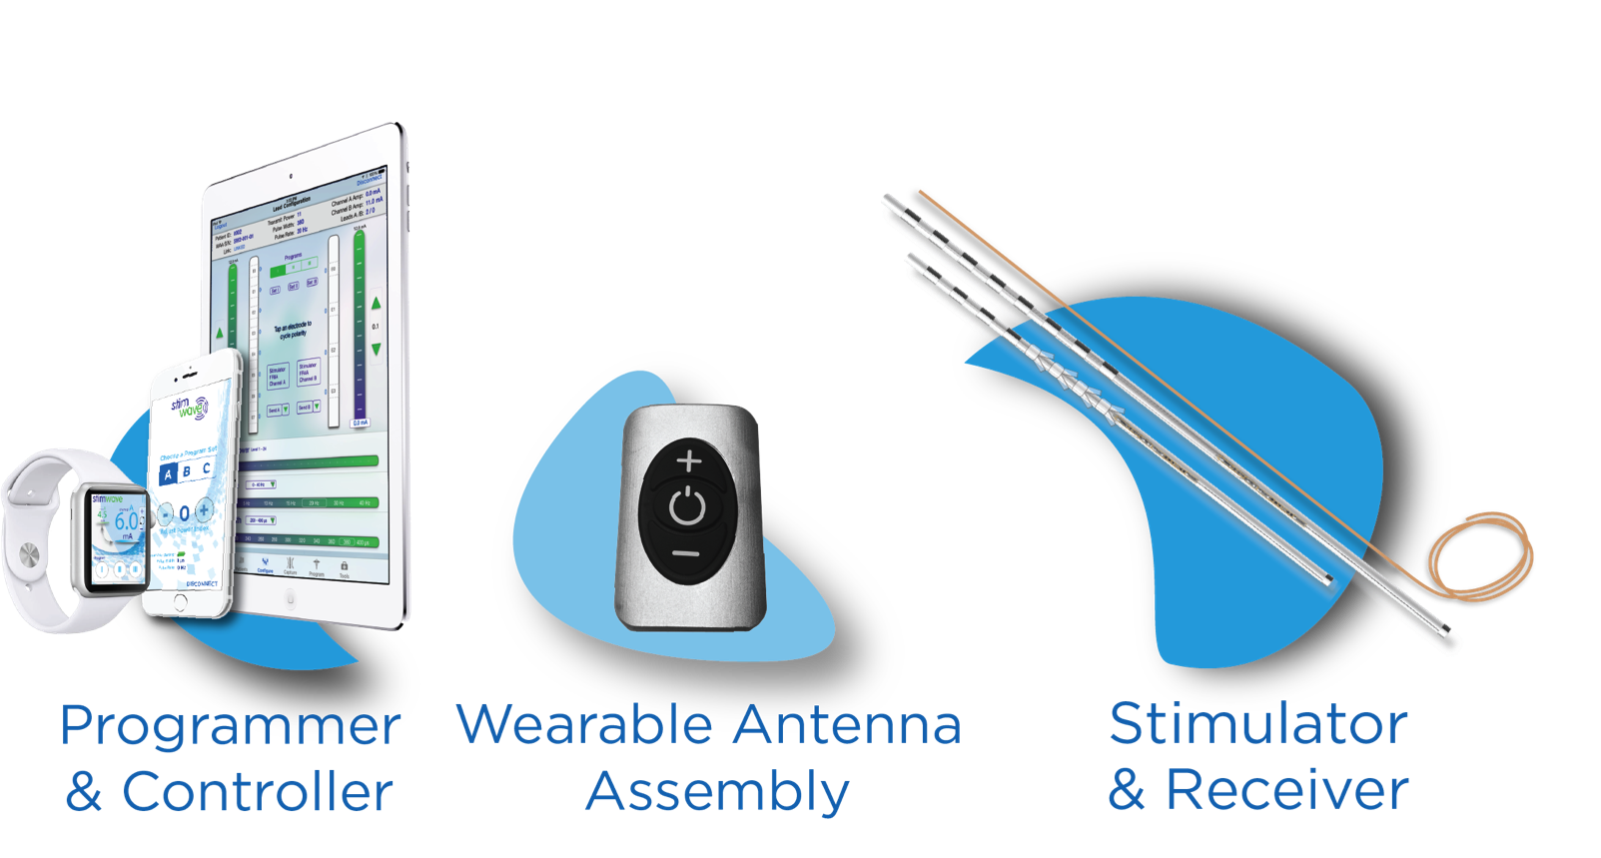
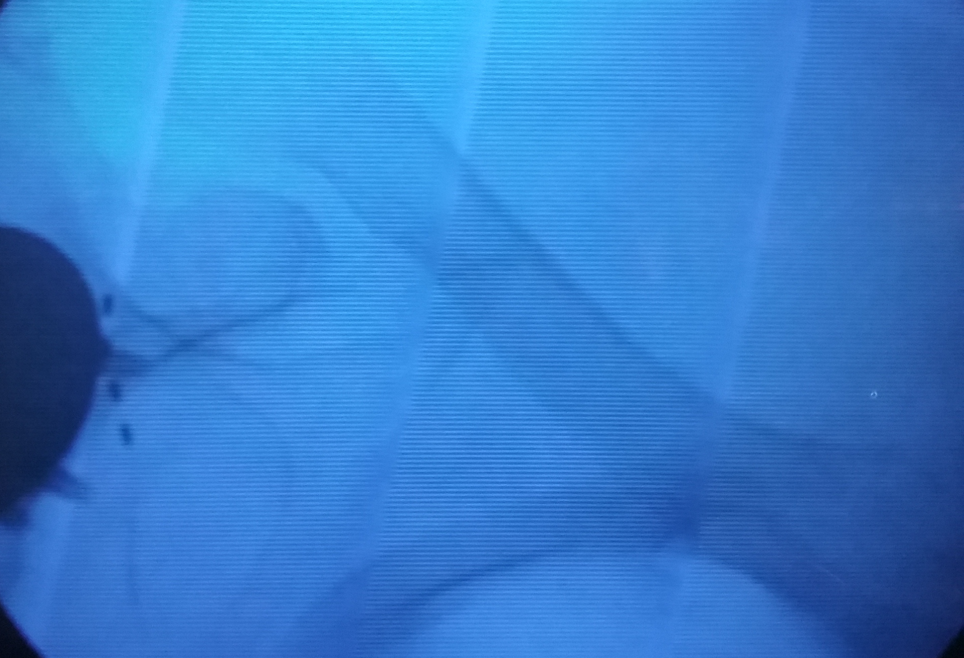
Peripheral Nerve Stimulation of the Suprascapular Nerve for the Treatment of Shoulder Pain
Suzanne Manzi MD¹, Niek Vanquathem²
¹Performance Pain and Sports Medicine, ²Stimwave LLC, USA
Background
Methods
Results
Conclusions
Suprascapular neuropathy is an uncommon cause of shoulder pain and can be challenging to diagnose, as shoulder pain can find its origin in many sources including rotator cuff, brachial plexus, and the cervical spine among others (1). Suprascapular neuropathy can be diagnosed through physical examination and electrodiagnostics after exclusion of other possible causes. Symptoms include: shoulder weakness, with atrophy and aching or burning pain at the back of the shoulder in the scapular area (2). Management of suprascapular nerve pain is challenging. Treatment options include pharmacological treatments such as acetaminophen, non-steroidal anti-inflammatory drugs (NSAIDs), anti-seizure medications and antidepressants. Non-pharmacological treatments include physical and occupational therapy. When these therapies fail, interventional procedures including surgical decompression, steroid injections and neuroablation may be considered (3). Pain control may be unsatisfactory despite all of the above modalities.
When the pain remains resistant to medications and interventions, peripheral nerve stimulation (PNS) might provide an alternative. PNS involves electrical stimulation of a specific nerve that supplies a distinct area of the body. This can be achieved percutaneously. However, conventional battery-dependent systems are not usually suitable for PNS due to the bulk and wiring of these systems, which are placed inside the patient’s body; issues may arise when one of these components malfunctions. Complications related to the wiring between electrodes and the implantable battery include: dislocation, erosion, and infection. Additional issues may arise from the implantable battery with displacement and pocket pain as common events (4, 5). The novel, wireless StimQ PNS system (Stimwave Technologies Incorporated) is designed to mitigate some of these types of complications and challenges.
Surgical description for the trial implant: A 13 gauge introducer needle was percutaneously inserted 4 inches medial to the axilla, near the inferior border of the scapula and was advanced under fluoroscopic guidance until the tip of the introducer was just inferior to the suprascapular notch on the right side. The needle stylet was removed, and a 4 contact, trial stimulator was placed through the introducer with the tip ending at the suprascapular nerve branches inferior to the suprascapular notch (Figure 1). The steering stylet was removed, and the receiver stylet was connected to the system. The process was then repeated in identical fashion on the left side. The exiting tubing was fixated to the skin.
During the 3-day trial, her average pain came down to a 3-4/10 from 8/10. Given the excellent results of the trial, the patient agreed to move forward with the permanent implant.
Surgical description for the permanent implant: The trial stimulators were explanted and replaced by a permanent system similar to the trial procedure. Once the electrode arrays were placed bilaterally, beginning at the inferior angle of the scapula and running towards the suprascapular notch at a gentle angle on each side, a receiver pocket was created between the shoulder blades in the center of the back and the stimulator tails were tunneled medially and horizontally toward one another subcutaneously so that the tails were both in the receiver pocket and the area between the marker bands on each device overlapped in the middle of the back.
One anchor suture was placed in the fascia and around each stimulator at the marker band. A knot was tied in the distal end of each stimulator in the receiver pocket. The stimulator was secured by passing anchor stitches through deep fascia in the receiver pocket and then through the stimulator itself. The receiver pocket was closed in layers after hemostasis and irrigation..
One external device with transmitting antenna was used to power both stimulators at the marker band region horizontally, between the shoulder blades where the stimulators overlapped beneath the skin. Stimulation parameters with pulse rate of 1.5 kHz and pulse width of 30 µs at 2 and 4 mA were tested and found effective. The patient tolerated the procedure very well. Improvement in pain scores was more then 60% from 8/10 to 3/10 on average. Subject had a reduced requirement in pain medications of 60% and noted overall improvement in pain control at the 3 months follow up.
This case suggests the efficacy of PNS in treating suprascapular neuropathic pain, which has been described very few times in prior literature. In addition, it conveys the simplicity of the procedure and efficacy of the system used without the need for an implantable battery or aggressive tunneling and large incisions. PNS is an option that should be considered for patients with suprascapular neuralgia after failure of conservative management.
Wireless System Components
Discussion
The Freedom SCS System (Fig. 2) utilizes wireless technology. Each stimulator contains four or eight contacts (1.3 mm in diameter with 4 mm spacing) with embedded electronics and a separate, mated receiver component. A small, externally wearable, rechargeable transmitter attached to a transmitting antenna worn in clothing provides the energy to power the implanted device wirelessly through the skin. The device uses pulsed electrical current to create an electrical field that acts on nerves to inhibit the transmission of pain signals to the brain.
The suprascapular nerve can be injured or irritated in several ways. Mechanical stress, compression, or injury from surgical procedures or trauma can cause serious damage and lasting pain (6, 7). Suprascapular neuropathy may lead to weakness in muscles supplied by the nerve including the supraspinatus and infraspinatus muscles. In addition, patients may complain of weakness in the shoulder during movement, which may, or may not, be appreciated on clinical exam (8, 9).
Diagnosis overall can be challenging as there are several other conditions that can paint a similar clinical picture including rotator cuff injury, cervical radicular pain, brachial plexopathy, bursitis and myofascial pain. A thorough history and exam are essential in finding the true source of the symptoms. Diagnostic injections of the suprascapular nerve are an important diagnostic tool.
A prior PNS case series for treatment of neuropathic pain conditions included a much more involved surgical procedure, not only for placement of the devices, but also in creating a large battery pocket, requiring removal of a significant amounts of tissue and extended time in the operating room. While the technique was more complex and traumatic using other systems, the patients still reported excellent improvement and efficacy of PNS for treating neuropathic conditions (12).
Placing a lithium ion battery in certain areas of the body (for example, in the foot) can be challenging, or even impossible, due to the lack of subcutaneous tissue, which makes the placement risky and likely to cause significant discomfort to the patient. The use of the StimQ PNS System is designed to mitigate these issues, as there is no need for battery implantation. Thus, stimulators can be placed vitually anywhere in the body and an external, soft antenna is used to send the power signal to the microprocessor embedded within the device usng RF communication, instead of a direct physical connection to an IPG/power source. The surgery is performed using a less than 1 cm incisions for each stimulator placement and another small incision for a receiver pocket.
Fig. 2: System components
Case Report
Fig. 1: Image showing the four-contact neurostimulator at the suprascapular nerve branches inferior to the suprascapular notch
References
The subject is a 84-year-old woman with a history of left shoulder replacement and bilateral shoulder pain. She was a candidate for a right shoulder replacement, but wanted to avoid another surgery and attempt less invasive measures to control her pain. She tried oral opiates, physical therapy, and radiofrequency ablation with unsatisfactory pain control. After failure of other treatment modalities, we discussed moving forward with suprascapular nerve blocks to be followed by a PNS trial and implant on condition that the injections produced good, albeit temporary results. Patient reported 8/10 pain with medications and 10/10 without medications. A suprascapular nerve block was performed with significant, but temporary improvement in pain. Based on the results of the suprascapular nerve block, she was sent for psychological evaluation and agreed to proceed with a PNS trial.
Antoniadis G, Richter HP, Rath S, et al. . Suprascapular nerve entrapment: experience with 28 cases. J Neurosurg. 1996; 85:1020 –1025.
Vastamaki M, Goransson H. Suprascapular nerve entrapment. Clin Orthop. 1993;( 297): 135 –143.
Massenet V, Crielaard JM. [SUPRASCAPULAR NEUROPATHY]. Rev Med Liege. 2016 May;71(5):242-7.
Cummins CA, Messer TM, Nuber GW. Suprascapular nerve entrapment. J Bone Joint Surg Am. 2000 Mar;82(3):415-424.
Trentman TL, Slavin KV, Freeman JA, Zimmerman RS. Occipital nervestimulator placement via a retromastoid to infraclavicular approach:a technical report. Stereotact Funct Neurosurg. 2010; 88: 121-125.
Eldabe S, Buchser E, Duarte R. Complications of spinal cord stimulation and peripheral nerve stimulation techniques: A review of the literature. Pain Med 2016; 17: 325-336.
Ferretti A, Cerullo G, Russo G. Suprascapular neuropathy in volleyball players. J Bone Joint Surg Am. 1987 Feb;69(2):260-263.
Callahan JD, Scully TB, Shapiro SA, Worth RM. Suprascapular nerve entrapment. A series of 27 cases. J Neurosurg. 1991 Jun;74(6):893-896.
Post M. Diagnosis and treatment of suprascapular nerve entrapment. Clin Orthop. 1999 ;(368): 92 – 100.
Reverberi C, Dario A, Barolat G, Zuccon G. Using peripheral nerve stimulation (PNS) to treat neuropathic pain: a clinical series. Neuromodulation. 2014 Dec;17(8):777-783; discussion 783.
Contact
drmanzi@performancepainhouston.com

