Slide 1
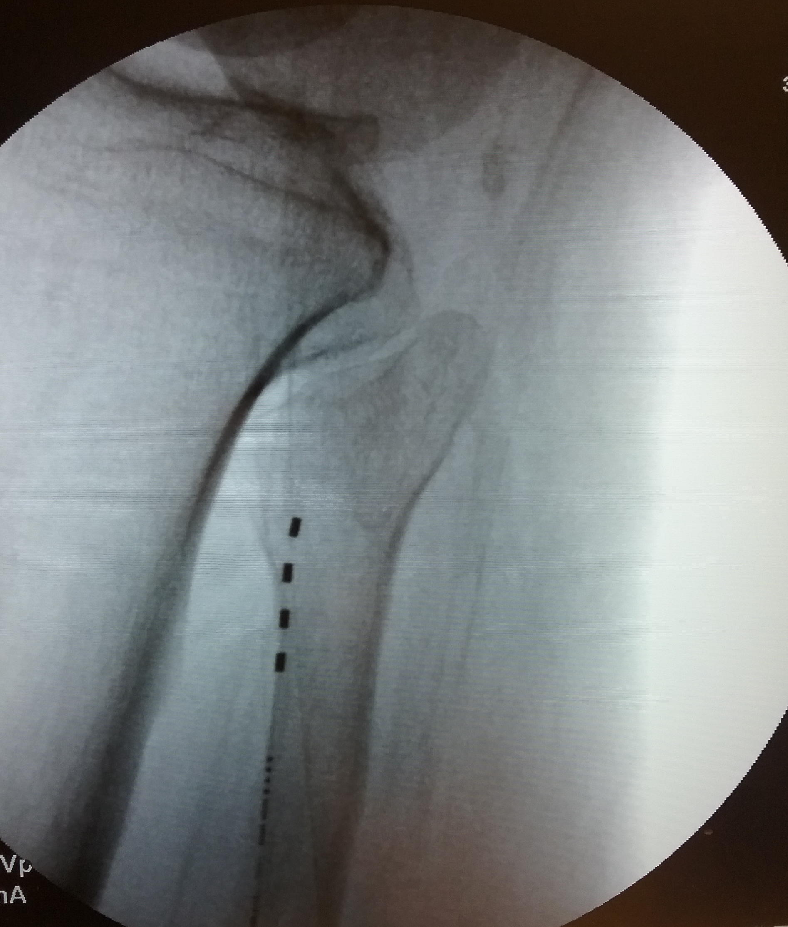
Peroneal Nerve Wireless Peripheral Nerve Stimulation to Treat Lower Extremity Complex Regional Pain Syndrome
Baominh Vinh^{1,} Niek Vanquathem²
¹CY-Pain and Spine, ²Stimwave Technologies
Background
left peroneal nerve. A 13-gauge (G) introducer was used to enter the skin and was positioned subcutaneously progressing from the mid outer calf to the posterior aspect of the fibular head. The first electrode array was inserted through the introducer and placed parallel to the common peroneal nerve. The contacts were confirmed to be over the fibular head. The steering stylet was removed and receiver inserted into the inner lumen of the electrode array. The trial stimulator was then secured to the skin with Mastisol and Steri Strips and completely covered under a sterile Tegaderm. The patient completed a trial and reported 50% pain relief.
Permanent Implant: The trial stimulator was removed, an incision made and the placement technique for the permanent stimulator was repeated. The steering stylet was removed and a receiver inserted into the inner lumen of the electrode array. approximately 10 cm from the first marker band on the electrode array and the neurostimulator tunneled to the pocket. A knot was tied to permanently mate the receiver and electrode array. The distal portion of the stimulator was coiled, sutured to itself to eliminate any sharp ends, and then sutured to the fascia. The pocket was closed with subcutaneous and then subcuticular sutures. The device was programmed with a frequency of 1499 Hz, pulse width of 30 μs, and current of1.2 mA. The Patient wears a sleeve with pocket to hold antenna vertically on the outer calf
Fig. 1: Image showing the quadripolar electrode array parallel to the common peroneal nerve
Conclusions
The common peroneal nerve is a branch of the sciatic nerve beginning just cephalad to the popliteal fossa, then splitting into additional branches at the fibular head and continuing through the outer calf (1). It can be vulnerable to damage from trauma as portions along its pathway are fairly superficial. It is also one of the most commonly involved nerves in complex regional pain syndrome (CRPS) of the foot and ankle region (2). Symptoms of CRPS include “burning” and “aching” pain as well as a variety of stimulus-evoked pain sensations, including hyperalgesia and allodynia (with mechanical, cold, and sometimes heat sensitivity)(3).
Wirelessly powered, battery-free, peripheral nerve stimulation was a successful option for this patient suffering of excruciating pain in the lower extremity as a result of trauma-related injury to the peroneal nerve that led to CRPS .
Wireless System Components
The StimQ PNS System (Fig. 2) utilizes wireless technology. Each electrode array contains four or eight contacts (1.3 mm in diameter with 4 mm spacing) with embedded electronics and a separate, mated receiver component. A small, externally, wearable, rechargeable transmitter attached to a transmitting antenna worn in clothing provides the energy to power the implanted device wirelessly through the skin. The device uses pulsed electrical current to create an electrical field that acts on nerves to inhibit the transmission of pain signals to the brain.
Case Report
Results
The patient received a permanent system after a successful trial (with VAS lowering to 3/10 from 7/10) and later reported 70% pain relief (VAS lowered to 2/10 from 7/10) 6 months after the permanent implant. He is now able the stand and walk for several hours, has increased sensation in his foot and is less likely to stumble or catch his toes as he walks.
Fig. 2: System components
A 50-year-old male presented with pain along the left lateral calf and dorsal aspect of the foot subsequent to trauma to his leg 20 years prior that injured the superficial peroneal nerve. Spinal cord stimulation (SCS) was previously tried, but did not provide pain relief to the affected area. Other failed therapies include NSAIDS, opiates and physical therapy. Prior to his peripheral nerve stimulator trial, the patient was only able to ambulate for 15 minutes.
Discussion
References
A wireless stimulator provides technical advantages compared to the conventional methods of tunneling leads to IPGs and implanted batteries. Wireless peripheral nerve stimulation is an effective option for chronic pain of peripheral nerve origin including the peroneal nerve.
Palastanga N & Soames R Anatomy and Human Movement, Structure and Function. 6th ed. China: Elsevier (Churchil Livingstone) Limited; 2012
Chae, Won Soek et al. “Reduction in mechanical allodynia in complex regional pain syndrome patients with ultrasound-guided pulsed radiofrequency treatment of the superficial peroneal nerve.” The Korean journal of pain vol. 29,4 (2016): 266-269. doi:10.3344/kjp.2016.29.4.266
Coderre TJ, Bennett GJ (2010) A hypothesis for the cause of complex regional pain syndrome-type I (reflex sympathetic dystrophy): pain due to deep-tissue microvascular pathology. Pain Med 11: 1224-1238.
Methods
Trial: Fluoroscopy and palpation were used to plan the introducer entry point and route for a 4-contact trial stimulator targeting the
Contact
bvinhmd@gmail.com

