Slide 1
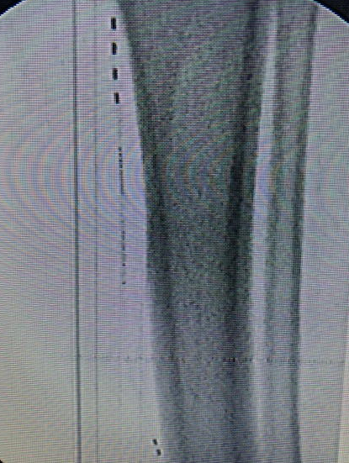
Wireless Peripheral Nerve Stimulation Bilateral Sural Nerves for Chronic Pain in Lower Extremities
Daniel Sandlin MD¹, Niek Vanquathem BA²
¹Georgia Pain and Spine Care, ²Stimwave Technologies
Background
Methods
Fig. 1: Image showing the quadripolar electrode array at the sural nerve
Conclusions
The sural cutaneous nerve consists of the fusion of the medial sural cutaneous nerve, which is a terminal branch of the tibial nerve, and the lateral sural cutaneous nerve from the peroneal nerve. These two branches are connected by the sural communicating branch and form the sural nerve. The nerve courses subcutaneously from the mid posterior popliteal fossa to just posterior to the lateral malleolus. It supplies sensation to the skin of the lateral foot, calf, and lower ankle. The sural nerve descends down the postero-lateral aspect of the calf its primary role is to innervate the skin over the distal one third of the lateral shin and outside of the foot towards the fith toe. It can be damaged by trauma and may present as long-term neuropathic pain.
Trial: Fluoroscopy, ultrasound and palpation were used to plan the introducer entry points. An 8-contact electrode arrays was inserted through the introducers and placed subcutaneously at the right sural nerve. The steering stylet was removed and receiver inserted into the inner lumen of the electrode arrays. The trial stimulator was then secured to the skin with Mastisol and Steri Strips and completely covered under a sterile Tegaderm. The same technique was used for the left leg.
Permanent Implant: A small stab wound was made at the anterior aspect of the right calf and the placement technique for the permanent 4-contact stimulators was repeated (Fig. 1). The steering style was removed and receiver inserted into the inner lumen of the electrode array. A receiver pocket was created approximately 10 cm proximal to the first marker band, and the electrode arrays were tunneled beneath the skin to the receiver pocket. A knot was tied to permanently mate the receiver and electrode array. The distal portion of the stimulator was coiled, sutured to itself to eliminate any sharp ends, and then sutured to the fascia. The pocket was closed with subcutaneous and then subcuticular sutures. The technique was repeated for the left leg. The transmitters were programmed with a frequency of 1499 Hz, pulse width of 30 μs, and 8.0 mA.
Wirelessly powered peripheral nerve stimulation bilaterally at the sural nerves was a successful option for this patient suffering of chronic pain in his calves. This battery-free system is able to offers advantages such as significant pain relief, devoid of complications associated with the bulk of an implantable pulse generator.
Wireless System Components
The StimQ PNS System (Fig. 2) utilizes wireless technology. Each electrode array contains four or eight contacts (1.3 mm in diameter with 4 mm spacing) with embedded electronics and a separate, mated receiver component. A small, externally, wearable, rechargeable transmitter attached to a transmitting antenna worn in clothing provides the energy to power the implanted device wirelessly through the skin. The device uses pulsed electrical current to create an electrical field that acts on nerves to inhibit the transmission of pain signals to the brain.
Results
The patient wears the transmitters and antennae on his calves. The patient received a permanent system after a successful trial (100% pain reduction), and pain scores remained consistent 6 months after the permanent procedure (100% pain reduction) The patient rates his satisfaction as 7/7, with increased quality of life and functionality.
Case Report
A 55-year-old male presented with bilateral sural neuralgia due to chronic compression. His pain originates at the mid-calf bilaterally and extends distally in a sural distribution to his feet. Conservative therapies including physical therapy, NSAIDS, and previous SCS trial were unsuccessful in treating his pain. Ultimately, it was decided to trial peripheral nerve stimulation.
Fig. 2: System components
Discussion
A wireless peripheral nerve stimulation system offers advantages such as significant pain relief, devoid of complications and cosmetic concerns associated with the bulk of an implantable pulse generator with extensive wiring.
Contact
dsandlin@gapaincare.com

