Slide 1
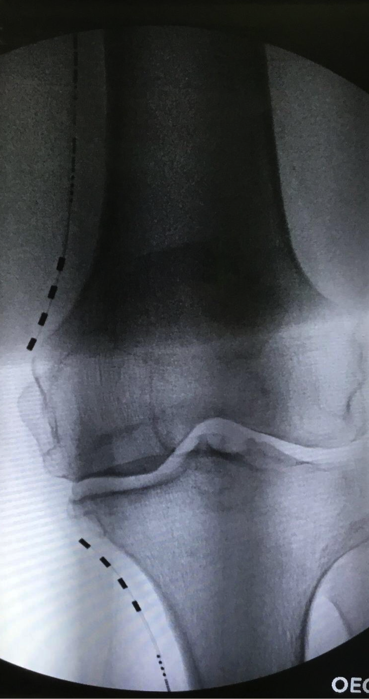
Wirelessly Powered, Battery-Free, Peripheral Nerve Stimulation of the Genicular Nerves for the Treatment of Bilateral Osteoarthritic Knee Pain
Jose Medina-Sanchez¹, Niek Vanquathem²
¹Florida Pain relief Group, ²Stimwave Technologies, USA
The first introducer was placed subcutaneously along the planned route. The 4-electrode array was inserted and placed at the left infrapatellar saphenous (IPS) nerve, distal to the medial tibial plateau. After confirming location, the steering stylet was removed from the device and the receiver inserted into the inner lumen of the electrode array. A similar technique was used to position the second 4--electrode array at the left superior medial genicular nerve, proximal to the medial femoral condyle (Fig. 1). The steering stylet was removed, and the receiver inserted into the inner lumen of the electrode array. The trial stimulators were then secured with Mastisol and Steri Strips and completely covered under a sterile Tegaderm.
Permanent Implant: The trial stimulators were explanted. An incision was made and a permanent system was positioned with a technique similar to the trial procedure. After confirming location, the introducer was removed, then the steering stylet was removed from the device, and the receiver was inserted into the inner lumen of the electrode array. A receiver pocket was created, approximately 10 cm from the first marker band on the electrode array and the neurostimulator tunneled to the pocket. A knot was tied to permanently mate the receiver and electrode array. The distal portion of the stimulator was coiled, sutured to itself to eliminate any sharp ends, and then sutured to the fascia. The pocket was closed with subcutaneous and then subcuticular sutures. The patient wears the transmitter and antenna as part of a knee wrap. The external RF transmitters were programmed with a frequency of 1499 Hz, pulse width of 30 μs, and 3.0 mA.
Conclusions
Background
Fig. 1: Image showing the quadripolar electrode arrays at the left infrapatellar saphenous and superior medial genicular nerve
Chronic knee pain after total knee arthroplasty occurs in approximately 20% of patients. They often experience debilitating pain with diminished quality of life. When conservative measures such as physical therapy, local nerve block injections, neuroablation, medications and pain management fail to provide resolution, patients are left with very few options. Osteoarthritis is the most common form of arthritis in the knee. It is a degenerative “wear-and-tear” type of arthritis that occurs most often in people 50 years of age and older. In osteoarthritis, the cartilage in the knee joint gradually wears away, often resulting in chronic pain.
We report one patient who successfully responded to the use of wireless peripheral nerve stimulation at the genicular nerve to treat her chronic knee pain.
Wirelessly powered, peripheral nerve stimulation was a successful option for this patient suffering of debilitating knee pain as a result of osteoarthritis. This battery-free system is able to offers advantages such as significant pain relief, devoid of complications associated with the bulk of an implantable pulse generator.
Wireless System Components
The StimQ PNS System (Fig. 2) utilizes wireless technology. Each electrode array contains four or eight contacts (1.3 mm in diameter with 4 mm spacing) with embedded electronics and a separate, mated receiver component. A small, externally, wearable, rechargeable transmitter attached to a transmitting antenna worn in clothing provides the energy to power the implanted device wirelessly through the skin. The device uses pulsed electrical current to create an electrical field that acts on nerves to inhibit the transmission of pain signals to the brain.
Results
This patient had very good relief while using both the IPS and the superior medial genicular stimulators interchangeably and reported approximately 60% pain relief during the trial. Both neurostimulators were placed permanently and 10 days later, patient reported 100% overall improvement, which continued at the 6 months post-implant visit. The patient has requested to be treated with the same approach for her right knee.
Case Report
A 71-year-old female presented with constant dull/aching/sharp pain in bilateral left >right knees. The pain worsened with standing, walking and exercising. The pain was relieved with rest, relaxation and pain medication. The patient was diagnosed with bilateral primary osteoarthritis. Intra-articular injections were successful in relieving her knee pain, but the effects were temporary. The patient was offered a chance to trial a wireless peripheral nerve stimulator system for the treatment of her left knee.
Fig. 2: Device Components
Discussion
The lack of subcutaneous tissue makes it very difficult to treat chronic knee pain with PNS using conventional IPG-dependent systems and can lead to multiple complications such as erosion, infection and pocket pain. The StimQ PNS system is designed to mitigate these types of issues and facilitate PNS in areas where anatomical obstructions can be overcome.
Case Report
Contact
Trial: Ultrasound, palpation and fluoroscopy were used to plan the introducer entry point and route for two trial stimulators.
jmsanchez@physicianpartnersoa.com

