Slide 1
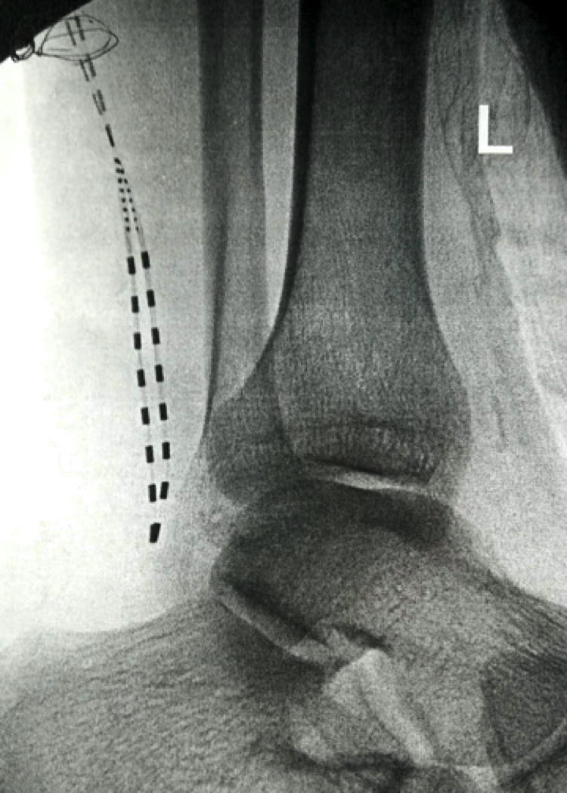
Wireless, Battery-Free Sural Nerve Stimulation for the Treatment of Chronic Foot Pain in Athletic Patient
Gladstone McDowell MD¹, Niek Vanquathem BA²
¹Integrated Pain Solutions, ²Stimwave Technologies
Background
Placement at the sural nerve was confirmed with fluoroscopy (Figure 1). The steering stylets were removed and receivers inserted into the inner lumen of the electrode arrays. The trial stimulators were then secured to the skin with Mastisol and Steri Strips and completely covered under a sterile Tegaderm.
Permanent Implant: A small stab wound was made at the anterior aspect of the left calf and the placement technique for the stimulators utilized in the trial was repeated for the sural nerve utilizing two 8-contact, permanent stimulators. The steering styles were removed and receivers inserted into the inner lumen of the electrode arrays. A receiver pocket was created approximately 10 cm proximal to the first mark band, and the electrode arrays were tunneled beneath the skin to the receiver pocket. A knot was tied to permanently mate the receivers and electrode arrays. The distal portion of the stimulators were coiled, sutured to itself to eliminate any sharp ends, and then sutured to the fascia. The pocket was closed with subcutaneous and then subcuticular sutures. The devices were programmed with a frequency of 1499 Hz, pulse width of 30 μs, and current of 6.0 mA. The patient wears the transmitter and antenna in a neoprene sleeve on his calf.
Fig. 1: Image showing the 8-contact electrode arrays at the sural nerve
Conclusions
The sural nerve, a sensory nerve, descends down the postero-lateral aspect of the calf; it innervates the skin over the distal one third of the lateral shin and the outside of the foot towards the fifth toe. It can be damaged by trauma, which may present as long-term neuropathic pain, which may hinder athletic activity.
Wirelessly powered peripheral nerve stimulation at the sural nerve was a successful option for this patient suffering of chronic pain in his left foot. This battery-free system is able to offers advantages such as significant pain relief, devoid of complications associated with the bulk of an implantable pulse generator.
Wireless System Components
Case Report
The StimQ PNS System (Fig. 2) utilizes wireless technology. Each electrode array contains four or eight contacts (1.3 mm in diameter with 4 mm spacing) with embedded electronics and a separate, mated receiver component. A small, externally, wearable, rechargeable transmitter attached to a transmitting antenna worn in clothing provides the energy to power the implanted device wirelessly through the skin. The device uses pulsed electrical current to create an electrical field that acts on nerves to inhibit the transmission of pain signals to the brain.
A 46-year-old male athlete fractured his left foot in an MVA. He reported pain along the outside of his foot, from 5th toe to heel and was not able to put any weight on the foot, which prevented him from enjoying sports. Alternative therapies such as ultrasound-guided injections and medication proved unsuccessful in the long term. After reporting a dramatic reduction in pain after a sural nerve injection, we decided to try peripheral nerve stimulation.
Results
The patient received a permanent system after a successful trial (60% pain reduction) and later reported 78% pain relief (9/10 to 2/10) 12 months after the permanent implant, which has remained consistent up to 3 years post-implant. The patient rates his satisfaction as 6/7, quality of life increased 60%, and he is now able to sleep through the night. He has since returned to sports.
Fig. 2: System components
Methods
Trial: Fluoroscopy, ultrasound and palpation were used to plan the introducer entry points and route for two 8-contact trial stimulators, targeting the left sural nerves. The electrode arrays were inserted through the introducers and placed subcutaneously along the planned route, directed toward the heel.
Discussion
A wireless peripheral nerve stimulation system offers advantages such as significant pain relief, devoid of complications and cosmetic concerns associated with the bulk of an implantable pulse generator with extensive wiring.
Contact
gmcdowell@ipscolumbus.com

