Slide 1
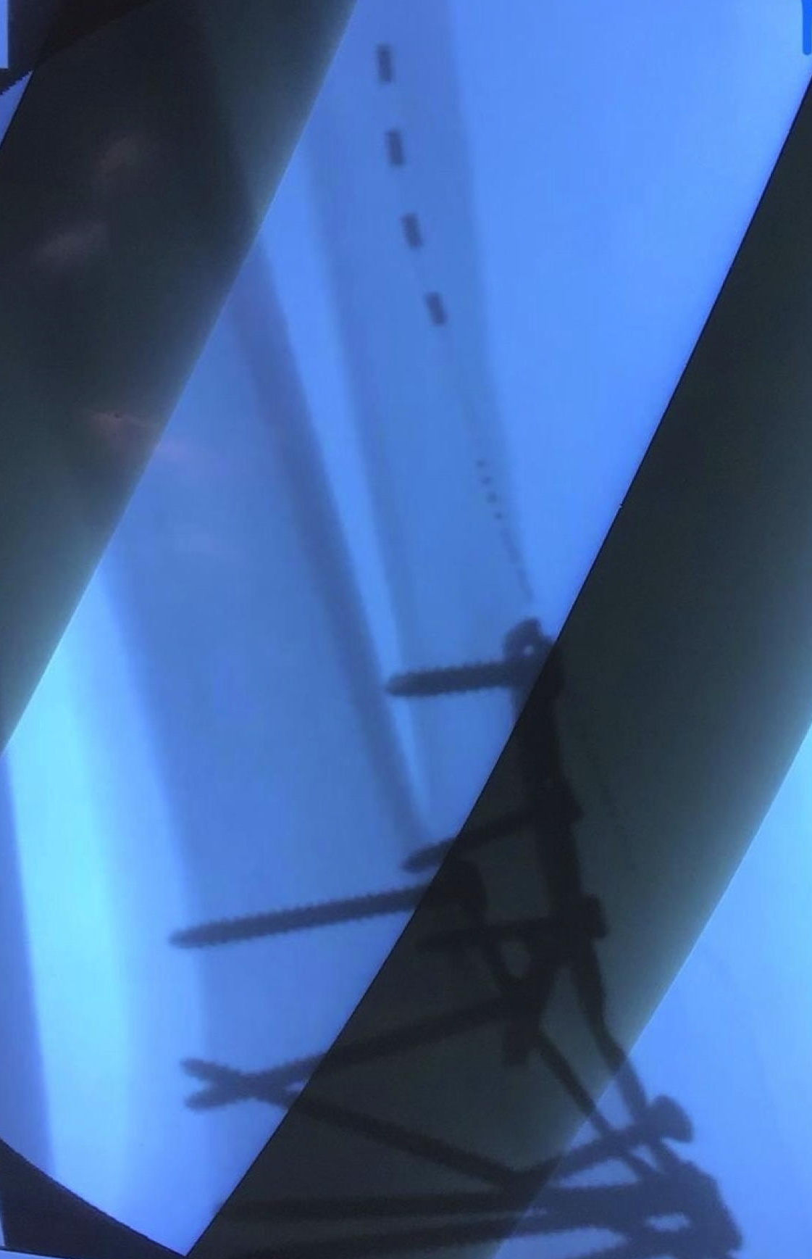
Wirelessly Powered, Battery-Free Peripheral Nerve Stimulation of the Posterior Tibial Nerve for Painful Diabetic Neuropathy and Chronic Regional Pain Syndrome (CRPS)
Manjul Derasari MD¹, Niek Vanquathem BA²
¹Florida Medical Clinic, ²Stimwave Technologies
Background
tibial nerve. The electrode array was inserted through the introducer and placed caudal to cephalad with the contacts aiming cephalad. Contacts were placed midline with the posterior aspect of the fibula, approximately 13 cm superior of the insertion site (ankle). Placement was confirmed with fluoroscopy (Figure 1). The steering stylet was removed and receiver inserted into the inner lumen of the electrode array. The trial stimulator was then secured to the skin with Mastisol and Steri Strips and completely covered under a sterile Tegaderm.
Permanent Implant: A small stab wound was made and the placement technique for the stimulator utilized in the trial was repeated for the posterior tibial nerve utilizing a quadripolar, tined, permanent stimulators. The steering stylet was removed and receiver inserted into the electrode array. A receiver pocket was created, and the electrode array was tunneled beneath the skin to the receiver pocket. A knot was tied to permanently mate the receiver and electrode array. The distal portion of the stimulator was coiled, sutured to itself to eliminate any sharp ends, and then sutured to the fascia. The pocket was closed with subcutaneous and then subcuticular sutures. The devices were programmed with a frequency of 1499 Hz, pulse width of 30 μs, and current of 3.5 mA.
Fig. 1: Image showing the quadripolar electrode arrays at the right posterior tibial nerve
Conclusions
The tibial nerve is a larger terminal branch of the sciatic nerve passing through the popliteal fossa to the arch of the soleus with root values of L4, L5, S1, S2 and S3. Peripheral nerve injury secondary to trauma to feet and ankles is an uncommon problem, which may lead to severe pain and serious disability. As there is no uniform definition or diagnosis to describe nerve pain as results of trauma, such conditions may be described as complex regional pain syndrome (CRPS).
Wirelessly powered peripheral nerve stimulation was a successful option for this patient suffering of excruciating pain in foot and ankle as a result of trauma related CRPS.
Wireless System Components
The StimQ PNS System (Fig. 2) utilizes wireless technology. Each electrode array contains four or eight contacts (1.3 mm in diameter with 4 mm spacing) with embedded electronics and a separate, mated receiver component. A small, externally, wearable, rechargeable transmitter attached to a transmitting antenna worn in clothing provides the energy to power the implanted device wirelessly through the skin. The device uses pulsed electrical current to create an electrical field that acts on nerves to inhibit the transmission of pain signals to the brain.
Case Report
A 78-year-old male had pre-existing painful diabetic neuropathy and had a left above the knee amputation. Patient’s left leg prosthetic failed while walking in 2017 and caused him to fall, resulting in tri-malleolar ankle fracture. Patient underwent surgery to stabilize the right ankle, but he continued to suffer from a large amount of pain secondary to a sustained posterior tibial nerve injury and required large amount of opioid medications. He was diagnosed with CRPS type 2 and was offered peripheral nerve stimulation as a possible alternative to opioids for the treatment of pain.
Results
The patient wears the antenna and transmitter around the ankle. The patient received a permanent system after a successful trial (pain decreased from 9/10 to 1/10) and later reported 78% pain relief (2/10) 6 months after the permanent implant. Quality of life has dramatically improved, medication reduced by at least 50% and satisfaction was rated at 6/7.
Fig. 2: System components
Discussion
Methods
A battery-free system offers advantages such as significant pain relief, devoid of complications associated with the bulk of an implantable pulse generator, and flexibility as related to device placement and programming protocols.
Trial: Fluoroscopy, ultrasound and palpation were used to plan the introducer entry point and route for a 4-contact trial stimulator, targeting the right posterior
Contact
Manjulderasari@gmail.com

