Slide 1
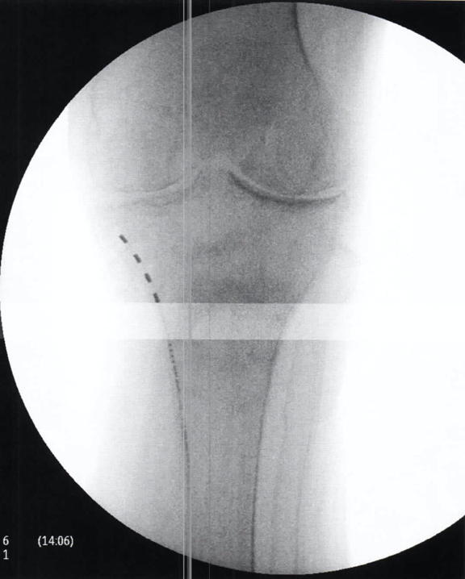
Wireless, Battery-Free Stimulation of IPS Nerve to Treat Chronic Bilateral Knee Pain from Osteogenesis Imperfecta
Charles Brownlow MD¹, Niek Vanquathem BA²
¹Georgia Pain and Spine Care, ²Stimwave Technologies
Trial: Fluoroscopy and palpation were used to plan the introducer entry point and route for a 4-contact trial stimulator targeting the right Infrapatellar Saphenous nerve. A 13-gauge introducer was used to enter the skin and the electrode array was inserted through the introducer and positioned along the planned route at the medial aspect of the proximal tibia just before the tibial plateau (Fig. 1). The steering stylet was removed, and the receiver inserted into the inner lumen of the electrode array. The trial stimulator was then secured with Mastisol and Steri Strips and a sterile Tegaderm. The procedure was repeated for the left leg.
Permanent Implant: A small incision was made and the placement technique for the permanent stimulators was repeated. The steering stylets were removed, and receivers inserted into the inner lumen of the electrode arrays. Receiver pockets were made approximately 10 cm from the first marker band on the electrode arrays and the neurostimulators tunneled to the pockets. A knot was tied to permanently mate the receivers and electrode arrays. The distal portion of the stimulators were coiled, sutured to themselves to eliminate any sharp ends, and then sutured to the fascia. The pockets were closed with subcutaneous and then subcuticular sutures.
Fig. 1: Image showing the quadripolar electrode array at the infrapatellar Saphenous nerve
Background
Methods
Conclusions
Osteogenesis Imperfecta (OI), also known as “brittle bone disease” is a group of genetic disorders that mainly affect the bones. It is caused by a defect in the gene that produces the protein collagen The term means “imperfect bone formation”. People with this condition have bones that fracture easily, often from mild trauma or with no apparent cause and this often leads to chronic pain. There is no cure for OI and treatment is based on specific symptoms. These treatments include physical therapy, mobility aids, occupations therapy, medicine, surgery and pain management. Preventing further fractures is imperative in people with OI and as such they need to avoid activities that put them at risk for a fall or collision, or put too much stress on the bones.
Wirelessly powered, peripheral nerve stimulation was a successful option for this patient suffering of debilitating bilateral knee pain as a result of trauma due to osteogenesis imperfecta. This battery-free system is able to offers advantages such as significant pain relief, devoid of complications associated with the bulk of an implantable pulse generator.
Wireless System Components
The SttimQ PNS System (Fig. 2) utilizes wireless technology. Each electrode array contains four or eight contacts (1.3 mm in diameter with 4 mm spacing) with embedded electronics and a separate, mated receiver component. A small, externally, wearable, rechargeable transmitter attached to a transmitting antenna worn in clothing provides the energy to power the implanted device wirelessly through the skin. The device uses pulsed electrical current to create an electrical field that acts on nerves to inhibit the transmission of pain signals to the brain.
Results
The devices were programmed with a frequency of 1499 Hz and a pulse width of 30 μs. This patient had excellent relief during the trial and reported approximately 100% pain relief. Both neurostimulators were placed permanently and patient reported 100% overall improvement 6 months later, and describes her improvement in pain, quality of life and functionality as a “dramatic improvement”. She is now able to independently transfer without lower limb pain and without excessive use of her upper body. Her limiting factor currently is instability and no longer pain.
Case Report
A 72-year-old female with osteogenesis imperfecta presented with bilateral knee pain after multiple fractures including compression fractures in the spine, ankle and most recently left femur due to OI; she was wheelchair bound due to the pain. She used to rely heavily on her upper body (arms) to transfer to and from her wheelchair and required the assistance of a caregiver.
Fig. 2: System components
Discussion
A wireless peripheral nerve stimulation system offers advantages in difficult to treat subjects, such as significant pain relief, devoid of complications and cosmetic concerns associated with the bulk of an implantable pulse generator with extensive wiring.
Contact
jabrownlow@gapaincare.com

