Slide 1
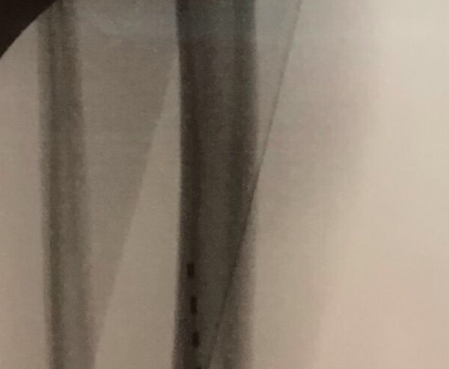
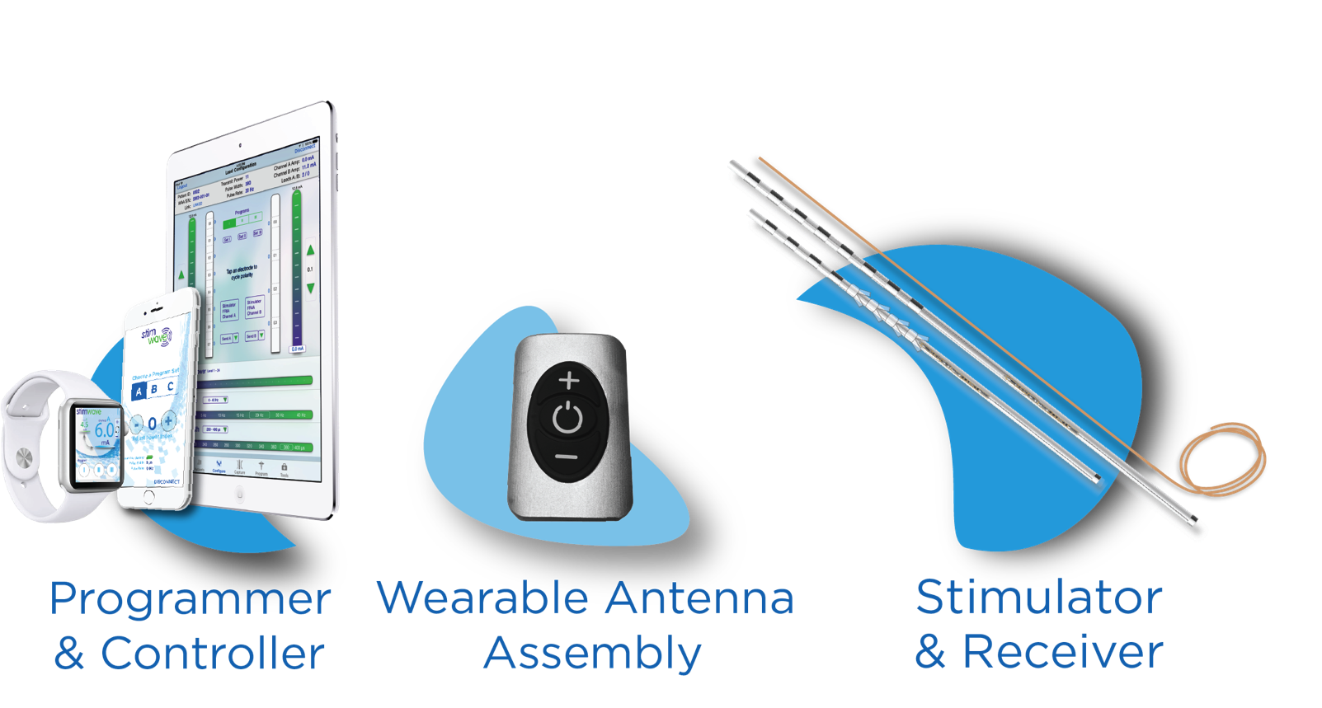
Peripheral Nerve Stimulation of the Tibial Nerve for Non-Ambulatory
Post-Surgical Chronic Pain with Wireless Implant
Carissa Stone MD¹, Niek Vanquathem²
¹Comprehensive Spine Institute, ²Stimwave LLC, USA
Background
Methods
in overall behavioral health (EQ-5D-5L). Her overall sleep also improved after both the trial and permanent implant, increasing sleeping hours from 5-hours to 8-hours. Post-implant the patient is living alone and working with improved ambulation. Medication has decreased from 3 to 1 oxycodone 10mg daily. A SOAP test for subjective and objective assessment of the need for meds went from “sometimes” to “seldom and coping post-implant.”
Conclusions
Wireless neurostimulation has been used effectively for the treatment of pain syndromes of multiple etiologies (1,2). An octopolar or quadripolar Implantable Nerve Stimulator (INS), is inserted percutaneously with a Touhy needle to the target area and a small, external, rechargeable wireless pulse generator (WPG) worn by the patient, provides stimulation parameters and energy to power the INS via radio frequency. The implantation of an implantable pulse generator (IPG) and the tunneling of the extensions required for traditional neurostimulation are not necessary.
Therefore, wireless neurostimulation therapy offers a minimally invasive implant system in difficult anatomical areas, such as the tibial nerve, with less potential complications, benefiting both the patient and the physician.
Following a two-week successful percutaneous trial, a permanent wireless PNS with 4 contacts (Stimwave) was implanted at the right tibial nerve (Fig. 1). The device was introduced caudal to cranially at 1/3 distance from the medial malleolus, between the malleolus and Achilles tendon. The implant was anchored with sutures in two places, at the introduction site and at the end of the lead with a coil within a subcutaneous pocket.
This case report confirms that wireless PNS of the tibial nerve is capable of significantly reducing pain and improving ADL and QoL. Wireless PNS represents a life-changing technological breakthrough for the more than 90 million people in the U.S. who endure daily chronic pain.
Wireless System Components
The Freedom SCS System (Fig. 43 utilizes wireless technology. Each electrode array contains four or eight contacts (1.3 mm in diameter with 4 mm spacing) with embedded electronics and a separate, mated receiver component. A small, externally wearable, rechargeable transmitter attached to a transmitting antenna worn in clothing provides the energy to power the implanted device wirelessly through the skin. The device uses pulsed electrical current to create an electrical field that acts on nerves to inhibit the transmission of pain signals to the brain.
Fig. 1: Entry points of leads and final placement
Fig. 2: Entry points of leads and final placement
Case Report
A 54-year-old female presented non-ambulatory, using an assisted walking device, with pain in her ankle and foot. Patient described pain as sharp, stabbing and aching, hindering activities of daily living (ADL), quality of life (QoL) and resulting in continuous opiate use and poor work performance. Prior therapies included ankle arthrodesis with extensive hardware, nerve blocks and rehabilitation. The patient was also prescribed opioids (10mg oxycodone pills 3 daily), anti-inflammatory medications and topicals. Patient was offered a wireless PNS device for treatment of chronic tibial nerve pain with the goal of tapering opiates and improving ADLs.
Fig. 3: Device Components
Discussion
Results
The preliminary results of this case are equivalent to those reported in previous studies, thus validating the efficacy of the PNS System. Conventional SCS devices with IPGs are responsible for a large percentage of adverse events. The use of wireless stimulation with no IPG eliminates complications related to the IPG implant.
Pain scores and sleep disturbances were recorded at baseline. Pain scores during the trial and through the six months follow-up were reduced to 2/10 (Fig. 2). The patient reported 7/7 patient satisfaction (PGIC) and more than 60% improvement
References
Weiner RL, Reed KL. Peripheral neurostimulation for control of intractable occipital neuralgia. Neuromodulation : journal of the International Neuromodulation Society. 1999;2(3):217-21. "sciatic nerve (anatomy)". Britannica Online Encyclopedia. Retrieved 23 April 2012.
Bolash R, Creamer M, Rauck R, Vehedifar P, Calodney A, Fox I, et al. Wireless high frequency spinal cord stimulation (10 kHz) compared to multi-waveform low frequency spinal cord stimulation in the management of chronic pain in failed back surgery syndrome subjects: Preliminary results of a multicenter, prospective, randomized controlled study. Pain Med, in press, 2019.
Contact
cstone2@physicianpartnersoa.com

