Slide 1
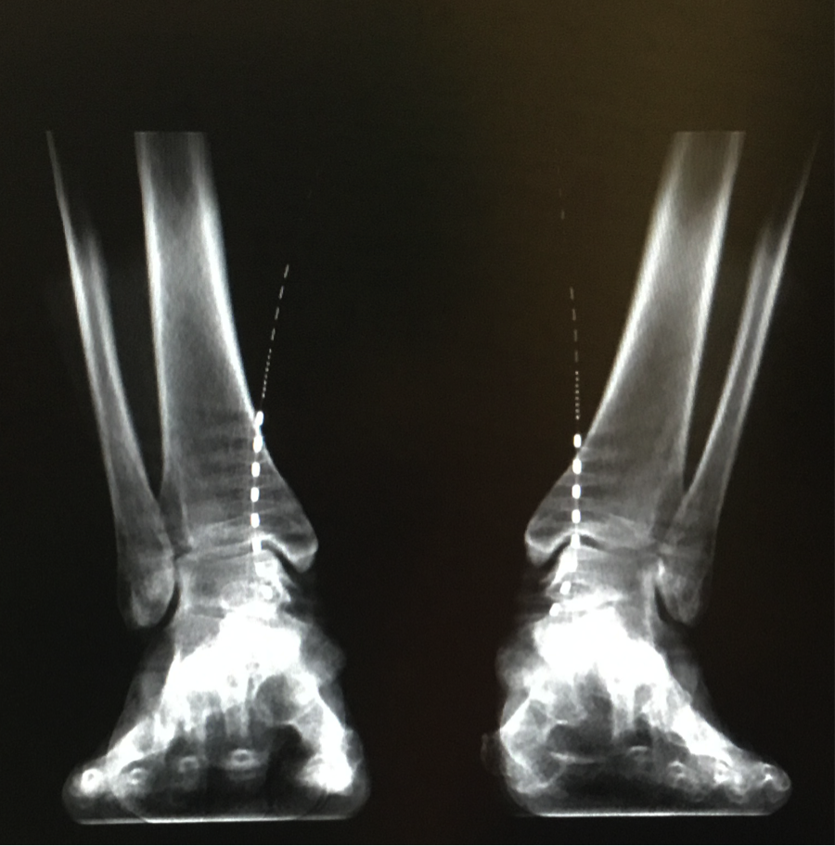
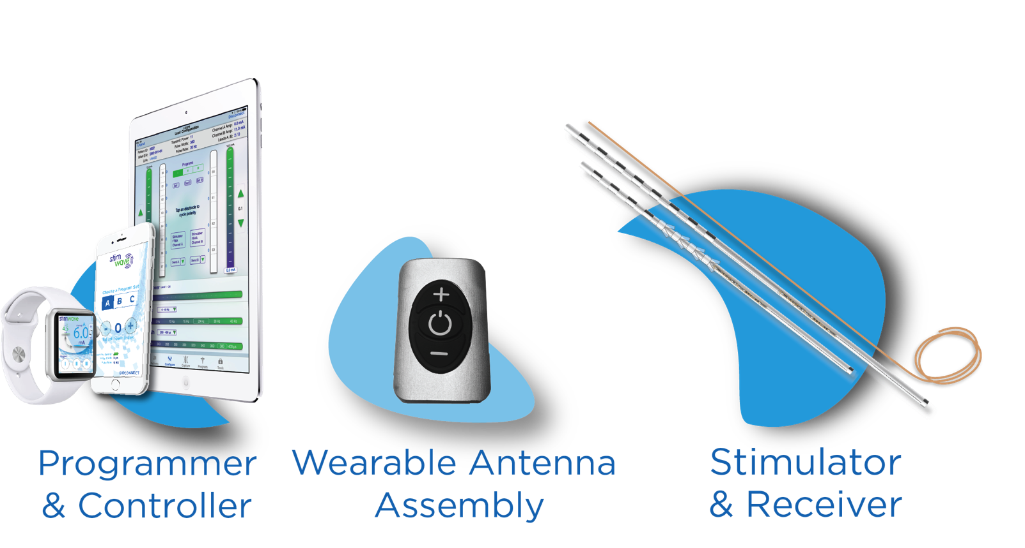
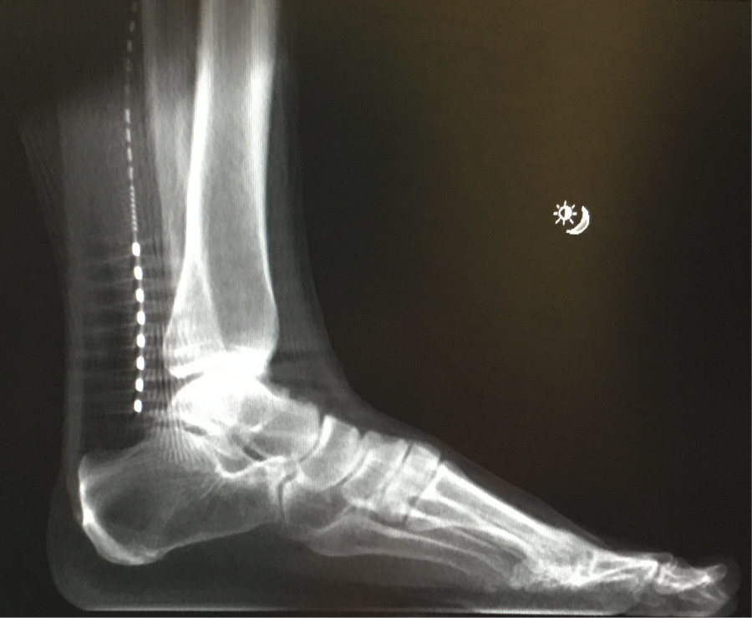
Wireless Peripheral Nerve Stimulation for S1 Radicular Foot Pain after Failed Spinal Cord Stimulation
Soubrata Raikar MD¹ Niek Vanquathem²
Midwest Anesthesia and Pain Management¹, ²Stimwave LLC, USA
Background
Methods
Fig. 2: AP X-ray of bilateral placement
Conclusions
The patient was trialed with two wireless neurostimulators at the tibial nerves. A 13-gauge introducer needle was inserted 2cm medial tp the medial border of the right tibia and directed 11cm toward the posterior border of the medial malleolus under fluoroscopic guidance. The introducer stylet was removed, and a 4-contact stimulator was placed through the introducer with the stimulator tip ending 1cm from the posterior border of the medial malleolus (Fig. 1). The steering stylet was removed, and the receiver was connected to the stimulator. The process was then repeated on the right side (Fig. 1 and 2). The implants were anchored with sutures in two places, at the introduction site and at the end of the stimulator, with a coil within a subcutaneous pocket. The stimulation parameters were set at 1.5kHz, 30ms pulse width and mA between 0.6 and 0.8.
Peripheral nerve stimulation can be an effective, safe, and less invasive treatment for foot pain related to neuropathy, allowing the patient to overcome debilitating pain and significant improvement in function.
Wireless neurostimulation has been used effectively for the treatment of pain syndromes of multiple etiologies (1,2). The implantation of an implantable pulse generator (IPG) and the tunneling of the extensions, responsible for a large subset of adverse events, and required for traditional neurostimulation, are not necessary. Therefore, wireless neurostimulation therapy offers an easier-to-implant system in difficult anatomical areas such as the tibial nerves, with less potential complications that benefits both the patient and the physician. This case report seeks to evaluate a novel, wireless peripheral nerve stimulation (PNS) of the tibial nerve for a patient that failed a spinal cord stimulation trial for bilateral foot pain due to S1 radiculopathy.
Wireless System Components
The Freedom PNS System (Fig. 3) utilizes wireless technology. Each stimulator contains four or eight contacts (1.3 mm in diameter with 4 mm spacing) with embedded electronics and a separate, mated receiver component. A small, externally wearable, rechargeable transmitter attached to a transmitting antenna worn in clothing provides the energy to power the implanted device wirelessly through the skin. The device uses pulsed electrical current to create an electrical field that acts on nerves to inhibit the transmission of pain signals to the brain.
Results
The patient rated her pain score at 2/10, reflecting 66% pain relief at the end of the trial compared to 6/10 average at rest and 8/10 average with activity before the trial. She was able to walk and stand longer, and she was able to sleep better due to reduction of hypersensitivity. Each day of the 5day trial she would wake up with a significant reduction of pain. It was mutually agreed that this was a successful trial and the patient was scheduled for permanent implantation of PNS System.
Case Report
49 year old woman presented with chronic bilateral foot pain due to S1 radiculopathy, Along with pain, she presented with functional and sensory deficits. She was unable to stand/walk for extended periods. She complained of hypersensitivity to light touch to her feet, and she could not sleep due to sheets touching her, exacerbating her symptoms. The patient failed medication therapy, a series of epidural injections, and treatments with a podiatrist. The patient had then undergone a spinal cord stimulator (SCS) trial, with leads at T8-T12, and reported 0% pain relief. We then proceeded with PNS trial.
Fig. 3: Device Components
Fig. 1: Lateral X-ray of placement at tibial nerve
Discussion
The anatomical conditions of the area are such that the implant of a conventional system with an IPG would have been virtually impossible. In general, peripheral nerve stimulation is difficult with conventional devices which require not only an IPG but also extensions to the site where the IPG is implanted.
References
Weiner RL, Reed KL. Peripheral neurostimulation for control of intractable occipital neuralgia. Neuromodulation : journal of the International Neuromodulation Society. 1999;2(3):217-21. "sciatic nerve (anatomy)". Britannica Online Encyclopedia. Retrieved 23 April 2012.
Bolash R, Creamer M, Rauck R, Vehedifar P, Calodney A, Fox I, et al. Wireless high frequency spinal cord stimulation (10 kHz) compared to multi-waveform low frequency spinal cord stimulation in the management of chronic pain in failed back surgery syndrome subjects: Preliminary results of a multicenter, prospective, randomized controlled study. Pain Med, in press, 2019.
Contact
s.raikar@icloud.com

