Slide 1
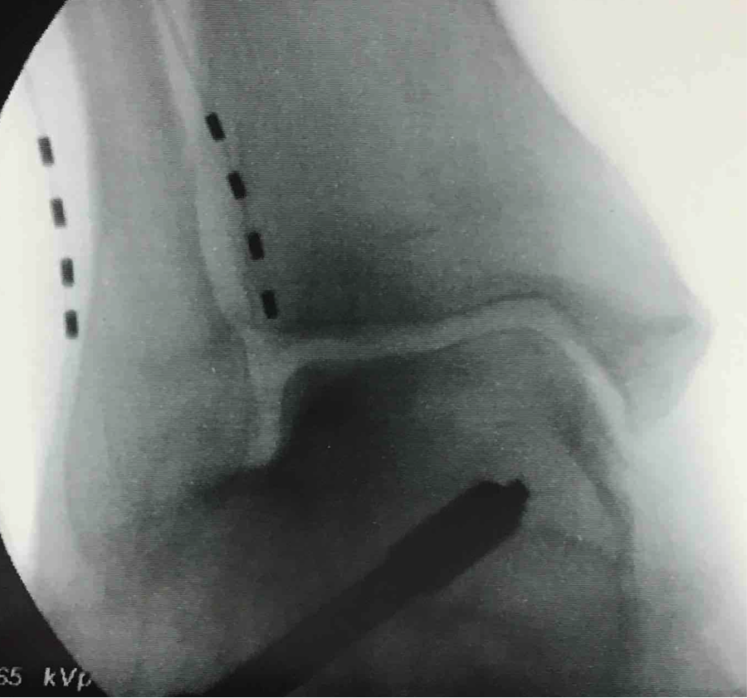
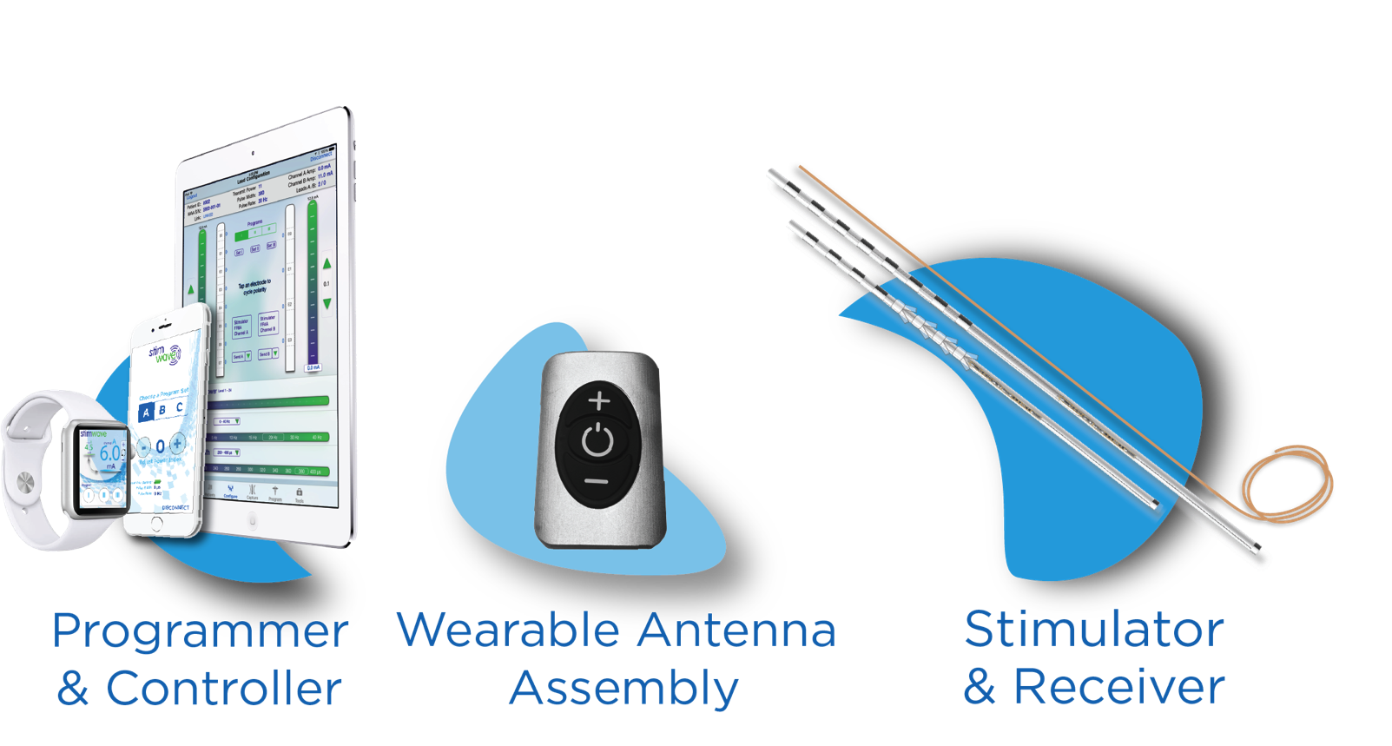
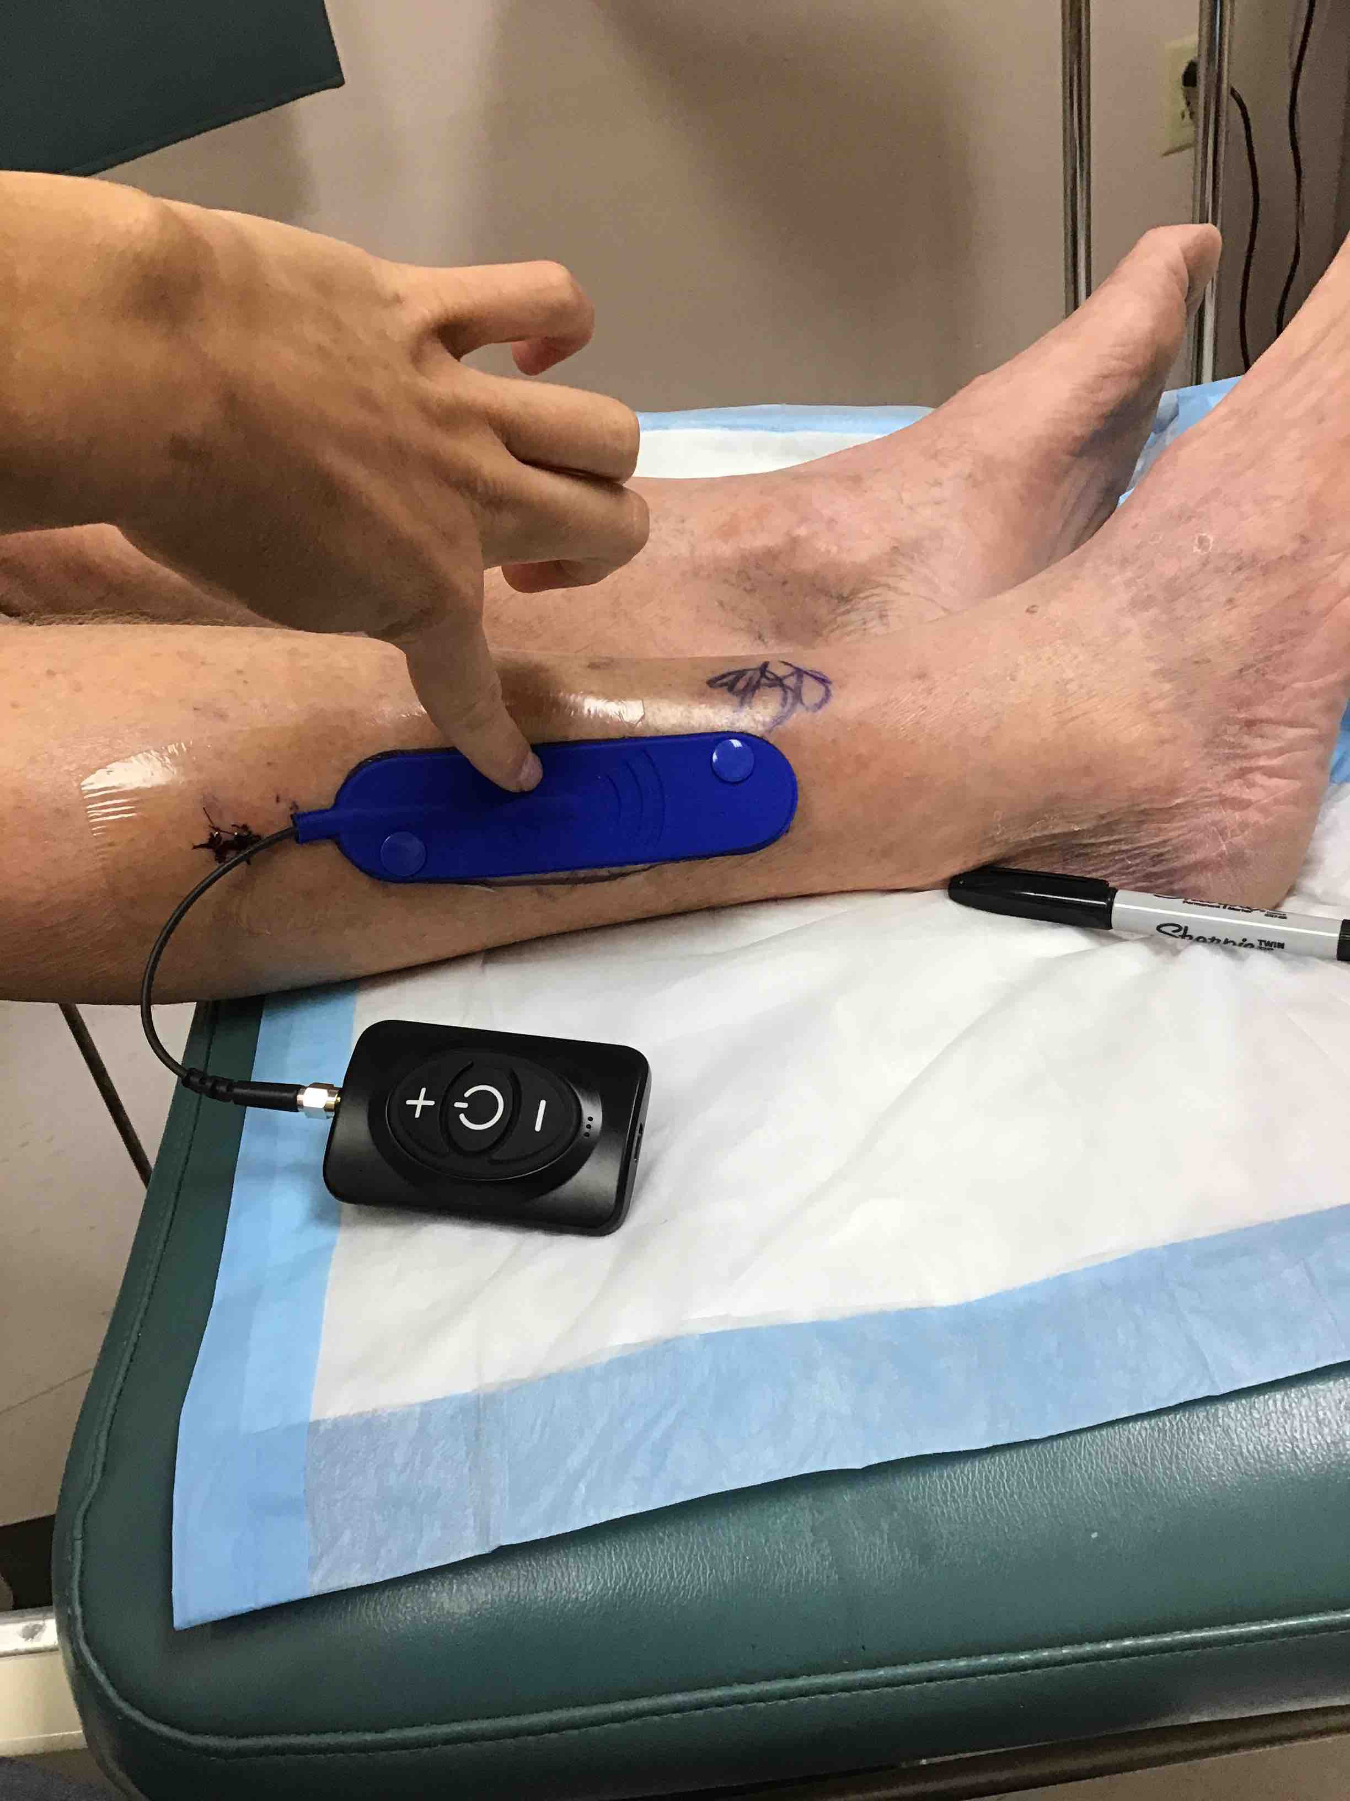
Wireless Peripheral Nerve Stimulation for the Treatment of Chronic Ankle Pain
Post-Joint Fusion
Beth Pearce DPM¹, Niek Vanquathem²
¹Orthopaedic Associates of St. Augustine, ²Stimwave LLC, USA
Background
Methods
Fig. 1: X-ray showing placement at sural and superficial peroneal nerve targets
Conclusions
The foot and ankle regions have traditionally been difficult to stimulate with conventional SCS. Recognition of peripheral nerve entrapments as a cause of neuropathic pain has led to a reevaluation of the etiology and therefore the treatment of lower extremity neuropathic pain. Peripheral nerve stimulation (PNS) of the distal lower extremity has been limited in the past by the need to tunnel a lead to an IPG that is often in the abdomen or buttock. Introduction of a wireless peripheral stimulator has dramatically expanded the treatment options.
Trial Procedure: Local infiltration was provided with approximately 2 ml of Xylocaine and Marcaine mixture. A small stab incision was made for easy insertion of the introducer at a shallow angle of no more than 10 degrees, which was passed in the subcutaneous tissue towards the superficial peroneal nerve (Fig. 1) entered distally. The stimulator was inserted through the introducer and advanced to the target nerve. The identical procedure was then performed for the sural nerve target (Fig. 1) using the original entry point. Introducers were retracted, testing was provided and tubing fixated to the skin with Tegaderm. The subject reported excellent pain relief from the percutaneous trial.
Permanent Implant: Both stimulators were introduced through a single small incision approximately 13 cm proximal to the lateral malleolus, and positioned with technique similar to the trial procedure. A second, small subcutaneous incision was made approximately 10 cm proximal to lead insertion point. A superficial tunnel was created from the lead insertion point to receiver pocket incision. Using the introducer, each lead was advanced through the same tunnel. After inserting the receiver stylet in the inner lumen of the stimulator and tying a knot in each system, proximal to the channel marker band, both stimulator tails were double knotted together. Non-absorbable suture was threaded through the double knot, and sutured to the fascia to secure the leads in place. The subcutaneous pocket was closed using a multilayer closure.
Wireless PNS technology on the sural and superfical peroneal nerve for ankle pain associated with post-joint fusion has proven effective after diagnostic block. Patients may see almost immediate pain improvement when using the device when needed.
Wireless System Components
The Freedom SCS System (Fig. 3) utilizes wireless technology. Each electrode array contains four or eight contacts (1.3 mm in diameter with 4 mm spacing) with embedded electronics and a separate, mated receiver component. A small, externally, wearable, rechargeable transmitter attached to a transmitting antenna worn in clothing provides the energy to power the implanted device wirelessly through the skin. The device uses pulsed electrical current to create an electrical field that acts on nerves to inhibit the transmission of pain signals to the brain.
Case Report
Results
We present a 67-year-old male with persistent and worsening neuralgia post hindfoot fusion on the right as a result of a softball injury approximately 30 years earlier. Patient is retired but still delivers paint several days a week, requiring him to stand and walk for lengths of times. These are the types of activities that would typically aggravate his pain. Cryoablation was tested and found effective, but only for a limited amount of time, with chronic pain returning. Similar outcomes were noted with injections of the sural and superficial peroneal nerves in 2015 which gave the subject excellent but temporary pain relief. When wireless PNS became available in 2019, diagnostic injections were again performed at the sural and superficial peroneal nerves, with complete but temporary pain relief. Based on these results, it was decided to trial wireless PNS.
Preoperatively, patient describes pain that would reach “10/10”. Stimulation parameters were set at 1.5 kHz and 30 μs. Patient is wearing the external system on his lower leg (Fig. 2). Postoperatively, he noted that he was “pain free” except for occasional pain at night when he is not wearing the device. Pain relief has been consistent throughout 6 months. Pain medications decreased from hydrocodone 10/325 3/day to prn at night. He is able to walk and stand without pain.
Fig. 3: device Components
Fig. 2: External system
Contact
drfootmagic@gmail.com

