Slide 1
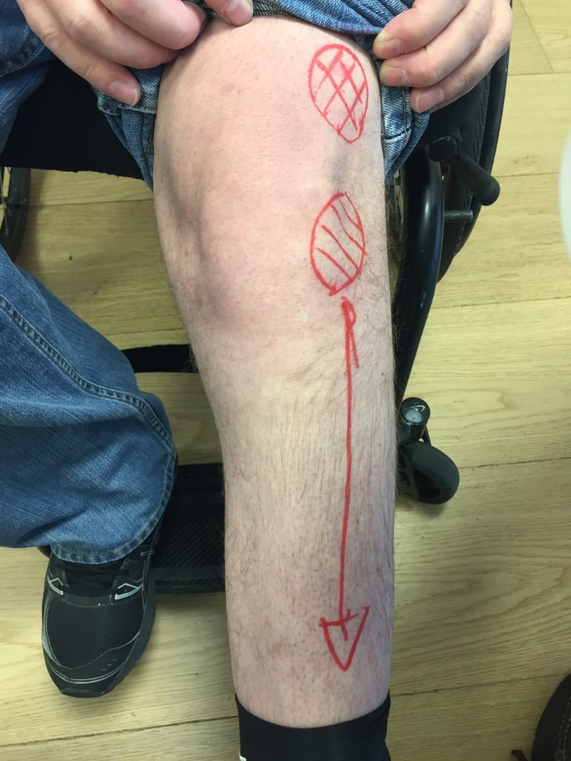
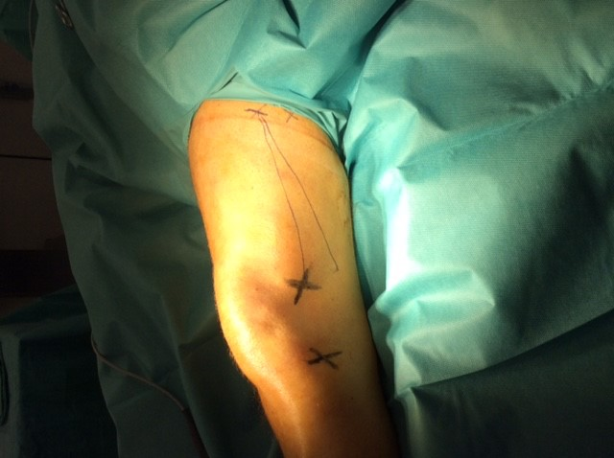
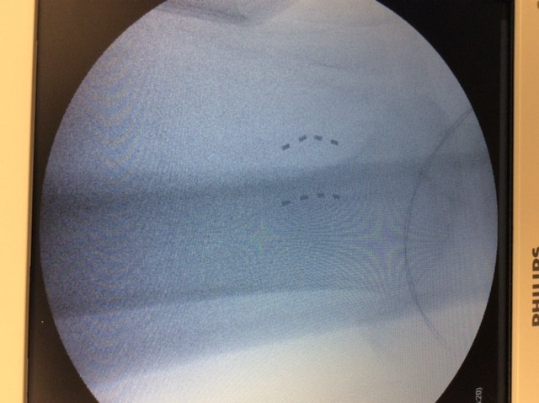
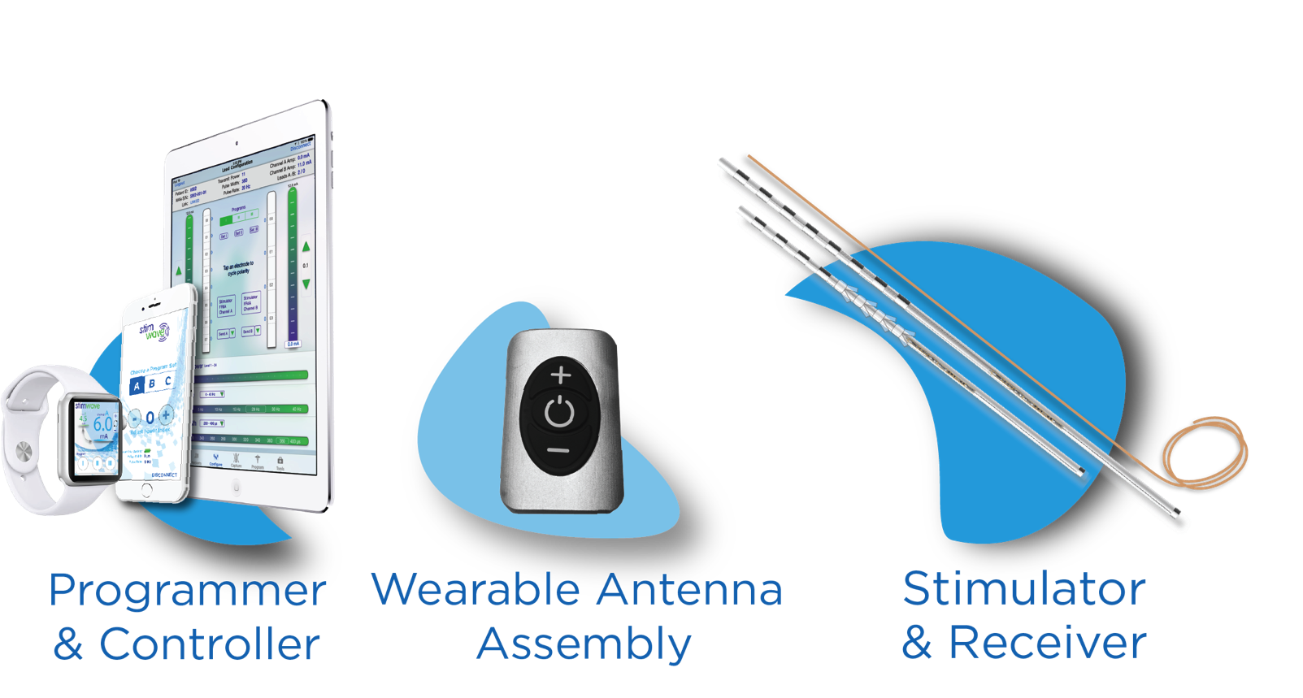
Wireless Peripheral Nerve Stimulation for the Treatment of Chronic Leg Pain Due to Partial Paraplegia
Daniel Herschkowitz MD¹, Niek Vanquathem²
¹Private Clinic Bethanien, ²Stimwave LLC, USA
Background
Fig. 1: Subject applies pressure to point above knee to stop the pain
Approach was done from lateral to the poplietus nerve as in a distal ischias block (Fig. 2). The stimulators were then fixed with a conventional anchor on the muscle fascia. There were no complications during the procedure.
Conclusions
Wireless neurostimulation has been used effectively for the treatment of pain syndromes of multiple etiologies (1,2). An octopolar or quadripolar Implantable Nerve Stimulator (INS), is implanted percutaneously with a Touhy needle in the required area and a small, external, rechargeable wireless pulse generator (WPG) worn by the patient, provides the stimulation parameters and energy to power the INS via radio frequency. The implantation of an implantable pulse generator (IPG) and the tunneling of the extensions required for traditional neurostimulation are not necessary.
Therefore, wireless neurostimulation therapy offers a simpler-to-implant system in difficult anatomical areas with less potential complications that benefits both the patient and the physician.
Wireless peripheral nerve simulation was a successful option for this patient suffering of debilitating, jolting neuropathic pain due to partial paraplegia. WNS allows PNS in difficult to access sites, and the procedure is much more straightforward for the physician, since he/she does not have to consider how and where the extensions connecting the stimulation lead to the IPG could be tunneled.
Fig. 2: Entry points of Electrode arrays and final placement
Wireless System Components
The Freedom SCS System (Fig. 3) utilizes wireless technology. Each electrode array contains four or eight contacts (1.3 mm in diameter with 4 mm spacing) with embedded electronics and a separate, mated receiver component. A small, externally, wearable, rechargeable transmitter attached to a transmitting antenna worn in clothing provides the energy to power the implanted device wirelessly through the skin. The device uses pulsed electrical current to create an electrical field that acts on nerves to inhibit the transmission of pain signals to the brain.
Popliteus nerve
Entry point at the cutaneous femoral nerve
Location of the receivers
The patient had been treated with gabapentin but experienced sides effects: at dose of 300 mg/day the patient was very sleepy and drowsy and had no pain reduction. Weight increased by approximately 10kg. These side effects resulted in discontinuation of the drug therapy. Opioids (tapentadol) were considered as a possible alternative for pain reduction, but the patient was not willing to start opioid treatment. Wireless peripheral nerve stimulation was then suggested to the patient, which he accepted.
Results
The devices were programmed to stimulate at 1.5 kHz and 30 Us pulse length, and an amplitude of 1 mA. Pain scores at trial stimulation were 2-4/10 compared to 8/10 without stimulation. These reduced pain scores were consistent at the 6 month follow up. All parameters indicate an immediate improvement after implantation No adverse events nor side effects were reported by the patient.
Case Report
The patient is a 53-year old male that had a parachute accident on 2015 which resulted in paraplegia. After a slow recovery, the patient was able to stand independently for short periods of time but is wheel-chair dependent to ambulate. The patient complained of intermittent jolting pain episodes (more than 20 per day) in the left leg, starting laterally under the knee and extending to the malleolus. He described that the only way to stop the pain was applying a constant and strong pressure to a point above the knee as shown in Figure 1 corresponding to the area of the cutaneous lateral femoral nerve. Because of the painful episodes, the patient was often missing from work.
Fig. 3: Device Components
Discussion
Methods
This was the first time that neurostimulation was used for this indication. The anatomical conditions of the area are such that the implant of a conventional system with an IPG would have been virtually impossible. In general, peripheral nerve stimulation is difficult with conventional devices, which require not only an IPG but also extensions to the site where the IPG is implanted.
We immediately performed a permanent implant procedure under light sedation, with local anesthesia and in supine position on 30 November 2018. The entry point for the two stimulators was laterally above the knee, and the contacts were placed at the condylus lateralis femoris of the left knee.
References
Weiner RL, Reed KL. Peripheral neurostimulation for control of intractable occipital neuralgia. Neuromodulation : journal of the International Neuromodulation Society. 1999;2(3):217-21. "sciatic nerve (anatomy)". Britannica Online Encyclopedia. Retrieved 23 April 2012.
Bolash R, Creamer M, Rauck R, Vehedifar P, Calodney A, Fox I, et al. Wireless high frequency spinal cord stimulation (10 kHz) compared to multi-waveform low frequency spinal cord stimulation in the management of chronic pain in failed back surgery syndrome subjects: Preliminary results of a multicenter, prospective, randomized controlled study. Pain Med, in press, 2019.
Contact
danhersch@me.com

