Slide 1
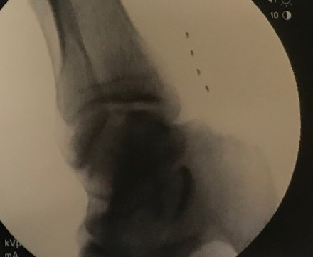
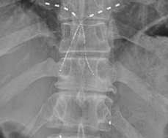
72
Wireless Peripheral Nerve Stimulation of Tibial Nerve for
Complex Regional Pain Syndrome (CRPS)
Hassan Chahadeh, MD¹ and Erwin Lo, MD²
*Presenting Author: Hassan Chahadeh, MD
Introduction
Methods
The tibial nerve is a larger terminal branch of the sciatic nerve passing through the popliteal fossa to the arch of the soleus with root values of L4, L5, S1, S2 and S3. There have been limited treatment options for nerve pain experienced in this area of the body. This case report investigates a patient diagnosed with complex regional pain syndrome (CRPS), chronic right foot pain, neuropathy and neuralgia. He is unable to bear any weight on his right leg, only able to walk very short distances and requires the use of a walking device.
A wireless PNS system (Stimwave) was placed 0.5 cm superficial to the tibial nerve between to medial malleolus and the Achilles tendon (Figure 2). The device was placed and secured to the fascia using 2-0 silk. Stimulators were tunneled to a secondary receiver pocket and sutured and tied at proximal end. Deep layers were closed using 2-0 Vicryl in an interrupted fashion. Superficial layers were closed using 2-0 Vicryl suture in an interrupted fashion. Patient is wearing the antenna on the calf using a compression calf sleeve.
Fig. 2 Placement on tibial nerve
Wireless System Components
Fig.1 System Components
Conclusions
This case report confirms percutaneous that placement of a wireless neurostimulator device directly adjacent to the affected peripheral nerve(s), is an efficacious and minimally invasive reversible option for pain control in patients with tibial peripheral nerve pain refractory to conventional medical management. Wireless PNS can provide relief to an undertreated patient population with pain distributions that are difficult to target. PNS using 1.5 kHz frequency was found to effectively control neuropathic pain from a peripheral nerve target.
Results
Stimulator &
Receiver
There were no adverse events reported. Patient reported a pain score (NRS) of 10/10 at baseline and a reduced pain score of 1/10 at the 1-month follow-up. Post-implant patient reported a global impression of change (PGIC) score of 7/7. Patient’s preferred pulse rate was 1.5 kHz with a pulse width of 30 μs. (Figure 3)
Programmer &
Controller
Wearable
Antenna
Assembly

