Slide 1
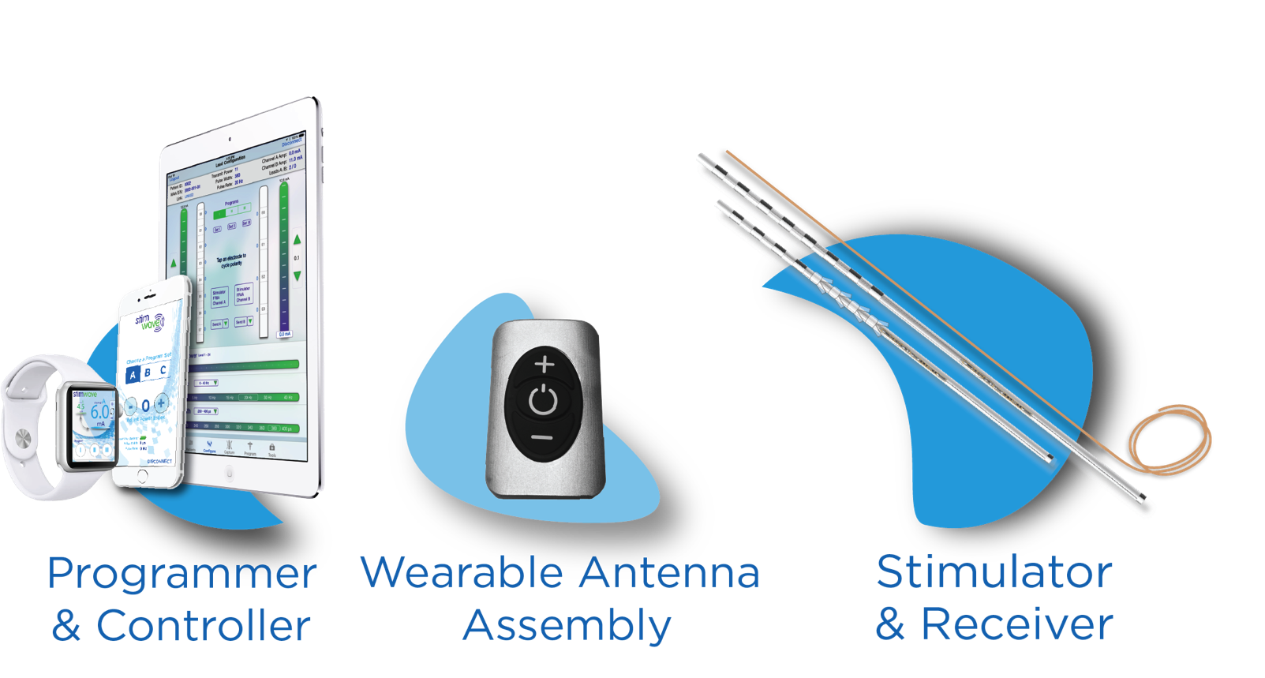
Wireless Peripheral Nerve Stimulation for the Treatment of Sural Neuralgia
Alaa Abd-Elsayed¹, Niek Vanquathem²
¹Wisconsin School of Medicine and Public Health , ²Stimwave LLC, USA
Background
chronic pain management was consulted
and an ability to decrease her dose of neuropathic medications to half.
At one year follow up, patient continues to report the same improvement.
Wireless System Components
The use of peripheral nerve stimulation (PNS) for chronic peripheral nerve pain has been documented as early as 1967 when Wall and Sweet reported eight cases using PNS to reduce chronic peripheral nerve pain [1]. Fifty years later peripheral nerve stimulation is still viewed as a last resort for chronic peripheral nerve pain. Today technological advancements allow for less invasive placement procedures and improvement in cosmesis, making implantation less morbid and more accessible [2]. Here we document the safe and effective use of wireless PNS for a patient with refractory sural neuralgia.
Methods
The Freedom SCS System (Fig. 2) utilizes wireless technology. Each electrode array contains four or eight contacts (1.3 mm in diameter with 4 mm spacing) with embedded electronics and a separate, mated receiver component. A small, externally, wearable, rechargeable transmitter attached to a transmitting antenna worn in clothing provides the energy to power the implanted device wirelessly through the skin. The device uses pulsed electrical current to create an electrical field that acts on nerves to inhibit the transmission of pain signals to the brain.
Three sural nerve blocks with 2ml of 0.25% bupivacaine and 40mg of kenalog were effective however duration was short lasting. A decision was made to perform a wireless PNS trial (Stimwave, Pompano beach, USA) to provide longer term relief. Patient underwent psychiatric evaluation and she subsequently underwent PNS trial which provided more than 50% improvement in pain and patient subsequently received a permanent wireless PNS implant. The stimulator electrode array was placed between the lateral malleolus and Achilles tendon, where the sural nerve is located, under fluoroscopic guidance and stimulation was provided using an external antenna and generator. Device was programmed to deliver high frequency stimulation.
Discussion
Wireless neurostimulation technology is cabable of elevating peripheral nerve stimulation techniques due to due to reduced bulk inherent to the technology. While conventional battery-dependent systems have been considered as a last option due to associated complications and reduced cosmesis, wireless peripheral nerve techniques have been designed to mitigate these types of disadvantages. This allows for the wide-spread use these techniques
Case Presentation
Fig. 2 : Device Components
Our patient presented with a history of right cuboid fracture due to motor vehicle accident status post arthrodesis 10 years ago. Recovery was uncomplicated for seven years postoperatively until she started to experience pain and swelling at the prior surgical site. She subsequently underwent hardware removal for pain alleviation, but her pain worsened thereafter including features consistent with Sural neuropathic pain. Conservative management with therapy and medication failed therefore
Conclusion
PNS has been approved by FDA for pain relieve. We report here a case of significantly improved refractory chronic peripheral neuropathic pain with the use of PNS. Early pain referral with appropriate pain treatment can improve quality of life and avoid side effect of pain medication especially opioids.
Results
One-month status post-nerve stimulator implantation patient reported considerable improvement in her symptoms, an increased ability to resume long hours of heavy work load,
References
1. Wall PD, Sweet WH. Temporary abolition of pain in man. Science 1967;155(3758):108–9.
2. Banks GP, Winfree CJ. Evolving techniques and indications in peripheral nerve stimulation for pain. Neurosurg Clin N Am 30 (2019) 265-273
Contact
alaaawny@hotmail.com

