Slide 1
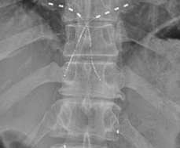
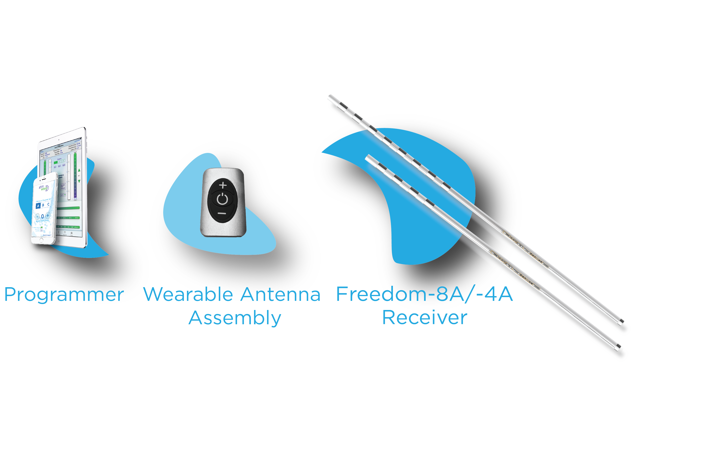
64
Wireless Peripheral Nerve Stimulation for the Treatment of Chronic Knee Pain Following Total Knee Arthroplasty: A Case Series
Beth Pearce, DPM¹, Kristen L. Scott, BSN, RN²
*Presenting Author: Beth Pearce, DPM
Introduction
Methods
Conclusions
Chronic knee pain after total knee arthroplasty (TKA) remains a reality for at least 20% of patients. Treatment consists of physical therapy, diagnostic and therapeutic injections, ablative procedures, neurolysis and pain medication management. When these therapies decrease in effectiveness, or fail altogether, patients are left with few options to treat debilitating pain and decrease in the quality of life (QoL). This case study reviews three patients who have received a permanent implant of a wireless peripheral nerve stimulator (PNS) along the infrapatellar saphenous nerve to treat chronic post-TKA pain.
Three patients, at least one year after total knee arthroplasty and ranging in age from 66-80 years of age, were evaluated and treated for infrapatellar saphenous neuralgia. Diagnosis was made utilizing patient history, physical exam and successful diagnostic nerve blocks of the infrapatellar saphenous nerve, consisting of 2 mL 0.5% marcaine and a corticosteroid. Following the failure of conventional treatments and the success of the nerve blocks, all patients were presented with the option to trial a PNS to treat their ongoing pain. All patients were trialed and reported significant improvement in their baseline pain, >75%. Each patient was implanted with a Stimwave, quadripolar PNS device along the infrapatellar saphenous nerve. Patients were assessed post-implant and are following an assessment schedule of 1, 3, 6 and 12- months for pain, medication usage and overall improvement in QoL.
Stimwave’s wireless PNS technology on the infrapatellar saphenous nerve for pain associated with chronic post-TKA pain has proven effective. PNS helped patients reduce the amount of pain medication consumed and allow patients improved QoL. Additionally, patients may see almost immediate pain improvement when using the device when needed.
Wireless System Components
The Freedom SCS System utilizes wireless technology. Each electrode array contains four or eight contacts (1.3 mm in diameter with 4 mm spacing) with embedded electronics and a separate, mated receiver component. A small, externally, wearable, rechargeable transmitter attached to a transmitting antenna worn in clothing provides the energy to power the implanted device wirelessly through the skin. The device uses pulsed electrical current to create an electrical field that acts on nerves to inhibit the transmission of pain signals to the brain.
Results
All patients reported an average VAS pain reduction of at least 75%. Patients reported wearing the device from 3 to 24 hours per day. Medication for one patient was reduced from prescription pain medications to over-the-counter (OTC) Tylenol. Medication for another patient was reduced from three tabs of hydrocodone/ acetaminophen 7.5/325mg per day, to ½ tab two times per day.
Fig.1 System Components

