Slide 1
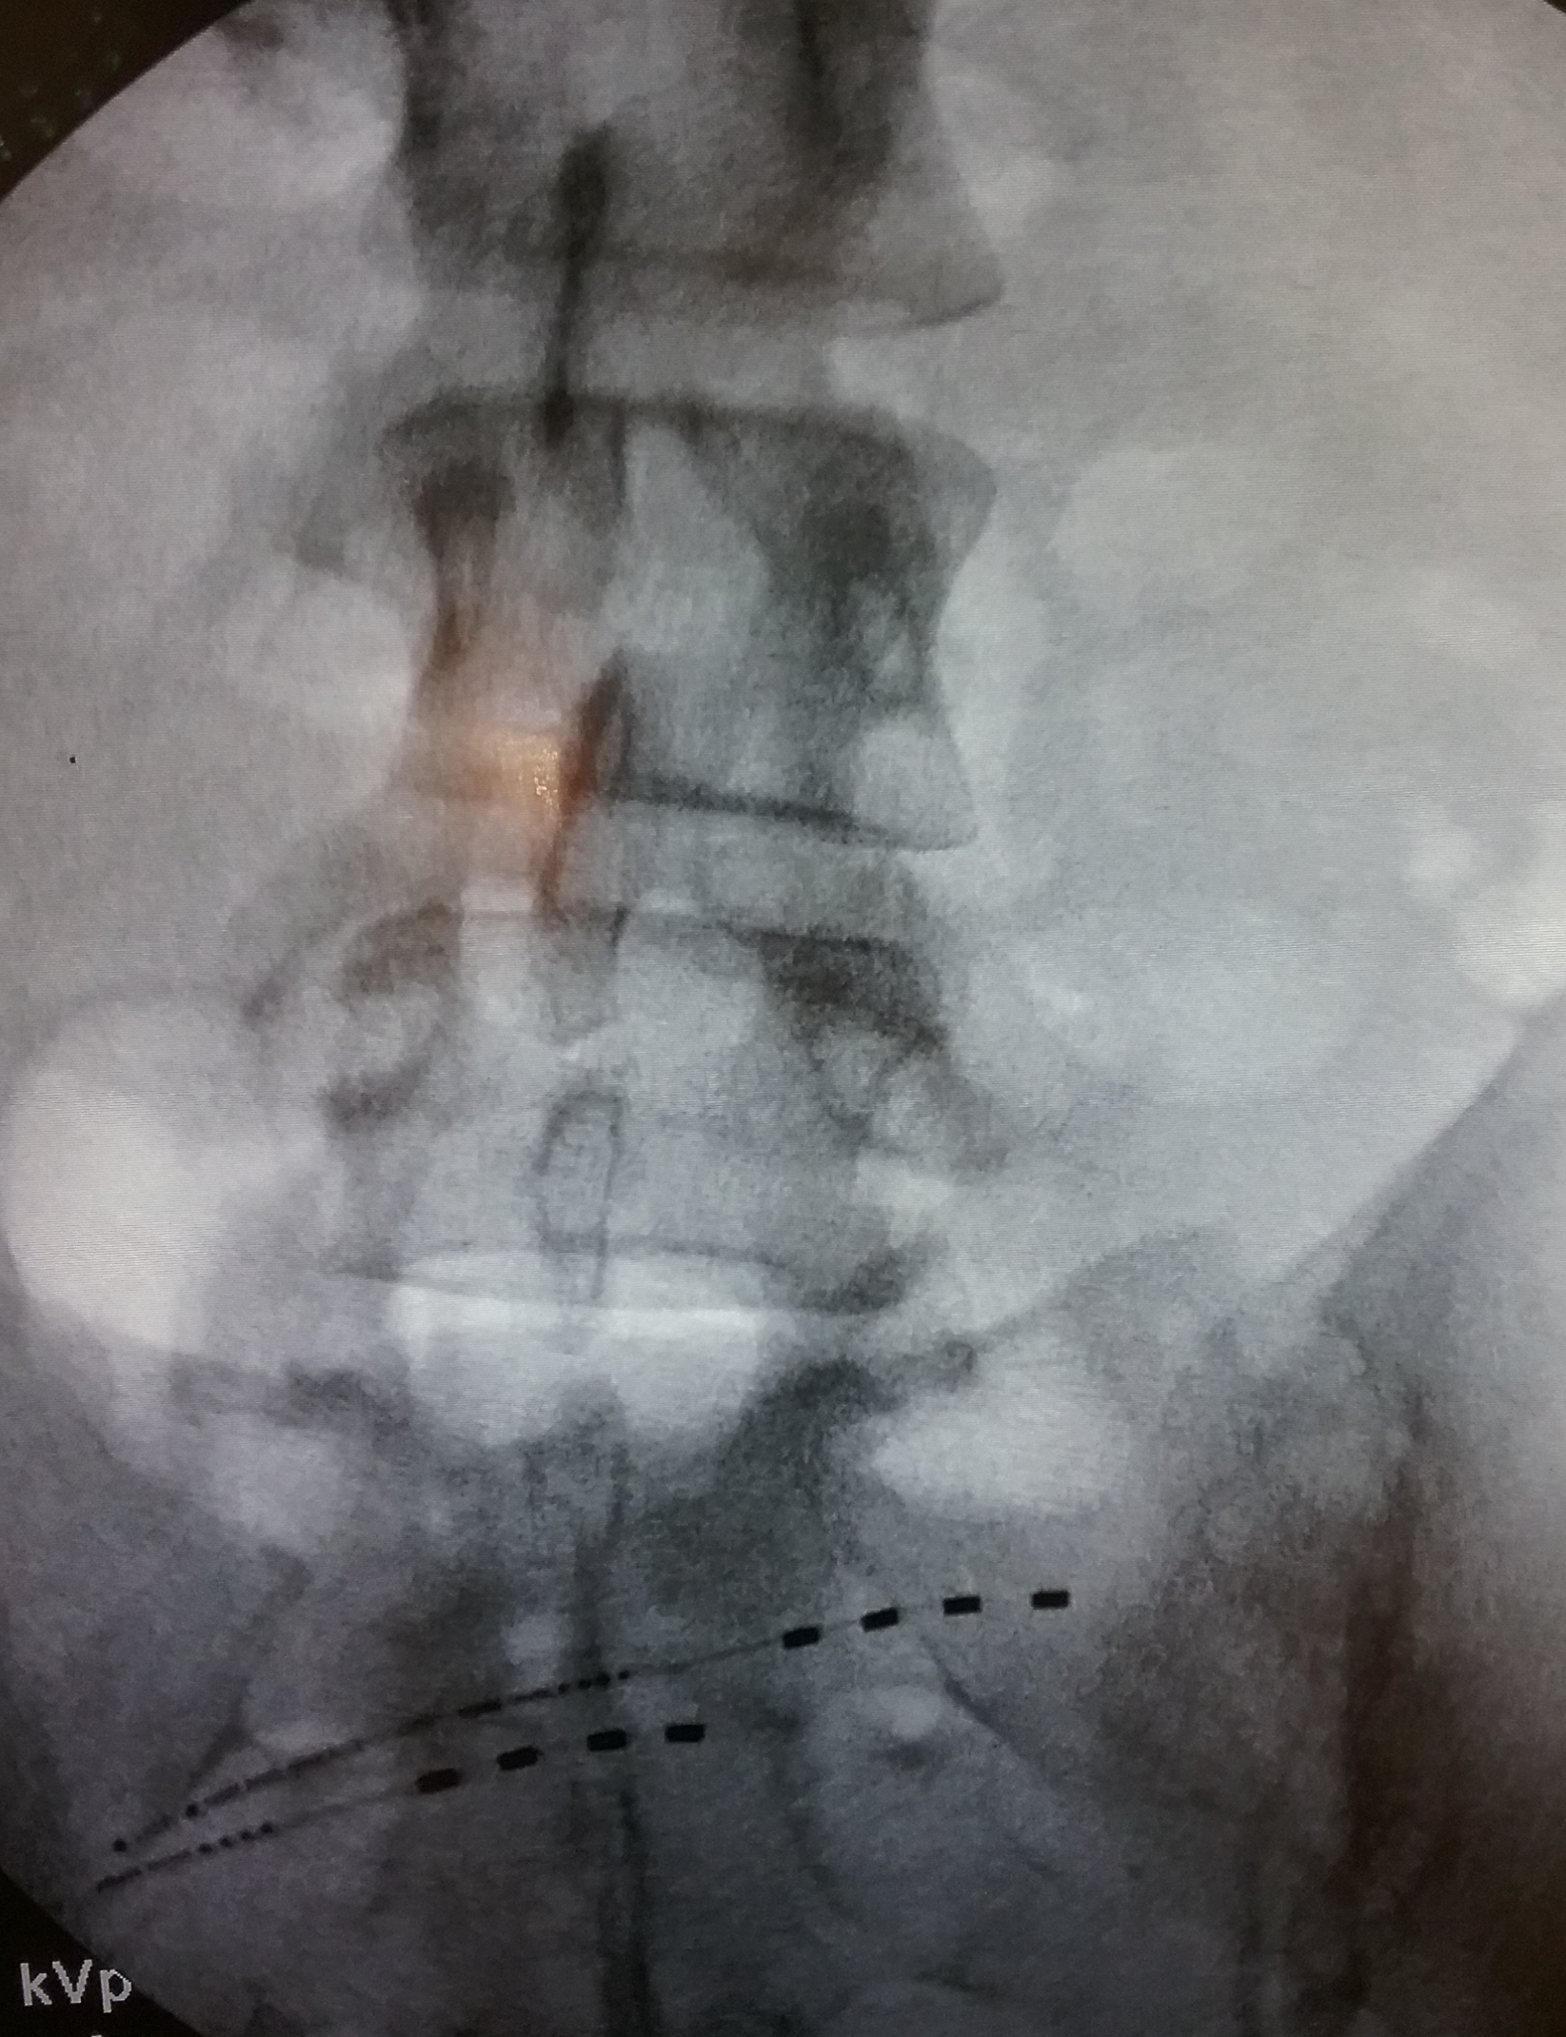
Wirelessly Powered, Battery-Free Peripheral Nerve Stimulation for the Treatment of Abdominal Pain from Post-Partum & Hysterectomy Complications
Jay Lafleur MD^{1,} Niek Vanquathem BA²
¹Texas Institute of Pain and Spine, ²Stimwave Technologies
Background
array was inserted and advanced to the ilioinguinal and iliohypogastric nerves approximately 2 cm superior to low transverse surgical scar, with the tail of the stimulator running across the lower abdomen toward the right hip. The second electrode array (also 8 contacts) was placed parallel to the first using the same technique. The steering stylets were removed, and the receivers inserted into the inner lumen of the electrode arrays. The trial stimulators were then secured with Mastisol and Steri Strips and completely covered under a sterile Tegaderm.
Surgical description for the permanent implant: The trial stimulators were explanted, two small stab wounds were made and 4-contact permanent systems were positioned with placement technique similar to the trial procedure (Fig. 1). After confirming location, the introducers and then the steering stylets were removed from the device, and the receivers were inserted into the inner lumen of the electrode arrays. A receiver pocket was created, approximately 10 cm from the first marker band and the neurostimulator tunneled to the pocket. A knot was tied to permanently mate the receivers and electrode arrays. The distal portion of the stimulators were coiled, sutured to itself to eliminate any sharp ends, and then sutured to the fascia. The pocket was closed with subcutaneous and then subcuticular sutures. The two electrode arrays were programmed at a frequency of 1499 Hz and pulse width of 30 μs. The patient was recommended to wear the antenna horizontally between the right hip and umbilicus either snapped into a long camisole, or in a Stashband® wearable.
Fig. 1: Image showing the four-contact neurostimulators at the ilionguinal and hypogastric nerve
Conclusions
Iliohypogastric and ilioinguinal neuralgia are under recognized causes of abdominal and pelvic pain that can present after abdominal or hernia surgery and result in disabling pain. Long-term complications are rare, but can include nerve damage. Management of chronic pelvic pain can be challenging and requires a multi-disciplinary approach. There are several treatment options for chronic post-surgical pelvic pain including: pain medications, nerve block, nerve ablation and peripheral nerve stimulation. Conventional spinal cord stimulation systems have inherent issues when targeting peripheral nerves such as cosmetic concerns and complications due to extensive tunneling. Novel wireless peripheral nerve stimulation systems devoid of wires and implantable batteries might provide a solution.
Wirelessly powered peripheral nerve stimulation has proven to be a successful treatment option for this patient suffering from debilitating abdominal and pelvic pain due to iliohypogastric and ilioinguinal neuralgia and CRPS. This case supports a viable option for significant pain relief, devoid of complications associated with the bulk of the battery from an implantable pulse generator while offering more flexibility as related to device placement and programming protocols.
Wireless System Components
The StimQ PNS System (Fig. 2) utilizes wireless technology. Each stimulator contains four or eight contacts (1.3 mm in diameter with 4 mm spacing) with embedded electronics and a separate, mated receiver component. A small, externally wearable, rechargeable transmitter attached to a transmitting antenna worn in clothing provides the energy to power the implanted device wirelessly through the skin. The device uses pulsed electrical current to create an electrical field that acts on nerves to inhibit the transmission of pain signals to the brain.
Results
Case Report
The patient reported 80% pain relief (pain decreased from 10/10 to 2/10) at the end of a trial period, which remained consistent up to 6 months after permanent implant. Some days she reports no pain at all. She is now leading a normal life with more activity, was able to return to work and is no longer bed-ridden by pain.
A 43-year-old female presented with pain in the lower abdomen and pelvis, which began after a Caesarean section and partial hysterectomy. She was diagnosed with chronic pain due to iliohypogastric and ilioinguinal neuralgia and CRPS. Previous treatment included peripheral nerve blocks, TENS, NSAIDS, physical therapy, and chronic opioid therapy prior to peripheral nerve stimulation.
Fig. 2: System components
Discussion
Methods
The preliminary results of this case are equivalent to those reported in previous studies, thus validating the efficacy of the PNS System. Conventional SCS devices with IPGs are responsible for a large percentage of adverse events. The use of wireless stimulation with no IPG eliminates complications related to the IPG implant.
Surgical description for the trial implant: The paths of the ilioinguinal and iliohypogastric nerves in the abdomen were visualized, and introducer entry points and pathways were planned using US, palpation, and fluoroscopy. After local anesthetic infiltration, a flexible introducer designed for PNS was advanced subcutaneously and the 8-electrode
Contact
llafleur@txpainandspine.com

